Slide 1




Cultivating Connection: Nurturing a Sense of Belonging to Promote Academic Librarian Wellness and Performance
Jennifer Crumpton, Health Science Liaison Librarian​
Brittany Kester, Ph.D., Education Librarian​
Notes:
(Jennie)
Hello everyone, and welcome to today's presentation titled "Cultivating Connection: Nurturing a Sense of Belonging to Promote Academic Librarian Wellness and Performance", today we are going to shine a light on the importance of community as it relates to an individual's well-being and professional development in an academic library environment.

Slide 2

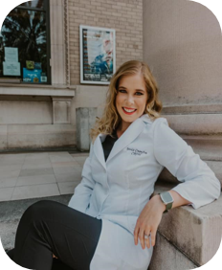
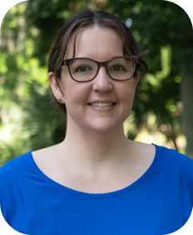

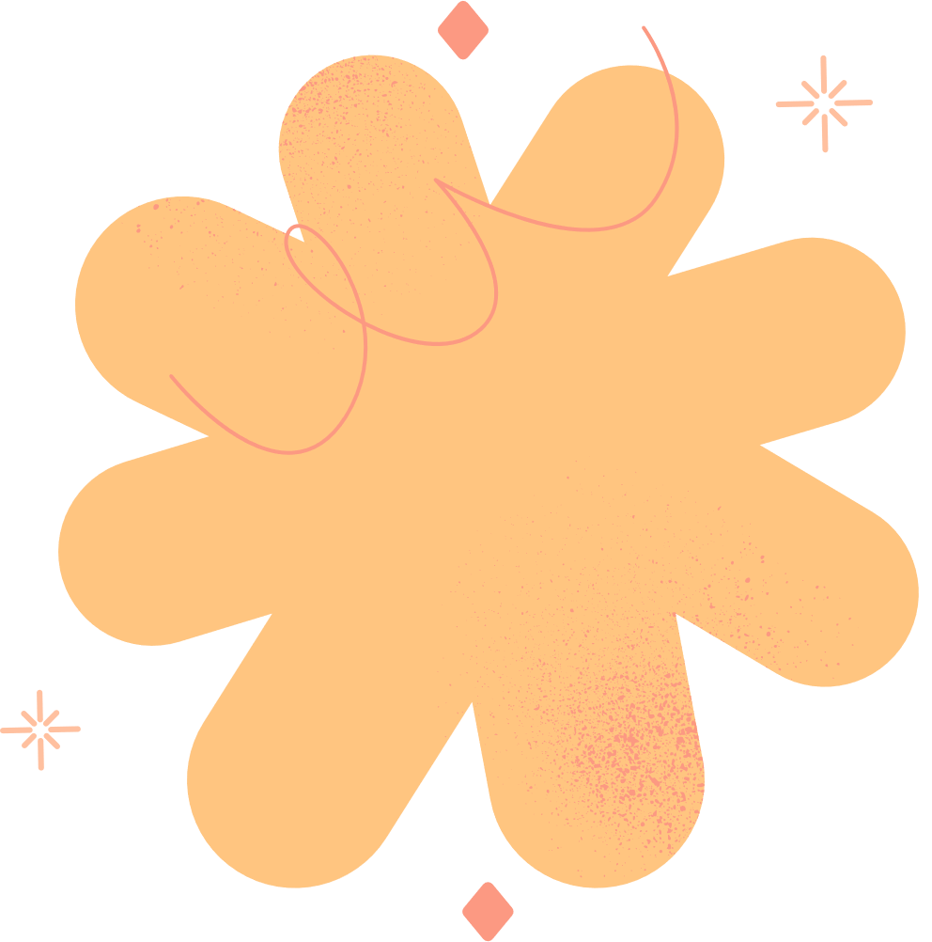
Introduction
Jennifer Crumpton​
Health Science Liaison Librarian​
Brittany Kester​
Education Librarian​
Notes:
(Jennie) My name is Jennie Crumpton, (the one pictured on the left of the slide here) and I am one of the health science liaison librarians at the health science center libraries, and today I will be presenting with my colleague Brittany Kester (pictured on the right of the slide) who is one of the education librarians at the University of Florida. ​
So, to start we wanted to provide you with a bit of background information related to our personal levels of experience. I did not originally come to the University of Florida with a library background, but with a clinical and medical background, having experience working in the subject areas of both occupational therapy and dental hygiene for a number of years. Therefore, after obtaining my MLIS, and entering my first library job in an academic environment I struggled for awhile with things like imposter syndrome and finding a sense of self in this new environment. I come to you know, with a little over a years experience, working in the health science library serving students, staff, researchers, and faculty feeling more settled, especially after finding a supportive community. ​
(Brittany)
And I have been with the libraries for 7 years and recently received tenure and promotion to Associate Librarian. I came from working at a very tiny academic library in South Carolina that had only 6 librarians to such a large academic library that has over 40 librarians and to a tenure track position. At the start I had very similar feelings to Jennie but finding mentors and collaborators both in the libraries and in my liaison area helped me find my footing. I now find myself in a position to be a mentor to newer librarians and staff and to support the work of others as they grow in their research and work towards their professional goals.

Slide 3


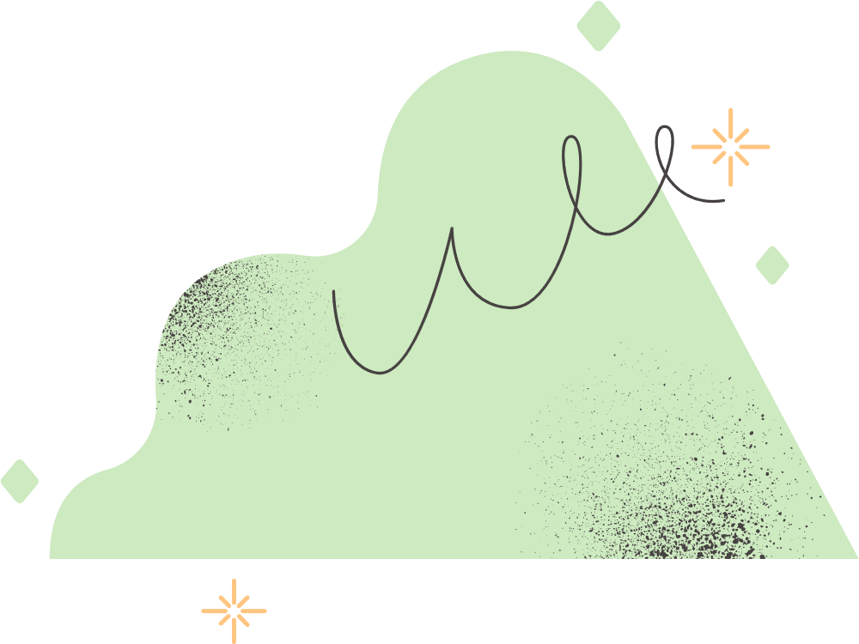
Agenda
  Background
  Cultivating community
  Our experiences
  Successes and challenges
  Share your stories
Notes:
(Brittany)
Today, we will cover some background information about cultivating community and developing connection in libraries, discuss our experiences in our roles as librarians at the University of Florida, share some of our successes, challenges, and lessons learned during our time in the library, and then hear from you!
We are excited to share our knowledge and experiences with you here at LOEX, and to hear your stories. We have had the opportunity to present similar information previously and hope to continue contributing to the research in the field.

Slide 4

"Sense of Community"​
defined as individuals' perceptions of informal organization and relationships” ​
(Park et al., 2023).
Notes:
(Jennie) In this circumstance, we based our definition of what a "sense of community is" on an article we located while doing a foundational literature search. ​
We chose to adopt Park’s definition of "sense of community," which emphasizes an individual’s perceptions of informal organization and interpersonal relationships. This provides a conceptual foundation for analyzing how community members experience belonging and connectedness.

Slide 5



Cultivating Community
Having community aids in the prevention and management of mental health issues and symptoms such as depression, anxiety, and stress (Park et al., 2023).​
Social support in the workplace may increase job satisfaction, promote relaxation, and reduce emotional exhaustion overall (Garmendia et al., 2023). ​
Notes:
(Jennie) As one might expect, cultivating a strong sense of community yields innumerable benefits, which are widely documented in the literature.
Park’s work highlights that community engagement plays an important role in preventing and managing mental health challenges, including symptoms of depression, anxiety, and stress. Complementing this perspective, another study emphasizes that workplace social support can enhance job satisfaction, foster relaxation, and mitigate emotional exhaustion.
Together, these findings showcase the deep connection between community, individual wellness, and organizational outcomes demonstrating that fostering supportive relationships not only promotes well-being but also contributes to greater job satisfaction and reduced turnover.

Slide 6
Cultivating Community
Communities build well-being through alignment, ownership, engagement, shared purpose, collaboration, communication, continuous learning, and resource management (Powell et al., 2024).​
Notes:
(Jennie) Building on these insights, another compelling example comes from the Powell article, which not only reinforces the findings we discussed earlier but also expands upon them by highlighting additional dimensions of workplace community.
Powell emphasizes that community fosters a shared sense of purpose, alignment, and ownership, while also strengthening communication, encouraging continuous learning and professional development, and supporting effective resource management. Together, these elements illustrate how community within the workplace extends beyond emotional support to actively shape organizational growth and individual engagement.

Slide 7

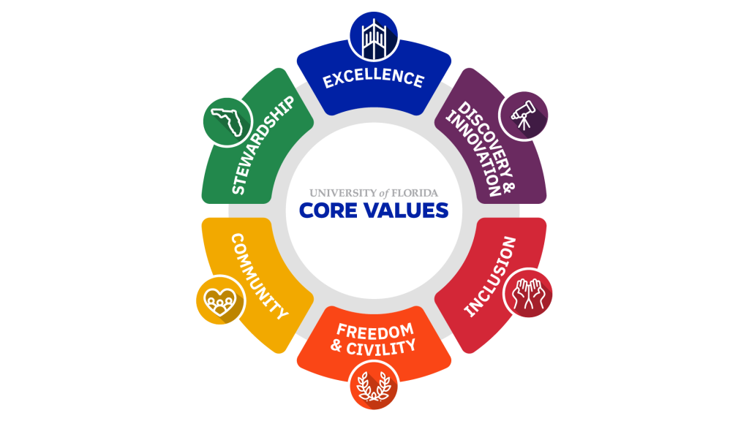

"Create a safe, welcoming community and a shared purpose that builds a sense of belonging and togetherness."​
- UF's Core Values
Notes:
(Brittany) The University of Florida also has a set of "core values" that it promotes as a standard for all of its employees. One of these is "community". The core value states that UF strives to create a safe, welcoming, community and a shared purpose that builds a sense of belonging and togetherness. ​
Additionally, the university states that, "We work together toward the betterment of our local community and the world around us. Our community has a shared sense of purpose that unites everyone around goals that are held in common. Those goals elevate the collective and are greater than any one of us alone. We utilize our intellect, creativity, skills, strength and compassion to create a supportive community that serves the common good."​
“Well-rounded individual”

Slide 8

Developing Connections
  Within and across library departments
  Offer librarians the chance to learn from each other, grow their confidence, and empower each other to thrive in their roles and responsibilities serving patrons.
  Result in networking, mentoring, collaborating, finding shared interests, friendship, etc.
Notes:
(Brittany)
An important part of cultivating community is to develop connections. This can be between co-workers in the same library, across branches or departments, or with users and patrons whether at an academic, public, school, or special library.
Connection can offer librarians the chance to learn from each other, grow their confidence, and empower each other to thrive in their roles and responsibilities serving patrons.
Can also result in networking, mentoring, collaborating, finding shared interests, friendship, etc. which we are next going to share some examples of from our own library experiences.

Slide 9



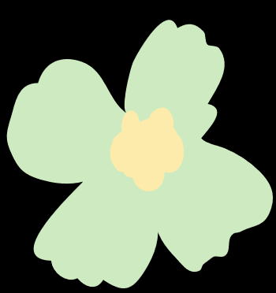
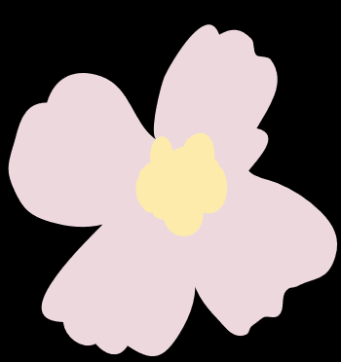
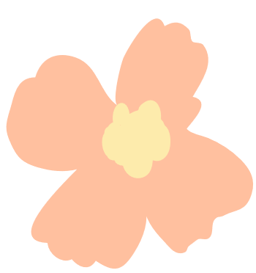
Collaborative Projects
Grants and Research
Outreach
Presentations/Workshops
Notes:
(Brittany) The UF Libraries encourages collaborative work and projects. This can include writing grants, conducting research, facilitating workshops, planning and implementing outreach, and presentations like this one.​ Creating an environment that supports colleagues reaching out to each other and including those at different levels can really create a strong community whose outputs result in high impact contributions to the field.
For example​:
Jennie and I are working on a project to survey neurodiverse students from which we hope to gain information about how our libraries are currently meeting as well as not meeting their needs.
Another example is a project I worked on with a subgroup of our accessibility committee where we conducted an accessibility audit of our library's accessibility services page (meta). I worked with two other librarians and a library staff member on the project and now we are traveling to Thailand in January to share our results and how others can conduct a similar audit of their library webpages.
This presentation is yet another example :)

Slide 10


Mentorship Program
Tenure Cohort Group
  Formal mentor program
  Offers professional support​
  Advises on career and research trajectory​
  Provides feedback on annual activity report, mid-career evaluation, and tenure packet​
  Formal Junior Librarian Group​
  Early Career Librarian Group Foundation
Notes:
(Brittany)
At the UF Libraries we have a mentor/mentee program where a Junior/Early Career Librarian matched with a Tenured Librarian​
Example​
Met weekly prior to mid-career packet submission for feedback and emotional support but then also during COVID.
Also, supervised a student together through the writing of an internal grant proposal to purchase multicultural children's books for the Baldwin and the Ed Library.
(Jennie) ​
So, in addition to the formal mentorship program that UF offers junior faculty, there are other groups meant to support the professional development and wellbeing of employees at large. ​
Prior to COVID in 2020, to provide a little history on the topic, there used to be a formal "junior faculty" group that met at least once a month, where pre-tenure individuals could go to network with other library colleagues, drink coffee and eat snacks, and occasionally learn from someone designated to come give a talk on a form of professional development catered to the group's needs. So, for example, a tenured library faculty member might come give a lecture on how to turn a presentation into a piece of published literature and describe the process in detail and offer space for questions/comments. ​
Unfortunately, post-COVID that junior faculty group has not managed to reconvene for a number of reasons including a lack of designated leadership, conflicting schedules, etc. However, when I started in my role at UF in June of 2024, I saw a need for a more intimate group focused on the support of new faculty navigating their roles and seeking opportunities to grow. So, without prior knowledge of the junior faculty group, I started inviting individuals that were hired from a year timeframe (which was from the month of June 2024-25) to join a tenure cohort group which meets once a month, and is focused on providing advice, emotional support, collaborative ideas, and as it turns out friendship to people across various branches of the library. ​
This group so far has been very successful, with each member prioritizing the meeting in their busy schedules. Additionally, the format thus far has been very informal in nature, basically we meet in person (with our coffee and/or breakfast), and discuss our recent projects, research, committee assignments, etc. and offer space to one another for further support, collaboration or advice in conversation there afterwards. Which is a very different format that the former more large scope Junior Librarian Group. But our tenure cohort group, has voted on keeping the group on the smaller side in order to foster a deeper connection among members and have the time for each member to be able to speak. ​
Additionally, as the group's lead, I have created a Team's channel for our tenure cohort group where I provide meeting reminders, continue conversations, provide a place for advice, continuing education opportunities, and store the notes I take during each meeting to keep up with member's and their projects/progress. We have recently added a more fun and social element to our channel, as a separate thread, as many of us unsurprisingly read for fun, and wanted to receive book recommendations from one another.

Slide 11

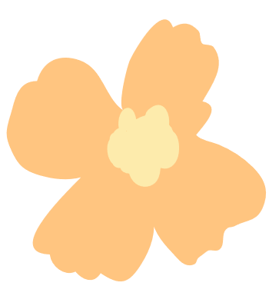
Interest-Based Groups
UF Accessibility Community of Practice
HSCL Wellness Team
Systematic Review Working Group
Crafts and the Library
Notes:
(Jennie) UF also has other groups which demonstrate our library's commitment to community.​​
Some examples are smaller more focused, interest-based groups like the health science center libraries "Wellness Team" - which I am also on and co-lead - which focuses on student wellness and plans various activities for them throughout the year (and is often tied to relieving stress around times like midterms or finals week).​​ - For example we host slime and snow globe making events during finals week in the fall.
Additionally, we have other varied groups such as the "UF Accessibility Community of Practice group", and the "Crafts and the Library group" that faculty can join.​
And lastly the "Systematic Review Working group" which I am also personally am a part of and can say as a newer librarian has been extremely helpful to me as research methodology, and assisting faculty in my liaison areas in this area was initially very challenging coming right out of school. I enjoy coming to meetings with real life scenarios of projects I have been working on, and then receiving feedback or advice from the group on certain searching techniques I can try, etc.

Slide 12


Questions?
Notes:
(Jennie)
Okay so let's take a moment to pause and see if anyone has any questions about the information we have covered thus far.
(If there are questions) Thanks for your questions we are going to continue moving forward and jump into some of the challenges that you might encounter when building your community.

Slide 13




Challenges
  Time constraints​
  Differing priorities​
  Potential power imbalances ​
  Different work cultures and pressures among the library branches​
  Turnover​
  Feeling excluded
Notes:
(Brittany) Some of the challenges that we both have experienced include:​
Time constraints​
Differing priorities – Mentor/mentee, have good communication! Change mentor if needed​
Potential power imbalances ​
Different work cultures and pressures among the library branches – outside mentor during SSLLI very small library​
Turnover – Suzan left :(​
Feeling excluded – smaller branch missing out

Slide 14

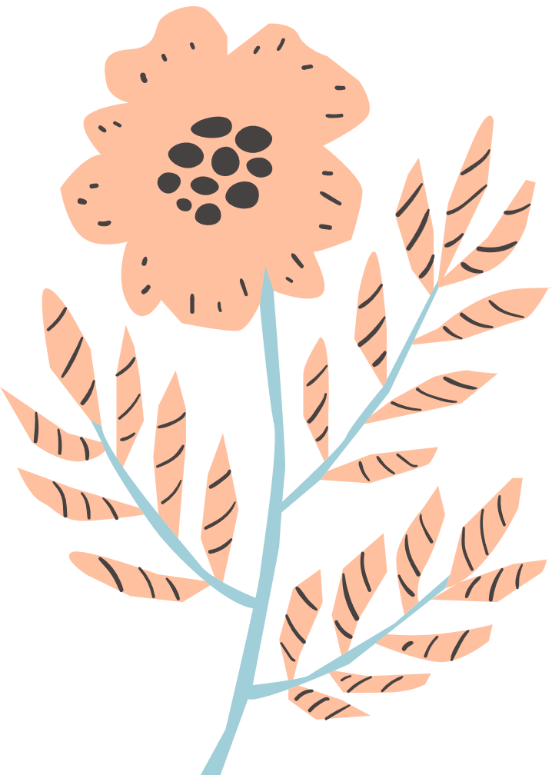
Successes
  General idea sharing ​
  Professional development​
  Learning outside of your specialty area/focus area ​
  Building relationships with colleagues across campus ​
  Learning how to thrive in the academic culture ​
  Emotional support ​
  Having fun!
Notes:
(Jennie) Some of the highlights we have experienced through community engagement in our roles have been;​
The ability to share a broad range of ideas with one another​
The various professional development opportunities ​
The ability to be able to learn outside of our library or degree background specific subject or focus areas​
Having the opportunity to build relationships with colleagues across campus in the 6 library locations ​
Learning how to thrive in a fast-paced academic culture – which was a huge challenge again for me coming from outside of the library career trajectory​
Providing emotional support to one another when needed – and encouraging each other to overcome various challenges. For example, helping each other with feelings related to burn out, or worry about acquiring tenure in the future.​
And of course, community can bring an element of fun! Which is always a positive.

Slide 15












Lessons Learned
Develop a sense of empathy
Prioritize working relationships
It is okay to say ”no”
Reaching out can be intimidating but its worth it
Be open to trying new things without overcommitting
Find a good mentor
Notes:
(Jennie) – Overall, both Brittany and myself have learned a lot working at an academic library. I would say that the top three tid-bits of advice I would offer others based on my experience thus far would be that;​
Having a developed sense of empathy is key when working with others – as it helps foster healthy communication, collaboration, and connection with others. ​
(Haha this is one I still struggle with) That it is okay to say no to projects that are not in your areas of interest (as someone who sees everything as a potential learning experience, and actively try's to avoid conflict or letting people down, I have learned it is also important to consider time constraints and my personal workload when considering collaborative projects – also so I am able to do a great job and be more present while doing so) – all while, on the flip side, considering leaving the door open to future collaborations when more of my time and effort becomes available! ​
And lastly, that it is important to prioritize working relationships with colleagues because you will learn through the collaborative efforts with them, and often end up with opportunities outside of your expectations. ​
​
(Brittany​)
Find a good mentor​
Reaching out can be intimidating but its worth it​
Be open to trying new things without overcommitting​
​

Slide 16

General Advice
  It is important to find your community​
  Asking questions and for help is okay when you are stuck​
  Try networking with individuals outside of your area of expertise
Notes:
​(Jennie) And collectively we have determined that there are several pieces of advice we have both found to be relevant in our academic library journeys so far and those are;​
That it is important to try to find your community at your library – especially when it comes to seeking the support of people at the same level as you, and also from individuals who are further along in their careers. ​
That asking for help and questions is okay when you are feeling stuck. Our experiences have made us believe that when a community is in place this becomes much easier.​
And lastly, it is crucial to network with individuals outside of your area of expertise - you never know who you might meet! For example, through my participation in the formal mentor program, I was encouraged to visit the education library once a month for meetings, and met Brittany, who I am now doing a presentation, and project with!

Slide 17

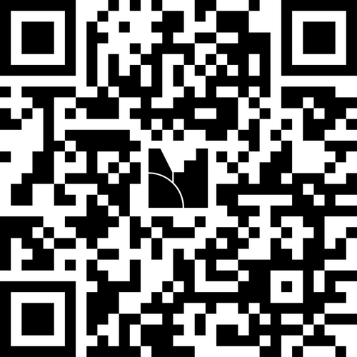
We want to hear from you!
Questions:​
  What does community mean to you?​
  How have you found community in your own library? ​
  What successes and challenges have you had?​
  What advice might you offer someone seeking community at their library?
Join at menti.com
Notes:
(Brittany) Introduce the mentimeter, and instructions for participation. Start the discussion. Jennie will chime in. ​
​
Open mentimeter on another screen and share so the audience can see the incoming advice, and comments from the audience. Ask people who are willing to share about their experiences, and feedback. ​
​

Slide 18

References
  Garmendia, P., Fernández-Salinero, S., Holgueras González, A. I., & Topa, G. (2023). Social Support and Its Impact on Job Satisfaction and Emotional Exhaustion. European Journal of Investigation in Health, Psychology and Education, 13(12), 2827–2840. https://doi.org/10.3390/ejihpe13120195​
  Park, E. Y., Oliver, T. R., Peppard, P. E., & Malecki, K. C. (2023). Sense of community and mental health: a cross-sectional analysis from a household survey in Wisconsin. Family Medicine and Community Health, 11(2), e001971. https://doi.org/10.1136/fmch-2022-001971 ​
  Powell, N., Dalton, H., Lawrence-Bourne, J., & Perkins, D. (2024). Co-creating community wellbeing initiatives: what is the evidence and how do they work?. International journal of mental health systems, 18(1), 28. https://doi.org/10.1186/s13033-024-00645-7​
  University of Florida's Core Values https://www.ufl.edu/about/core-values/#el-877a98b1
Notes:
(Brittany) These are the references we used as the foundation for our presentation, and our definition of "community."

Slide 19

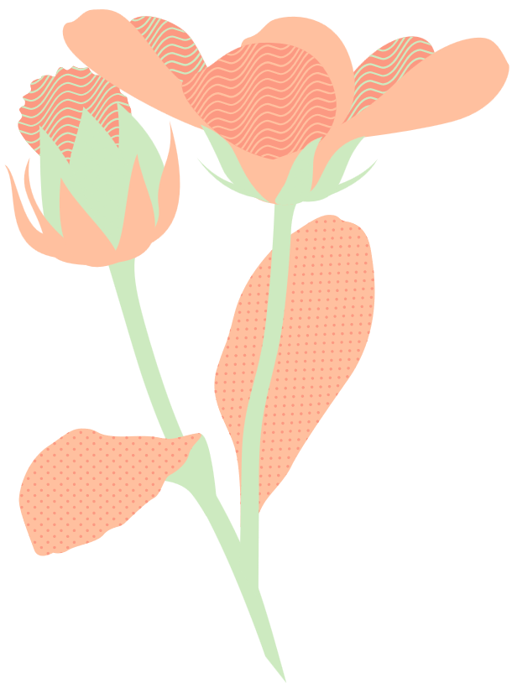
Thank you!
Questions?
Jennie Crumpton: jenniebalchunas@ufl.edu ​
Brittany Kester: brittany.kester@ufl.edu ​
Notes:
(Brittany) Thank you so much for attending our presentation today, at this time we want to open the floor for any questions or comments that you might have for us. Additionally, if you can't think of any in this moment please feel free to reach out to either Jennie or I via email, using the contact information we have provided for you on the slide!

