Slide 1


The PROMPT Design Framework
for AI Literacy: Preliminary Findings from a Mixed Methods Pre/Post Study
Sarah Hartman-Caverly & Dr. Ada Leung
LOEX Fall Focus | 17-19 Nov. 2025
Image credit: unsplash
Notes:
Sarah

Slide 2


Sarah
Hartman-Caverly
About Us
  Associate librarian,
  reference & instruction
  Penn State University Libraries
  Collaborators on
  Course-related information literacy since 2018
  AI literacy since 2023 (Leung et al., 2025)
  Co-investigators on a mixed-methods study of the PROMPT Design Framework
  Joined by 2 undergraduate research assistants:
              Janet Ruiz
          Jeilyn Tineo
Dr. Ada Leung
  Associate professor,
  Marketing
  Penn State Berks
Notes:
Sarah / Ada

Slide 3




Today’s Session
PROMPT Design Framework
Research Questions &
Preliminary Findings
Future Work
  Curricular integration of AI literacy
  Data analysis
  Limitations
  Mixed methods pre/post study of PROMPT as an AI literacy intervention
Image credit: nappy.co, unsplash, unsplash+
Notes:
Sarah

Slide 4
How did you learn about prompt engineering?
Notes:
Sarah
To set the stage, 36% of our study participants, mostly second year undergrads, reported never learning anything about prompt engineering prior to participating in the study – an indicator that AI literacy instruction generally, and prompt engineering skills specifically, presents an opportunity for instruction librarians.

Slide 5

01.
PROMPT Design Framework
  Original AI literacy intervention
Image credit: nappy.co
Notes:
Sarah
We’ll start off by sharing the PROMPT Design Framework and contextualizing it within AI literacy instruction.

Slide 6



Working Definitions
01.
02.
03.
AI literacy
Prompt engineering
Intervention
“Knowing how AI works and how to use it wisely and ethically” (Chan & Colloton, 2024)
Knowledge, skills, and dispositions
The process of constructing queries or inputs (i.e. prompts) for generative AI tools so as to elicit the most relevant, accurate, and useful responses.
The introduction of new information and techniques to affect knowledge, skills, and dispositions
Notes:
Sarah
For purposes of our study, ‘AI literacy’ refers to “knowing how AI works and how to use it wisely and ethically” (Chan & Colloton, 2024), and comprises knowledge, skills, and dispositions.
‘Prompt engineering’, or prompt design, is the process of constructing queries or inputs for generative AI tools so as to elicit the most relevant, accurate, and useful responses.
And an ‘intervention’ is the introduction of new information and techniques to affect knowledge, skills, and dispositions.

Slide 7
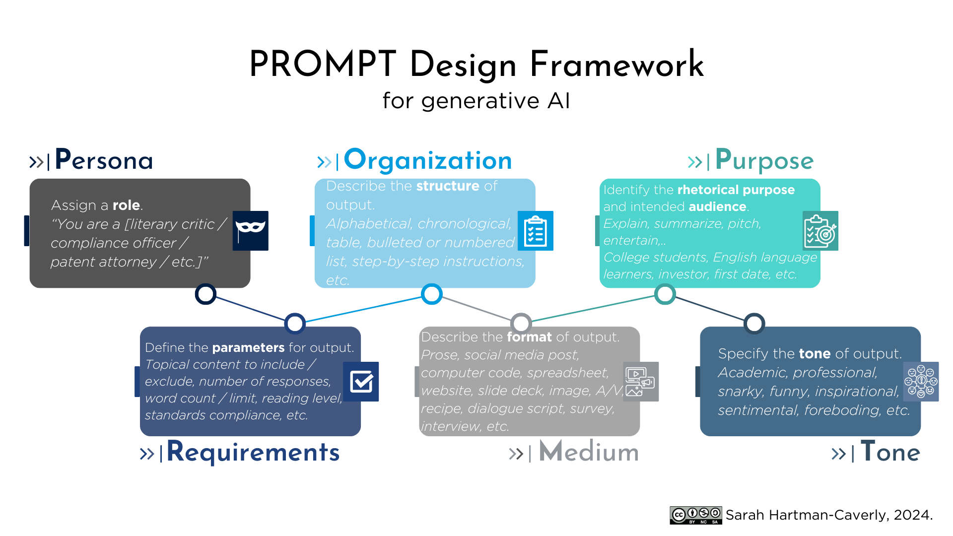
Notes:
Sarah
This PROMPT Design Framework for generative AI guides users through the process of composing effective and efficient prompts. It uses the word “prompt” as a mnemonic (Campbell et al., 2025) in which each letter stands for an element of an AI prompt: Persona, Requirements, Organization, Medium, Purpose, and Tone.

Slide 8
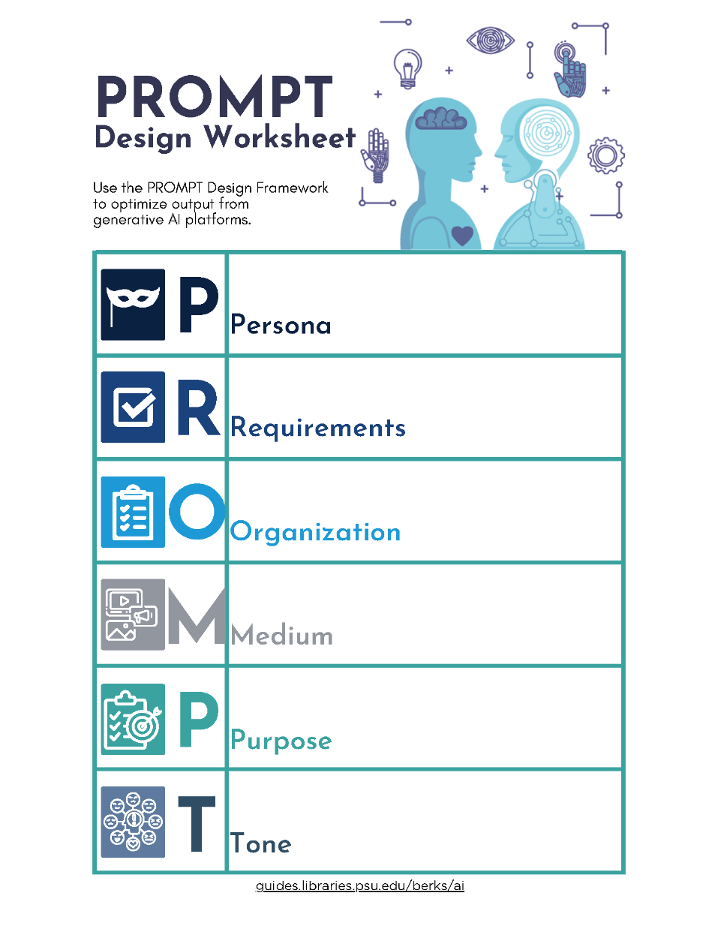
AI Literacy Integration
Course-related instruction
  Marketing, business, entrepreneurship & innovation, hospitality management, engineering, English rhetoric & composition
Standalone workshops
  Hidden Layer: Intellectual Privacy & Generative AI
  Augmented Innovation
OER Learning Object
  Adopted or adapted by other educators
Notes:
Sarah
The PROMPT Design Framework is used in AI literacy instruction across a range of contexts at Penn State Berks, including in course-related instruction, standalone workshops, and as an open-licensed learning object that has been adopted or adapted by other educators.

Slide 9
CLEAR + PROMPT
CLEAR Framework
(Lo, 2023)
Concise
Logical
Explicit
Adaptive
Reflective
Persona
Requirements
Organization
Medium
Purpose
Tone
(Hartman-Caverly, 2024)
Notes:
Sarah
The PROMPT Design Framework was borne out of my early efforts in AI literacy instruction. I started out using Leo Lo’s CLEAR Framework, but I found that students continued to struggle with prompting, and needed direct instruction that was more procedural in nature.
The PROMPT framework is intended to scaffold down from the CLEAR Framework, primarily from the Explicit element, and secondarily from the Logical element, by giving generative AI users strategies for including specificity and clarity in their prompts.

Slide 10

Student Perspective
“My success in AI comes from prompt engineering”
International computer science student Kanika Gupta uses ChatGPT to refine her pitches​.
Won $1000+ in pitch contests in 2023.
Bad prompt
Summarize the book 1984.​
Good prompt
Imagine you're a book expert. Quickly tell me what George Orwell's '1984' is all about and why it's a big deal in literature.
“See the difference? The good prompt gives the AI a clear, detailed task, so you get a more useful answer.​”
(Gupta, 2024)
Notes:
Sarah
The PROMPT Framework also incorporates a student perspective on prompting. Kanika Gupta, pictured here, wrote for Penn State’s Connect Happy Valley newsletter about how she was using generative AI to refine her pitches and win pitch contests. She attributes her success to prompt engineering and provides an example of a ‘good’ prompt: “Imagine you’re a book expert. Quickly tell me what George Orwell’s ‘1984’ is all about and why it’s a big deal in literature.” This is the inspiration behind the Persona in the PROMPT framework.

Slide 11
PROMPT Framework in Action
Persona
Requirements
Organization
Medium
Purpose
Tone
Good Prompt: "Imagine you're a book expert. Quickly tell me what George Orwell's '1984' is all about and why it's a big deal in literature."
(Gupta, 2024)
By chapter, theme, character, etc.
By chapter, theme,
character, etc.
Video; concept map visualization.
Video; concept map visualization.
Like a college student.
Like a college student.
Notes:
Sarah
During the intervention phrase of the study, we dissected Kanika Gupta’s ‘good prompt’ to see the PROMPT Design Framework in action.
We can see that she assigns the AI a Persona by prompting, “Imagine you’re a book expert.”
Next, she establishes some Requirements by prompting, “Quickly tell me what Geoge Orwell’s ‘1984’ is all about.”
She also described a Purpose, to understand “why it’s a big deal in literature.”
In this example, Kanika doesn’t explicitly use the Organization, Medium, or Tone elements of the PROMPT Framework. However, we can imagine ways that Kanika could use these elements to refine her prompt even more. For example, she could prompt the AI to Organize its summary by chapter, theme, character, or some other literary element. She could have asked for the summary in a format like a brief video or a concept map visualization. Finally, many college students have mastered the Tone element of the PROMPT Framework by instructing AI to write “like a college student” or “like a first-year undergraduate.”

Slide 12
Why does prompt design matter?
AI Ethics
Green AI
AI Bias
Fabrication (hallucination)
Relevance
Quality
Usefulness
Social
Political
Commercial
Carbon footprint:
  1 prompt = 5-6 web searches (Wired)
Power:
1 image = charging a smartphone (Harvard Business Review)
Water:
50 prompts = 16 oz. used for data center cooling (AI for Education)
Notes:
Sarah
In the intervention phase of the study, we also contextualize prompt design within the AI ethics landscape. Specifically, we argue that prompt design can mitigate some AI fabrication and bias by specifying requirements to increase the relevance, quality, and usefulness of output. Additionally, we argue that the process of reflecting on one’s information need for purposes of prompt design also primes one’s mind for critical thinking and evaluating the output. And while end users’ locus of control is small, we know that most of the environmental impact of LLM’s is created in their inference phase, when they are actively used to generate output; consequently, we suggest that crafting effective prompts can generate better quality output in fewer attempts.
---
Prompt design can increase the relevance, quality, and usefulness of generative AI output. A well-crafted prompt can reduce the tendency for AI fabrication (or hallucination), when generative AI output false information. You can also apply prompt design techniques to re-prompt an AI platform if you critically evaluate the original output and determine it is not relevant, accurate, or useful for your needs.
Prompt design can also reduce bias in AI output. Generative AI platforms exhibit various kinds of biases, including social, commercial, and economic. Reducing AI bias contributes to output that is more relevant, higher quality, and more useful.
Prompt design can also make your use of generative AI more resource efficient. Large language models (LLMs) consume the most energy for computation and water for data center cooling in their inference phase, when they are actively being used to generate content. A single prompt has the same carbon footprint as 5-6 web searches. Generating 1 image consumes the same amount of power as charging a smartphone. And 16 oz. of water is used for data center cooling for every 50 prompts. Crafting more effective prompts reduces the number of prompts you have to submit in order to generate the output that you need, making your prompting more efficient and your use of generative AI less resource-intensive.

Slide 13



Research Questions: Will PROMPT Design Framework improve…
01.
02.
03.
Students’ AI usage and attitude
Students’ AI self-efficacy
Students’ prompt quality
Notes:
Ada
Since 2023, AI applications have exploded, especially in my discipline, marketing and business in general. I attended as many AI-themed seminars/webinars/conference session as possible. Although faculty in general are skeptical about students' AI usage, I think it'd better to teach students how to use AI tools ethically, efficiently and professionally.
In this presentation, we are going to present preliminary findings of a recent study (conducted in September 2025) that answer these three research questions:
Will the PROMPT design framework improve undergraduate students' AI usage and attitude?
Will the PROMPT design framework improve the perceived AI self-efficacy among undergraduate students?
Will the framework improve students' prompt quality?

Slide 14

02.
Preliminary Findings
  Pre/Post study methodology
  Preliminary results
Image credit: unsplash
Notes:
Ada

Slide 15

PROMPT Design Study Methodology
01.
02.
Pre-Intervention
Intervention
Post-Intervention
Focus Group
  PROMPT Design Framework
  AI ethics
    Fabrication
    Bias
    GreenAI
  Workbook
  PROMPT report card
  Facilitated discussion
  Penn State IRB STUDY00027385 (exempt)
  Demographic questionnaire
  Marketing research using Copilot
  AI literacy self-assessment
  Repeat research task using Copilot
  Repeat AI literacy self-assessment
Image credit: unsplash
Notes:
Ada
We got IRB approval for the project in summer.
Our methodology is divided into two stages. In the first stage, during the class meeting, students conducted a research task using the generative AI tool, Microsoft Copilot. Basically, we asked them to use Copilot to conduct market research on the feasibility of implementing an electric vehicle business in Berks County, PA.
Then we conducted the intervention. Students then learned the PROMPT Design Framework, and we positioned the PROMPT Framework and AI literacy generally as knowledge that can mitigate AI harms and enhance the ethical use of AI. After learning the Framework, students repeated the research task so that we can compare their work before and after learning PROMPT (or, pre- and post-intervention).
In stage 2 of our research, we conducted focus groups. We were especially excited to "flip the script" and invite students to give the PROMPT Framework a grade!

Slide 16
Study Flow
28
  Complete sets of pre/post prompt-output artifacts
  73 artifacts total
    45 pre-intervention; 28 post-intervention
13
Focus group participants
7 in session 1
6 in session 2
Incentives
  Extra credit
  Healthy snacks
47
Total consenting participants
Valid survey responses
Undergraduates recruited from ‘Principles of Marketing’ course
Notes:
Ada
I have 80 students enrolling in my principles of marketing class. We asked for their consent in participation. 47 students gave us consent to participate in the research.
We used Qualtrics survey to conduct the main study. Apart from getting survey results about students' AI usage and self-efficacy, the students were instructed to upload their prompt-output artifacts that they got before and after the interventions to the online survey drop boxes. We got 28 complete sets of pre/post prompt-output artifacts, as some students copied the output only.
We also conducted 2 focus groups to further probe the students' usage experiences and satisfaction of the PROMPT framework.

Slide 17
Participant Characteristics
Number of survey participants | 47
Female | 38%
Class standing Second year Third year Fourth year | 68% 28% 4%
Academic major Business | 79%
Ethnic background White Asian Hispanic or Latino Black or African American | 60% 19% 17% 4%
Part-time job (<20 hours) | 53%
Notes:
Ada
As principles of marketing is a core business class, so the majority of the students in the sample is Sophomore majoring business. 60% of the sample are while, and the rest are students from underrepresented groups.

Slide 18
Students’ generative AI tool usage
Notes:
Ada
We started the study by asking the students their current usage of AI for school and personal purposes. ChatGPT is the most common, and students use it more for personal purpose. Copilot followed, but it is used for school purposes.

Slide 19
Students’ attitude towards AI
  I feel confident using AI tools for schoolwork.*
  I am knowledgeable about AI tools.*
  I have a positive opinion toward AI tools.
*Statistically significant difference between before and after intervention
Instrument adapted from (Gastineau, 2024; Guha et al., 2024; and Wang & Chuang, 2024)
Notes:
Ada
We asked students about their attitudes towards AI before and after learning the PROMPT design framework. The scores before the intervention are green, and the scores after the intervention are black. We are using a 5-point scale for the statements, 1 is strongly disagree, and 5 is strongly agree, therefore the higher the scores, the more the students agree to the statements.
We conducted "paired sample t-test" to check if the differences in scores are statistically significantly different before and after intervention.
And yes, students, on average, are more confident using AI tools for school work and are more knowledgeable about AI tools. The difference of "positive opinion towards AI tools" is not statistically significant.

Slide 20
Students’ AI Self-Efficacy
  AI as assistance*
  Comfort*
  Output quality*
*Statistically significant different between before and after intervention
Instrument adapted from (Gastineau, 2024; Guha et al., 2024; and Wang & Chuang, 2024)
Notes:
Ada last slide
The survey has a battery of statements to check for the changes in AI self-efficacy among students.
We found that there are statistically significant differences in these dimensions of AI self-efficacy: AI as assistance (e.g., AI tools save time, I find it easy to get AI tools to do what I want them to do), comfort (e.g., when interacting with AI, I feel very comfortable, relaxed, and very happy), output quality (e.g., I found the output generated by Copilot is very relevant, accurate, very useful). These statements provide encouraging subjective evidence that the students feel confident about using AI and are satisfied with the AI outputs.

Slide 21
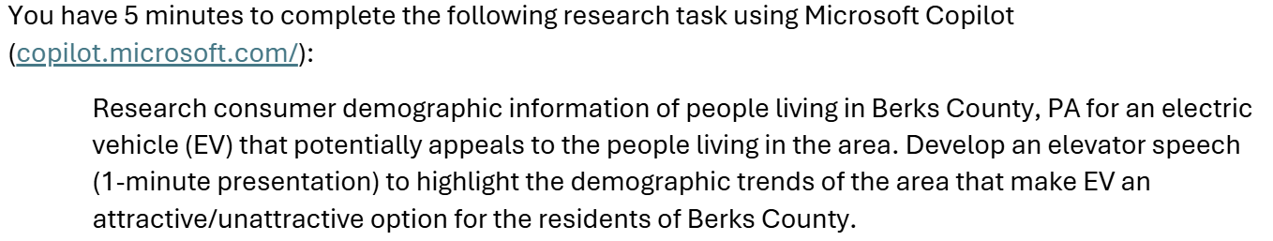
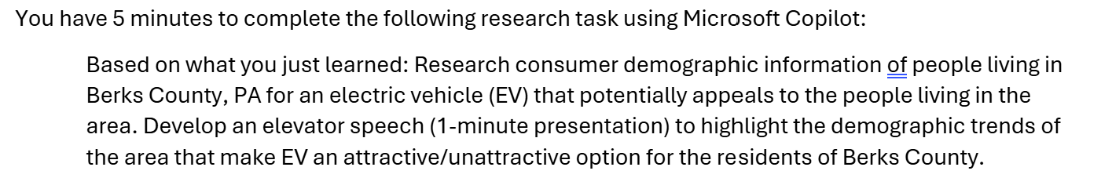
Research task using Copilot
Pre-intervention
Post-intervention
Notes:
Ada
Now let's take a closer look at the research tasks. The first task is conducted before intervention, i.e. before the presentation of the PROMPT design framework.
The second task prompt the student to repeat the research task, with just an extra phrase, "based on what you just learned"

Slide 22
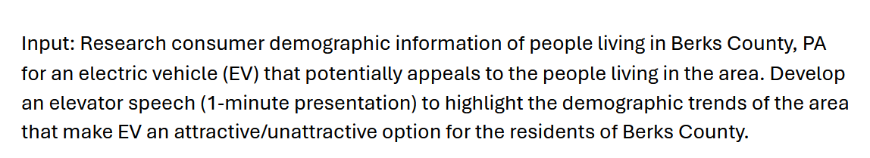
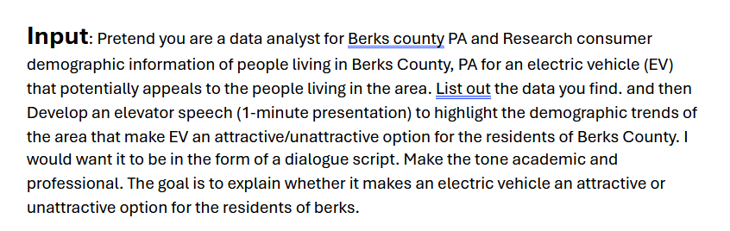
Students’ Prompt Quality
Before
After
Notes:
Sarah
We just onboarded a team of independent raters to evaluate participants’ pre- and post-intervention prompts to determine whether learning the PROMPT framework has an effect on students’ prompting behavior.
In our preliminary analysis, we see some indicators that students’ prompting strategies improved as a result of the PROMPT framework intervention. These are example ‘before’ and ‘after’ prompts from the same study participant. The ‘before’ prompt is literally a copy and paste of the research task. By contrast, the ‘after’ prompt reflects many elements of the PROMPT framework, including the persona of ‘data analyst,’ the organization of ‘list[ing] out’ data’ and presenting the elevator pitch as a ‘dialogue script,’ the purpose of ‘explaining’ EV feasibility, and the ‘academic and professional’ tone.

Slide 23
Prompt Quality
  Evaluation of prompting "adaptiveness" (Lo, 2023)
  Descriptive statistics based on 28 complete pre-post artifact pairs (56 total artifacts).
  Methodology adapted from (Knoth et al, 2024; Woo et al, 2024)
 | Pre |  | Post |  | Δ
Element | Total instances | % of prompts | Total instances | % of prompts | Total instances | % of prompts
Persona | 1 | 3.6% | 20 | 57.1% | 19 | 53.6%
Requirements | 120 | 100% | 170 | 100% | 50 | -
Organization | 3 | 7.1% | 13 | 21.4% | 10 | 14.3%
Medium | 0 | 0% | 0 | 0% | 0 | -
Purpose | 33 | 100% | 40 | 96.4% | 7 | -3.6%
Tone | 2 | 7.1% | 28 | 46.4% | 26 | 39.3%
PROMPT elements per prompt | 6 | - | 10 | - | 4 | 66.7% increase
PROMPT elements total | 159 | - | 271 | - | 112 | 70% increase
Notes:
Sarah
These are preliminary, descriptive statistics across the entire set of 56 student artifacts in the study. We counted each instance of the elements from the PROMPT framework in pre-intervention and post-intervention prompts, and then calculated the difference (or ‘deltas’) between them. We also assessed the percentage of pre- and post-prompts that include each element from the Framework.
These preliminary results suggest increased use of the Persona, Organization, and Tone elements.
Overall, we observe a 67% increase in the use of framework elements per prompt, and a 70% increase in framework elements across the entire set of student artifacts, since some students overachieved in their prompting adaptiveness.
---
An approach used in (Knoth et al., 2024) and (Woo et al., 2024) is to count the instances of prompt engineering strategies in pre-post prompts and calculate the Δ:
“Each component contained in a prompt was given one point. Thus, a score of 0 indicates that none of the six components were included in the prompt, while a score of 6 indicates that all of the prompt components were included.” (Knoth et al., 2024)
“We counted the number of strategies in a student’s pre- and post-workshop prompt libraries and compared the results. Furthermore, we compiled descriptive statistics to compare each strategy’s usage before and after the workshop and all students’ performance before and after the Workshop." (Woo et al., 2024)

Slide 24
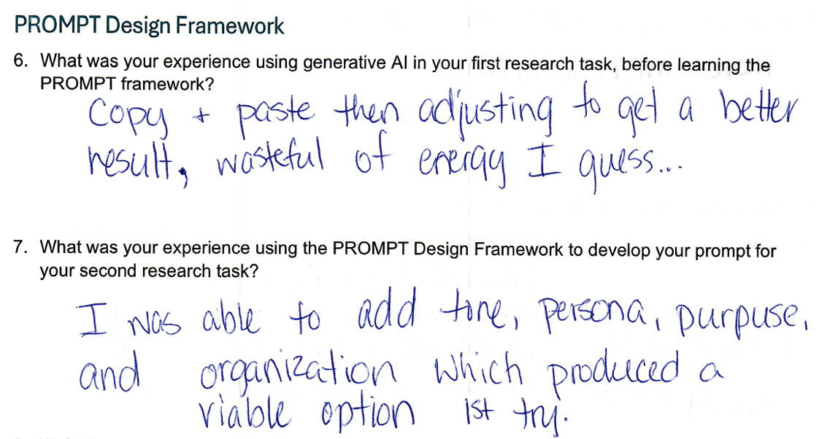
Notes:
Sarah
We are also in the early stages of analyzing qualitative data from the focus group sessions, but we have additional preliminary evidence that learning the PROMPT framework improved participants’ prompting strategies and resulting AI output.
In this excerpt from one participant’s focus group workbook, they disclose that they merely copied and pasted the research task as their pre-intervention prompt, and then used iterative prompting to improve the result, which they acknowledge is “wasteful of energy.”
Post-intervention, this participant describes adding framework elements Persona, Purpose, and Organization, resulting in a “viable option 1st try.”

Slide 25
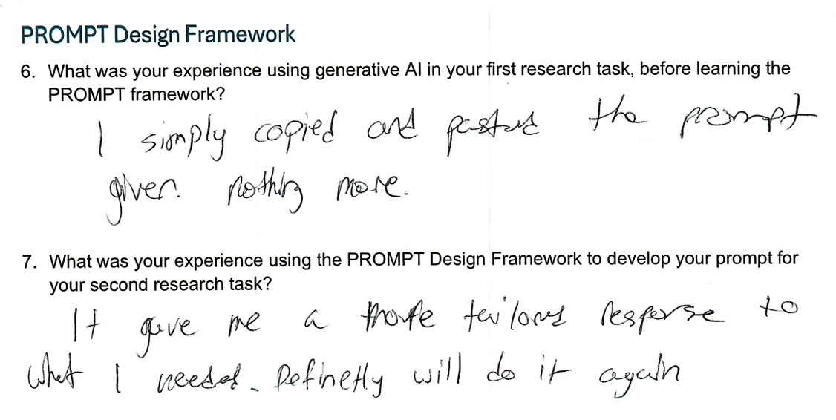
Notes:
Sarah
This is another example of a participant who merely “copied and pasted” the research task as their pre-intervention prompt. This participant claims they “definitely will do it again” when asked about using the PROMPT framework to develop their post-intervention prompt.

Slide 26
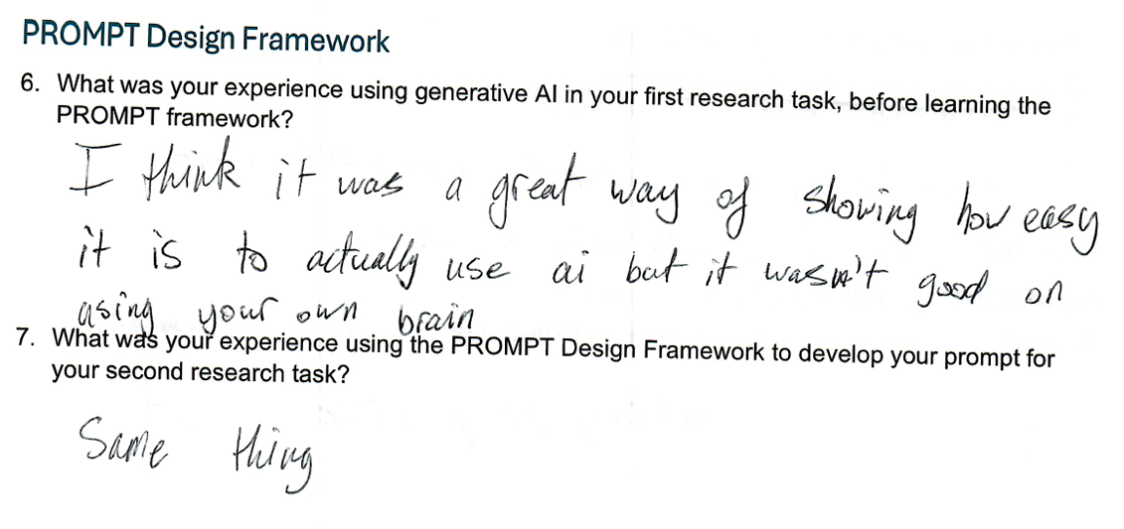
Notes:
Sarah
This participant found the PROMPT framework useful as procedural knowledge for using AI, but wants to address “using your own brain” – similar topics are surfacing in the coding of focus group transcripts, as we’ll see in just a bit.

Slide 27
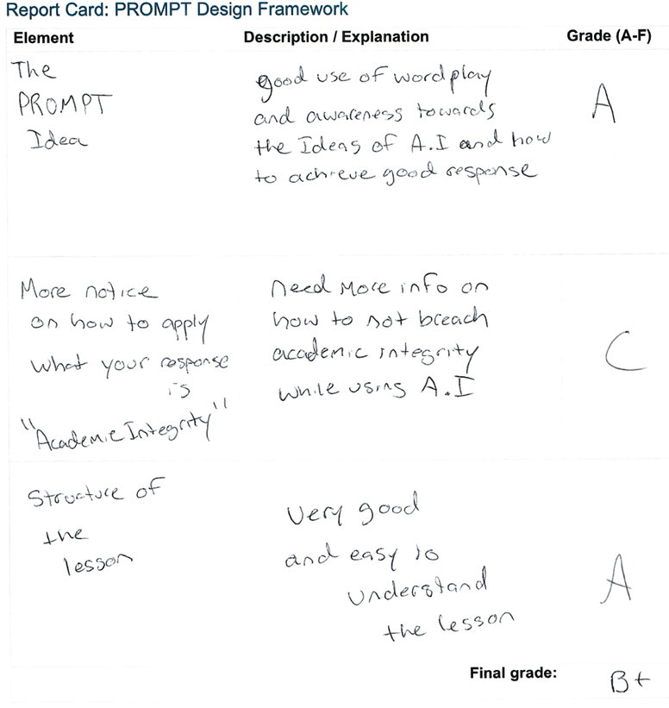
Notes:
Sarah
In their focus group workbooks, students were invited to grade the PROMPT Design Framework in a report card format.
This participant awarded A’s to the PROMPT mnemonic and to the lesson plan; however, they wanted more information on how to use AI output consistent with academic integrity norms, giving that concept a C.

Slide 28
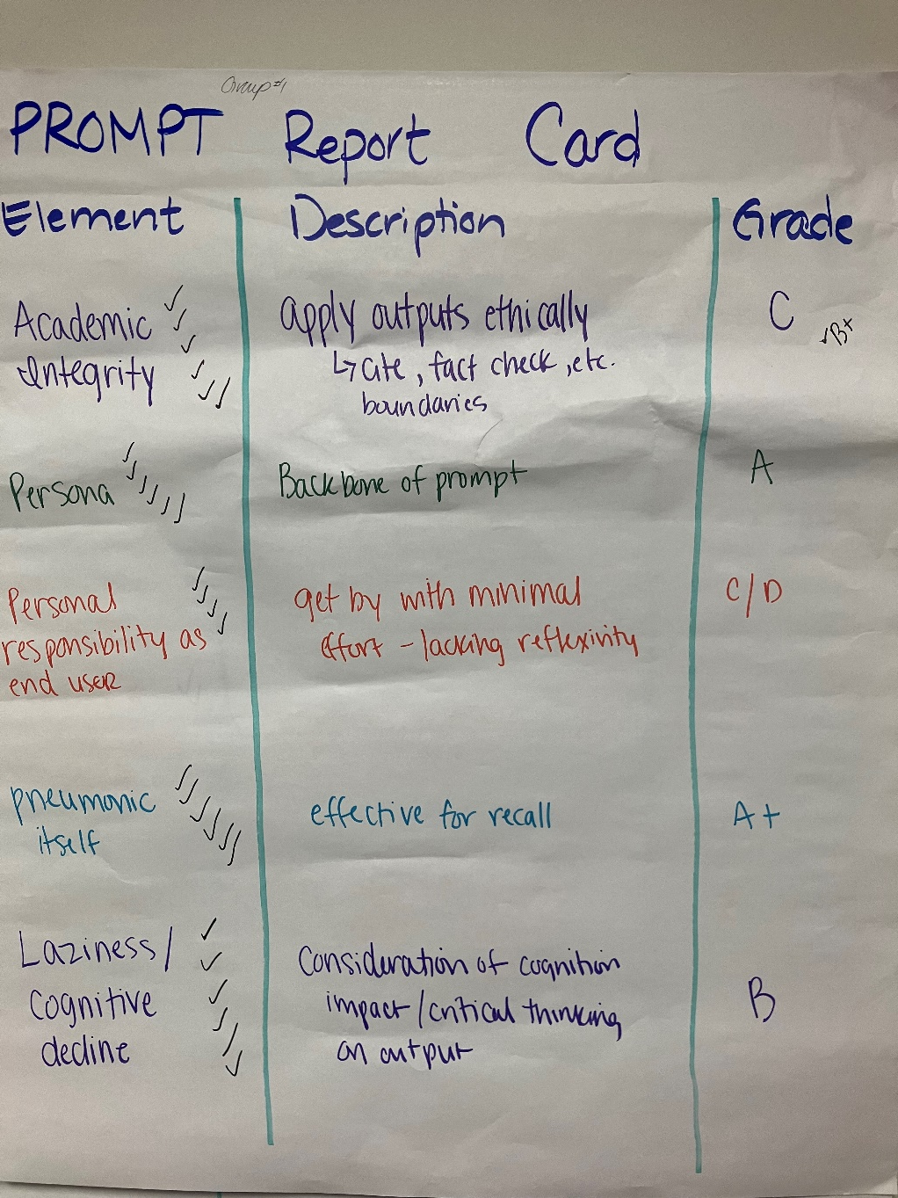
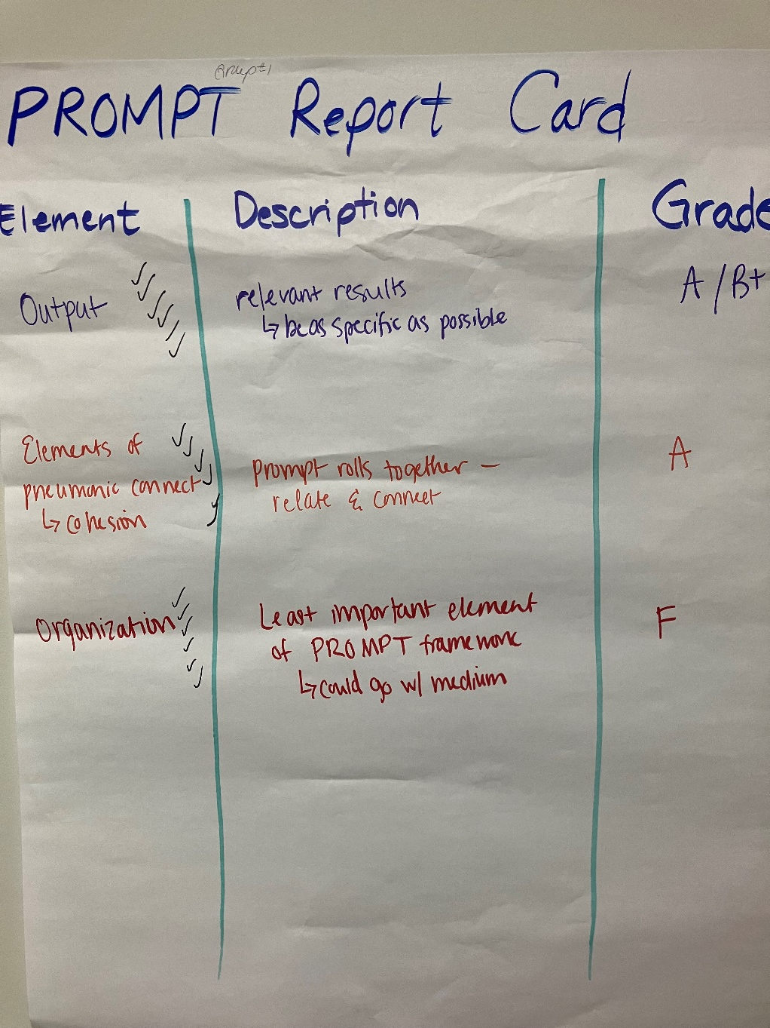
Notes:
Sarah
Here is a PROMPT report card aggregated for all participants in focus group 1. These participants awarded high scores to the PROMPT mnemonic and to the Persona and Output elements. Broader AI literacy concepts like academic integrity and personal responsibility have room for improvement, and this group thought Organization was the least important framework element.

Slide 29
Qualitative Findings
Characterization of AI
Information Concierge | 50.9%
Medium | 22.0%
Bot | 16.1%
Artificial Intimacy | 11.0%
Orientation to AI
Prompting as Strategic Exploration | 66.7%
AI antipathy (secondhand) | 15.0%
AI antipathy (firsthand) | 8.2%
AI apathy | 3.4%
AI realism | 1.9%
AI natives | 1.0%
AI Literacy
Prompting | 26.7%
Synthesizing; citing | 4.7%
Academic integrity; classroom guidelines | 4.2%
Evaluation | 1.0%
Disposition | 1.6%
Pedagogy | 2.6%
Resources | 2.1%
PROMPT Framework | 48.7%
AI Concerns
Personal responsibility | 18.6%
Green AI | 16.4%
Cognitive decline; AI dependency | 15.8%
AI fabrication (“hallucination”) | 13.7%
Satisficing; information overload | 10.9%
Job displacement | 8.2%
Bias; disparate impact; social trust; AI divide | 6.6%
Student displacement | 5.5%
Notes:
Sarah
A preliminary round of open coding with the two, one-hour focus group transcripts yielded 254 unique codes and 763 total codes. Additional axial and selective coding surfaced four broad themes: participants’ characterization of AI, their orientation to AI, their AI literacy interests, and their AI concerns.
Within the Characterization of AI theme, approximately half of codes describe AI as an Information Concierge – an agent that delivers personalized, point-of-need information services. 22% of open codes describe AI as a Medium – a tool or implement used in their own creative work. 16% of codes describe AI as a Bot, using terminology related to computation and machine learning. Approximately 1 in 10 characterize AI in terms related to artificial intimacy (Brooks, 2021), such as a therapist, virtual friend, or digital lover.
Under the Orientation to AI theme, two-thirds of codes refer to Prompting as Strategic Exploration – the use of AI to explore a broad range of personal, academic, and professional interests, with participants often employing trial-and-error or free web resources to teach themselves prompting techniques. 15% of codes described experiencing AI antipathy secondhand, often from professors, while 8% expressed firsthand AI antipathy. A small number of codes exhibited AI apathy or AI realism, and identified as AI natives.
When discussing AI literacy, participants primarily focus on research-related procedural knowledge. About 27% of codes identified prompting as a skill of interest, but this could be an artifact of the study itself. Nearly 5% of codes prefer instruction on synthesizing and citing AI output, and 4% wanted further discussion of academic integrity and classroom guidelines. A small number of codes observed how AI literacy could influence participants’ dispositions toward AI use. Small numbers of codes also discussed participants’ preferences for AI literacy pedagogy, especially active learning approaches, and resources they reference when independently learning AI skills. An artifact of the study, the PROMPT Framework accounts for 49% of codes in the AI literacy category.
In the AI Concerns category, the highest concentration of codes related to personal responsibility at 19%, with green AI and the environmental impact of generative AI following closely at 16%. Cognitive decline and AI dependency account for another 16% of codes. AI fabrication is present in 14% of codes, while satisficing and information overload is present in 11% of codes. Job displacement is present in 8% of codes, but participants also discussed ‘student displacement,’ the idea that improper or excessive use of AI for academic purposes is interfering with their learning experience, peer and instructor relationships, and making college a poor investment of time and money. Finally, social harms of AI account for almost 7% of codes in the AI Concerns category.

Slide 30

"I think I'll never look at a prompt the same way again."
-Student focus group participant
Image credit: unsplash
Notes:
During the focus group, one participant remarked, “I Think I’ll never look at a prompt the same way again,” suggesting that contextualizing prompting and the PROMPT Design Framework within broader AI ethics considerations is an impactful approach to AI literacy.

Slide 31

03.
Future Work
  Data analysis
  Study limitations and future directions
Image credit: unsplash+
Notes:
Ada
Let's do a quick review about the summary of findings and how we will move forward with this research stream.
A large proportion of students did not have formal training of prompt engineering.
They are very concerned about academic integrity when using AI in their assignments.
The PROMPT design framework improves students' perceived AI self-efficacy (subjective), and their prompt quality (objective)

Slide 32

Additional Data Analysis
01.
02.
03.
Independent ratings
Further quantitative analysis
Further qualitative analysis
Independent raters will evaluate pre/post prompt-output pairs using a rubric
Investigate the relationship between AI experience and output effectiveness
Additional thematic and axial coding
Examining potential correlations between codes and student groups
Notes:
Ada
During the interim, we are asking professional librarians to help us rate students' prompt-output pairs
We will conduct sub-group analysis to investigate if AI usage, AI self-efficacy, prompt quality, prompt-output quality are different among students from various groups, e.g., gender, race, students' work status
We will conduct thematic analysis of answers to the open-ended survey questions and the focus group transcripts.

Slide 33
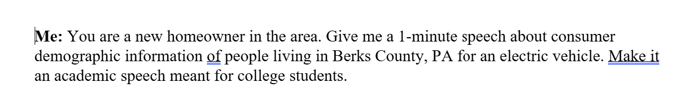
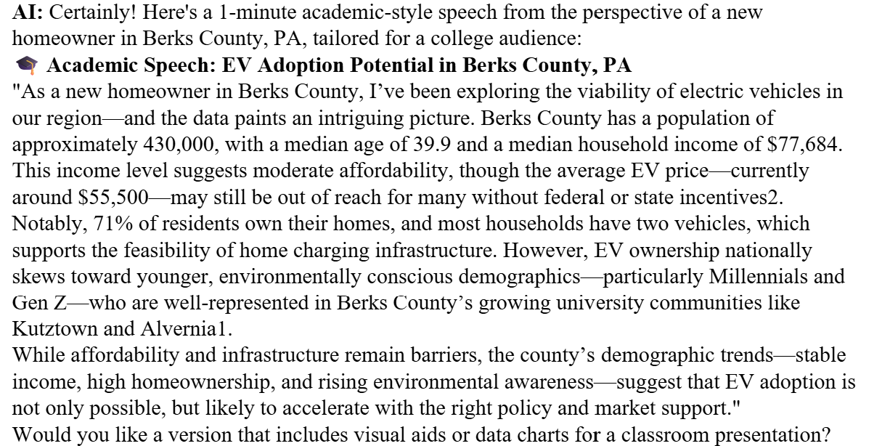
Sample independent rating of the artifact
Prompt
Output
Notes:
Ada
This is a sample of prompt-output pair we are asking independent raters to provide ratings.
(Move to the next slide)
For example: Conciseness: prompt is good may be even a 5, but the output can be a 4 or even 3, because some of the information may not be relevant or useful

Slide 34
Items based on (Gastineau, 2024; Lo, 2023; Rossi, 2024) | 1 Unsatisfactory | 2 Dissatisfied / Developing | 3 Meets expectations | 4 Satisfied / Exceeds expectations | 5 Exemplary
Conciseness | Vague, ambiguous | Open to competing interpretations | Clear enough with room for improvement | Succinct and clear | Contains only necessary content
Logic | Lacks logical flow | Flow lacks sequencing or connections | Minor inconsistencies or gaps | Well organized | Perfectly ordered sequence of ideas
Explicitness | Lacks clear requirements | Incomplete or unclear specifications | Some requirements with room for improvement | Includes all necessary requirements | Precisely defines expected output and requirements
Adaptiveness | Post-intervention: no customization | Post-intervention: limited customization | Post-intervention: some customization | Post-intervention: sufficient customization | Post-intervention: highly customized
Relevance | Broad, generic, vague | Context introduced insufficiently | Includes some context for requirements | Includes sufficient context for requirements | Includes all necessary context for requirements
Notes:
Ada
Independent, external raters are evaluating prompt-output pairs using this rubric, based on the CLEAR Framework by Leo Lo and its implementation in rubrics in two similar studies. We will receive their results in January and use them to assess the net change in post-intervention prompting behavior compared to pre-intervention prompting behavior.
To earn a 3 rating in any category, the prompt must result in output that is relevant, accurate, or useful (achieves ONE of these).
To earn a 4, it must result in output that is relevant, accurate, and/or useful (achieves TWO of these).
To earn a 5, it must generate relevant, accurate and useful output (achieves ALL of these).
(go back to the previous slide)
We are evaluating prompt adaptiveness by counting the instances of each PROMPT Framework element in pre- and post- intervention prompts and calculating the difference (delta).

Slide 35

Study Limitations
01.
02.
03.
04.
Recruitment & Participation
Instrument design
Artifact collection
Investigator bias
Image credit: Construction Management Association of America
Notes:
Ada
Only business students are recruited
Research task: text-to-text, medium is not mentioned in the studprompt quality
We lose some data when students forgot to include their prompts in the prompt-output pair artifacts. Better instructions are needed
Investigator is doing the coding, which may cause investigator bias

Slide 36

References
AI’s impact on the environment. AI for Education. https://www.aiforeducation.io/ai-resources/ais-impact-on-the-environment
Brooks, R. (2021). Artificial Intimacy: Virtual Friends, Digital Lovers, and Algorithmic Matchmakers. Columbia University Press.
Campbell, L., Jeffery, K., & Nowicki, R. (2025). AI, acronyms, and the future of facets: Mnemonics as heuristic instructional tools for structuring genAI prompts. Qualitative and Quantitative Methods in Libraries 14(1): 121-134. https://www.qqml-journal.net/index.php/qqml/article/view/906
Chan, C. K. Y. & Colloton, T. (2024). AI literacy. In Generative AI in Higher Education: The ChatGPT Effect. http://dx.doi.org/10.4324/9781003459026-2
Gastineau, J. (2024). Exploring the impact of generative AI prompt engineering in higher education: A study in undergraduate and graduate business analytics courses [Doctoral dissertation, University of Arkansas]. ScholarWorks@UARK. https://scholarworks.uark.edu/etd/5551/
Guha, A., Grewal, D., & Atlas, S. (2024). Generative AI and marketing education: What the future holds. Journal of Marketing Education, 46(1), 6-17. https://doi.org/10.1177/02734753231215436
Gupta, K. (2024). Student perspective: don’t use AI to do the work, use it to make the work better. Connect Happy Valley. https://happyvalleyindustry.com/student-perspective-dont-use-ai-to-do-the-work-use-it-to-make-the-work-better/
Hartman-Caverly, S. (2024, November 19). Theory of machine mind: Conceptual framework for AI literacy education [Presentation]. Heterodox Libraries Mini-Symposium: AI and Learning Design. https://doi.org/10.26207/zsqe-cn18
Knoth, N., Tolzin, A., Janson, A. & Leimeister, J. M. (2024). AI literacy and its implications for prompt engineering strategies. Computers and Education: Artificial Intelligence, 6, article no. 100225. https://doi.org/10.1016/j.caeai.2024.100225
Kumar, A. & Davenport, T. (2023, July 20). How to make generative AI greener. Harvard Business Review. https://hbr.org/2023/07/how-to-make-generative-ai-greener
Lo, L. S. (2023). The CLEAR path: A framework for enhancing information literacy through prompt engineering. The Journal of Academic Librarianship, 49(4), no. 102720. https://doi.org/10.1016/j.acalib.2023.102720
Leung, A., Hartman-Caverly, S., Attaran, S., Price, E., & Clarke, T. (2025, March 21-22). AI and the innovative marketing educator: Integrating AI into digital and social media marketing education [Conference paper]. Marketing Management Association Spring 2025 Virtual Conference. https://www.mmaglobal.org/_files/ugd/a41a45_892e337a2c7a43f9a6f331d52b99a3aa.pdf
Prabha, C., Connaway, L. S., Olszewski, L., & Jenkins, L R. (2007). What is enough? Satisficing information needs. Journal of Documentation, 63(1): 74-89. https://doi.org/10.1108/00220410710723894
Rossi, V. (2024). Inquiring the 'oracle'. An empirical study on how artificial intelligence literacy and prompt engineering influence the use of LLMs and GAI in higher education [Master’s thesis, Università Ca’Foscari Venezia]. UNITesi. https://unitesi.unive.it/handle/20.500.14247/23630
Stokel-Walker, C. (2023, February 10). The generative AI race has a dirty secret. Wired. https://www.wired.com/story/the-generative-ai-search-race-has-a-dirty-secret/
Wang, Y. Y. & Chuang, Y. W. (2024). Artificial intelligence self-efficacy: Scale development and validation. Education and Information Technologies 29: 4785–4808. https://doi.org/10.1007/s10639-023-12015-w
Woo, D. J., Wang, D., Yung, T., & Guo, K. (2024). Effects of a prompt engineering intervention on undergraduate students' AI self-efficacy, AI knowledge and prompt engineering ability: A mixed methods study. https://doi.org/10.48550/arXiv.2408.07302
Image credit: unsplash

Slide 37
Thank you!
Sarah Hartman-Caverly
  smh767@psu.edu
Dr. Ada Leung
  cxl51@psu.edu
  This project is supported in part by a Penn State University Libraries Faculty Organization Research Grant.
Notes:
PROMPT Design Framework for AI Literacy study
Sarah Hartman-Caverly: smh767@psu.edu
Dr. Ada Leung: cxl51@psu.edu
AI literacy workshop with PROMPT Design Framework materials: https://guides.libraries.psu.edu/berks/ai

Slide 38

This presentation template is free for everyone to use thanks to the following:
  SlidesCarnival for the presentation template
  Pexels for the photos
Happy designing!

