Slide 1
"Tell Me, Can You Hear Me Now?"
Using the Practices of Citation Justice to Foster Students' Sense of Belonging
Nebraska Chatham, Simmons University
Tuesday November 18, 2025

Slide 2
Students of Color at PWIs
Experience higher instances of microaggressions at school.
(Foxx, 2021)
Women, trans, and nonbinary students express similar experiences of ostracization.
(Chaffee & King, 2025; Thomas, 2025)
Leading to higher levels of dissatisfaction and lowers levels of sense of belonging.
Sense of belonging correlates with academic performance, retention, and mental health.
(DeCuir-Gunby et al., 2023; Fan et al., 2020)

Slide 3
Citation Justice: What is it?
Alternative names: inclusive citation, citation diversity, critical citation
Act of consciously citing people with marginalized identities to uplift their voices.
(Albert S. Cook Library, n.d.)
For example:
Black women in scholarly writings.
(Garrett-Scott & Smith, 2021)
Classwork and discussions at PWIs often revolve around a white perspective.
(Thomas, 2025)
Sense of belonging improves as institutions value student’s communities.

Slide 4
Teaching Citation Justice in the Library
Citation justice isn’t intended to simply “fill a quota” in diverse citations. It is an act of resistance that defies white supremacy and supports minority scholars, thereby benefiting us all.
Introduction
Ask current understanding of citation justice
Share the academic currency of citations.
Use
Modern examples of citation.
Citation justice specific terms and resources.
Clarify
Potential confusion when citing trans & non binary authors.
Or when citing indigenous communities.
Activities
Available citation workshops
“Read and Review”
Citation Managers
Audit Citations
Evaluate the diversity of citations.
Tracking sheets and code software to document changes.
Diversity Statement
States percentage of citations by race/ gender & methodology for citation assessment.

Slide 5
Supplemental Resources
Cite Black Authors
This site seeks “to enhance recognition and citation of black academic voices.”
Women Also Know Stuff
“For relevant experts when you are writing syllabi, planning conferences, organizing panels, selecting speakers, citing research, inviting essays and op-eds, and identifying expert sources.”
Anti-Colonial Research Library
“This Library holds a collection of open-access articles and books, websites, and YouTube videos on Indigenous and anti-colonial research methodologies.”
Diverse Sources
“Database of experts to include more underrepresented voices and perspectives in your science, health and environment work on deadline.”

Slide 6
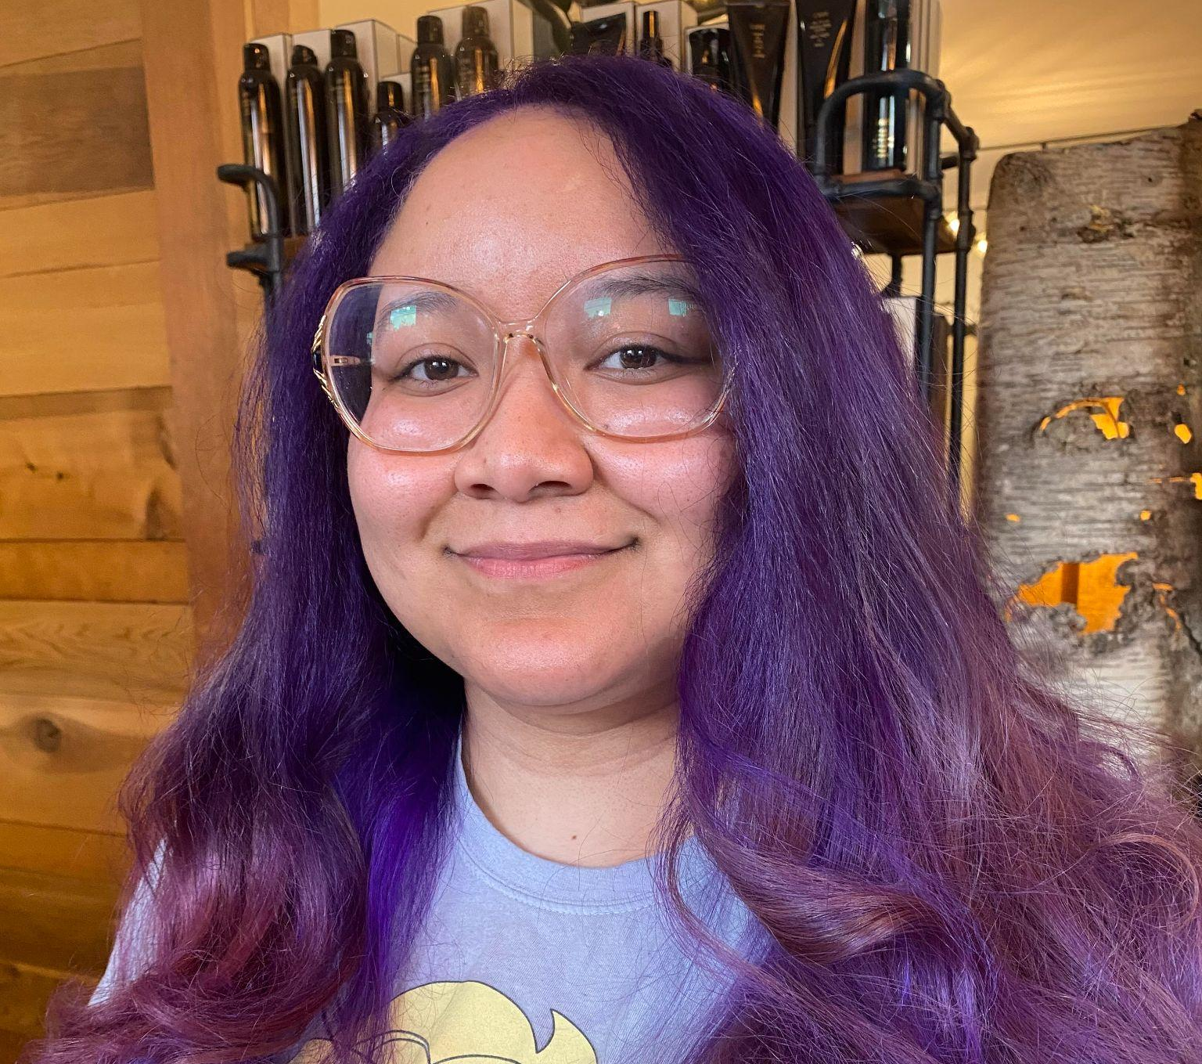

Thank you!
Questions? Contact
chatham@simmons.edu

