Slide 1


Belonging:
What we do when we can’t say DEI
TRICIA BOUCHER (she/her)
Assistant Professor, Social Sciences Librarian at the University of New Hampshire, middle class, white, married lesbian.
Sadly, currently without a pet.
And who are you? Share in the chat!

Slide 2

TODAY
TODAY
Part 1
From EDI to belonging
Part 2
Belonging and learning
Part 2
Allyship as embodied EDI

Slide 3
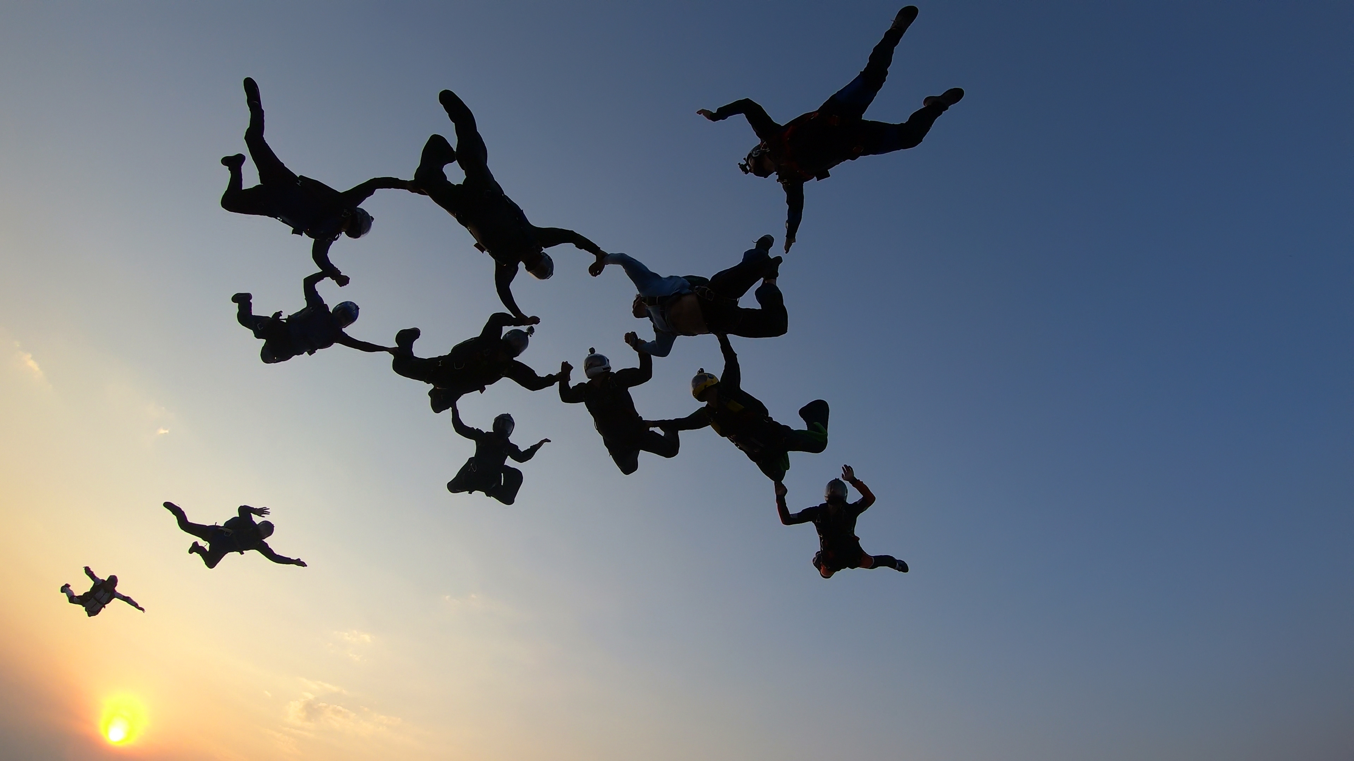
PART 1
From EDI to belonging

Slide 4


REFLECTION
REFLECTION
What does belonging mean to you?
OR
What does it mean to belong?

Slide 5
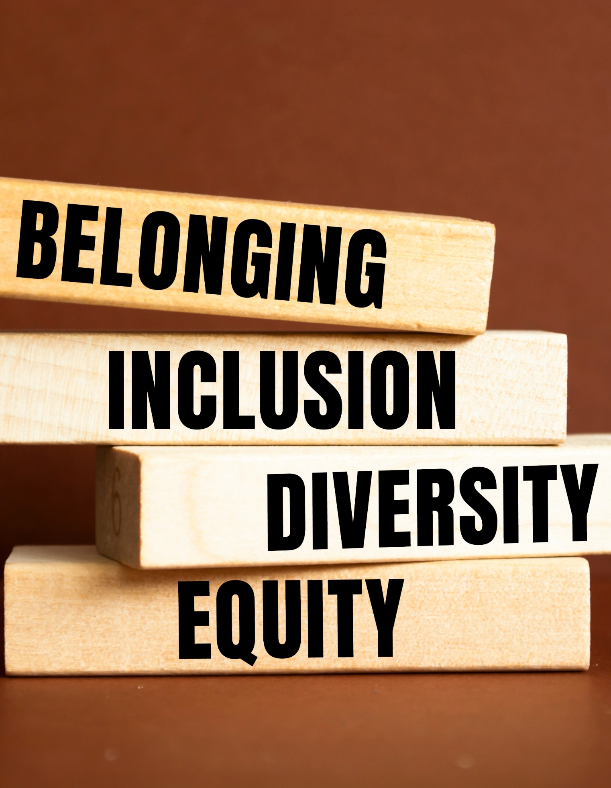
LANGUAGE
Built with an original prompt using Microsoft CoPilot, 2025.
Build, bottom to top!
Belonging: “degree to which an individual feels respected, valued, accepted, and needed by a defined group” (Strayhorn, 2012)
Inclusion: creating an environment that is welcoming and open
Diversity: recognizing and respecting the many ways we are diverse
Equity: ensuring both access and accessibility

Slide 6




iBelong Scale: AUTHENTICITY
iBelong Scale: AUTHENTICITY
We provide a space where students can belong because they feel they can be their authentic selves.
Seen
Respected
Valued
Accepted
In general, I do not have to change my behavior.
I am free to be myself in class or at an event.
In general, I do not have to hide parts of who I am.
I feel accepted for who I am.
From the ILee, B. A., & Neville, H. A. (2024). The iBelong Scale: Construction and validation of a measure of racial–ethnic–cultural belonging. Journal of Counseling Psychology, 71(3), 139–154. https://doi.org/10.1037/cou0000716

Slide 7





DEFINITIONS
DEFINITIONS
Different!
INCLUSION
BELONGING
We provide!
In a classroom, the creation of a diverse and equitable learning space where students’ personhood is affirmed.
Student feeling!
Happens when students
feel seen, accepted, valued, respected and supported.

Slide 8

QUESTIONS
About DEI and belonging?
Because we’re now moving to information about belonging and learning.

Slide 9
PART 2
Belonging and learning

Slide 10


SHARE:
SHARE:
Belonging
Think of an experience where you felt like you didn’t belong.
How did that impact your ability to interact with the group, the space, or the experience?

Slide 11






IMPACTS OF NOT BELONGING
IMPACTS OF NOT BELONGING
Stress
Lack of participation
Observable impacts…
Erosion of confidence
Internalization of negative stereotypes

Slide 12

BELONGING AND LEARNING
BELONGING AND LEARNING
Constructivist Learning Theory
Learning is the act of constructing knowledge.
Knowledge created is interpreted through learner’s worldview and experiences.
Vygotsky – learning is scaffolded and social
New information learned by:
  Assimilated into current schema
  Accommodated by revising schema

Slide 13
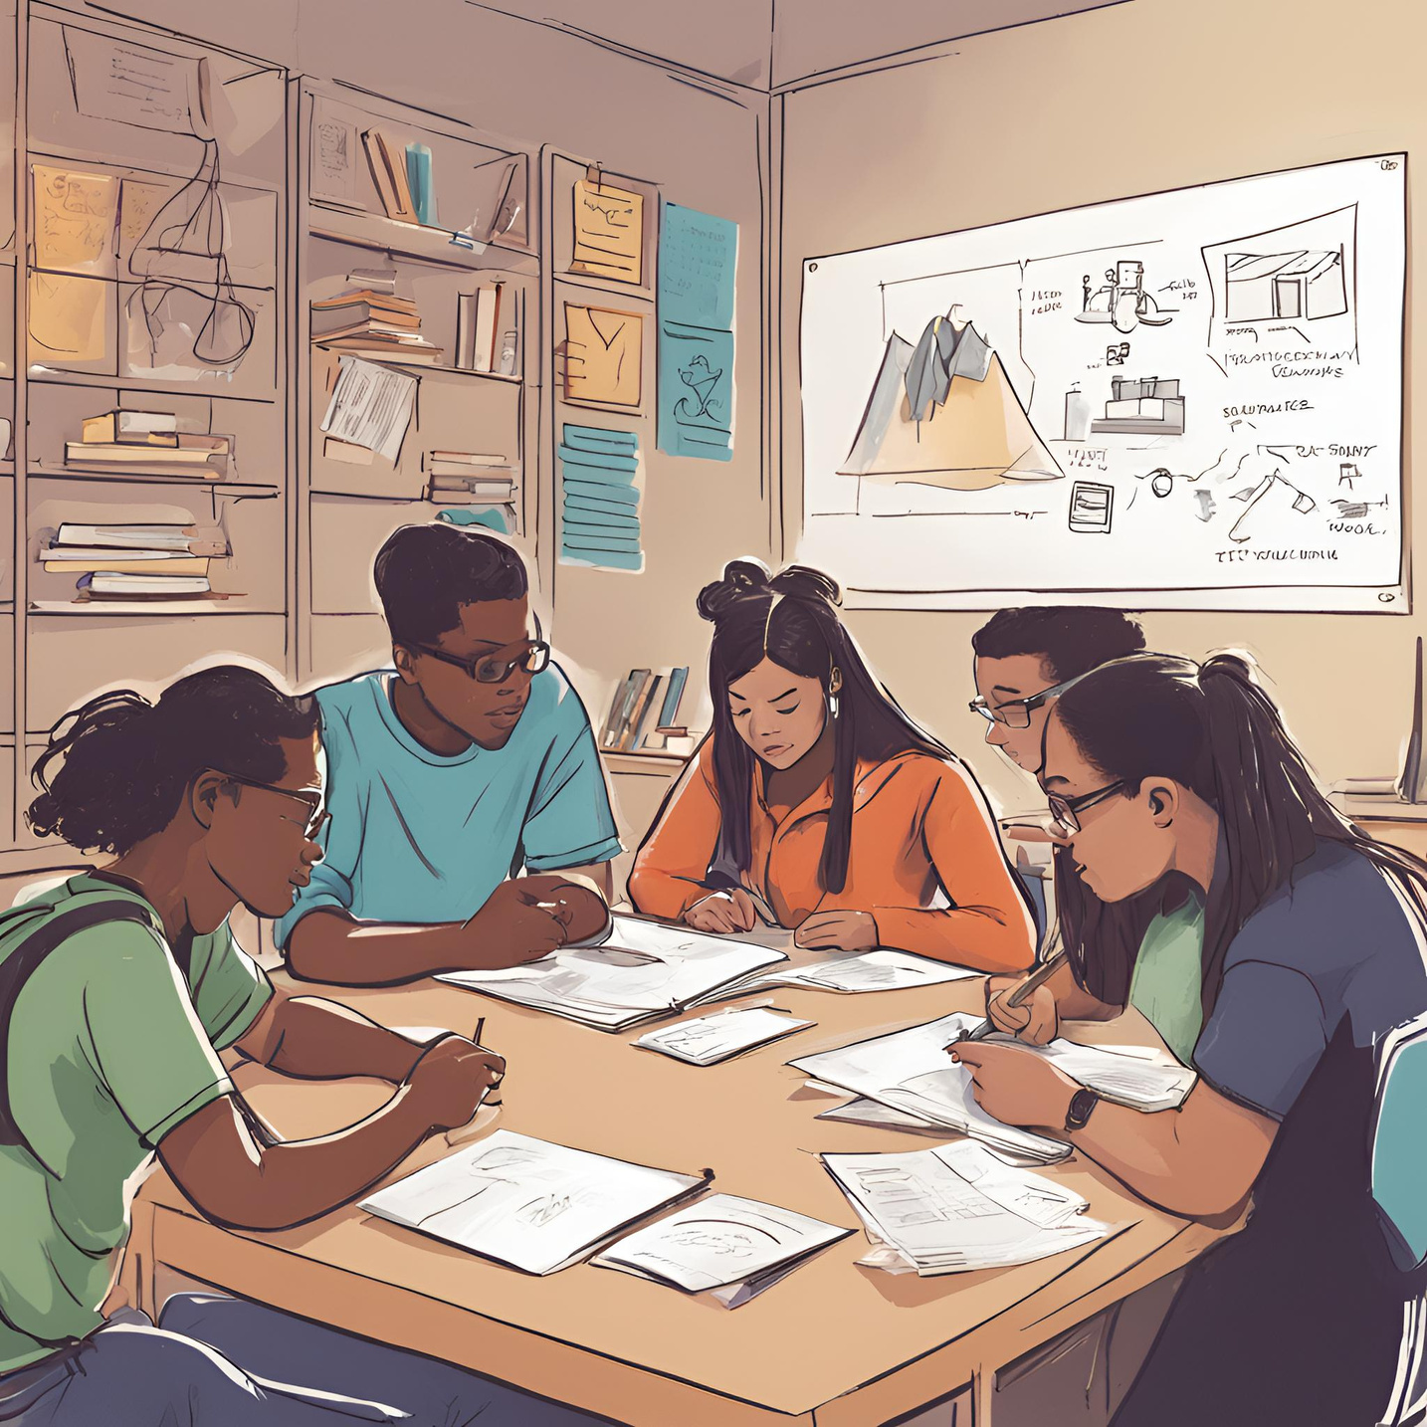


FROM NEGATIVE TO POSITIVE...
RESEARCH!
FROM NEGATIVE TO POSITIVE...
RESEARCH!
High levels of generativity
Giving back to affinity group
Solve real-world problems
Meaning is important
Recognition for work
innovation and autonomy are recognized

Slide 14



INCREASE BELONGING TO...
INCREASE BELONGING TO...
INCREASE ENGAGEMENT
INCREASE PERSISTENCE
INCREASE STUDENT SUCCESS

Slide 15
QUESTIONS
About belonging and learning?
Because we’re now moving to what we can do to help students feel they belong.

Slide 16
PART 3
Allyship as embodied DEI

Slide 17
You can’t make someone feel they belong.
All you can do is be an ally – DO DEI – to make the space expand to fit them.
You can’t make someone feel they belong.
All you can do is be an ally – DO DEI – to make the space expand to fit them.

Slide 18

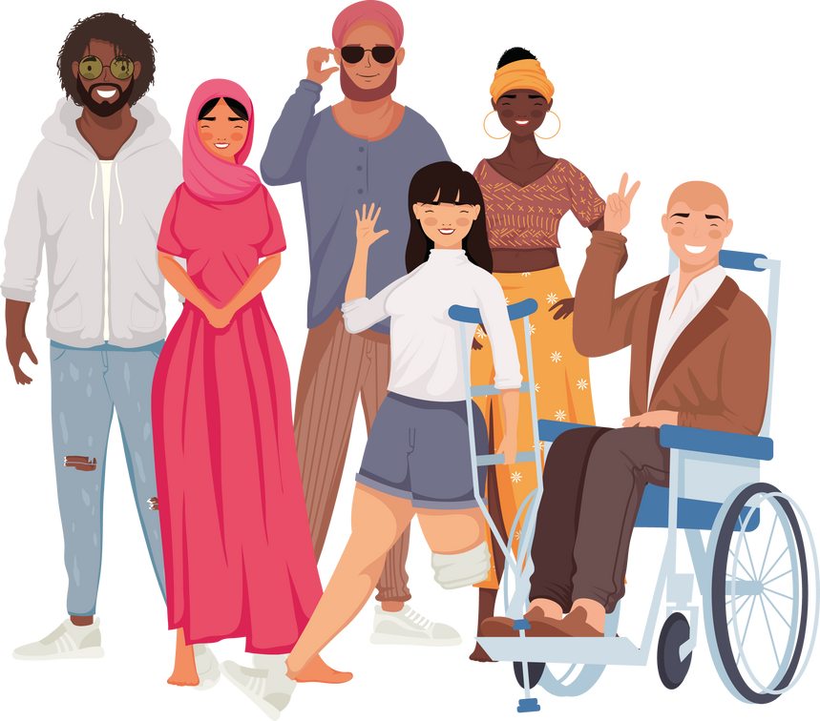



ALLYSHIP is both identity and action
ALLYSHIP is both identity and action
“I am an ally!”
Acknowledge privilege
Start small, make mistakes
Get curious
Keep learning
Use privilege to give others a seat at the table – then get out of the way.
Ask, don’t tell. People know themselves better than you do.
Start with a single act. If you make a mistake, apologize and move on.
This is a JOURNEY. It’s all about the lifelong learning.
From Karen Caitlin at Better Allies: https://betterallies.com/more-content/

Slide 19
Being an ally is about centering the marginalized.
Which is what we do when we do DEI.

Slide 20

CELEBRATE DIVERSITY,
PROVIDE
EQUITY,
INCLUDE
ALL.
Start with the mindset.
Take one small step. Then another.
Race/Ethnicity
Identity
Prior knowledge
Ability
Language
Orientation
Socio-Economic Class
Life Experience

Slide 21
CENTERING THE MARGINALIZED

Slide 22
SHARE:
http://bit.ly/4oHh5hk
Belonging
Coming from this mindset, how do you (or can you) create an inclusive environment where people can feel they belong?
This can be in instruction, outreach, or even in daily encounters!
https://bit.ly/deibelonging

Slide 23



HOW?
Instruction and outreach equity
Access:
  Provide all materials, equipment, information, and technical support students need to succeed.
Accessibility:
  Follow Universal Design for Learning Framework and/or the BSPH Center for Teaching and Learning Best Practices in Accessibility.
Preparation:
  Reduce jargon.
  Do not assume knowledge.
  Clarify expectations using Transparancy in Learning & Teaching Framework and scaffold all necessary information, provide rationale, and criteria for success.

Slide 24

HOW?
Instruction and outreach diversity
Representation:
  Baseline: Include representation of multiple diverse groups and use inclusive language.
  Better: Let students find ways to represent themselves and their interests.
Listen:
  Find ways to listen to concerns.
  Respond, don’t react.
  Be trustworthy with what is shared.
Preparation: strengths and research
  Start with their strengths – what do they bring to the table?
  Use the BSPH Center for Teaching and Learning JEDI Teaching Toolkit.
  Make it useful for the student or their community.

Slide 25

HOW?
Outreach – more of the same, plus…
Know your restrictions/laws
Include others
Make it about action/need rather than identity
Meet students where they’re at

Slide 26
Takeaways
https://bit.ly/deibelonging
Enacting equity and diversity build inclusive spaces and allow belonging.
Belonging impacts learning on multiple levels.
Allyship is an identity, actions, and a lifelong journey towards inclusion.
You can’t do everything. Approach life with a “center the marginalized” mindset.
Choose your first, specific step. Then add another.

Slide 27
Thank you!
Questions?
TRICIA BOUCHER (she/her)
Assistant Professor, Social Sciences Librarian at the University of New Hampshire, and all her other identities at:
patricia.boucher@unh.edu

Slide 28
References
and notes:
References available on the idea generating padlet.
If the above link does not work, please copy and paste the following link into your browser: https://bit.ly/deibelonging
NOTE: Information about images is provided in the alt text.
NOTE: Slides removed for time are provided below.

Slide 29
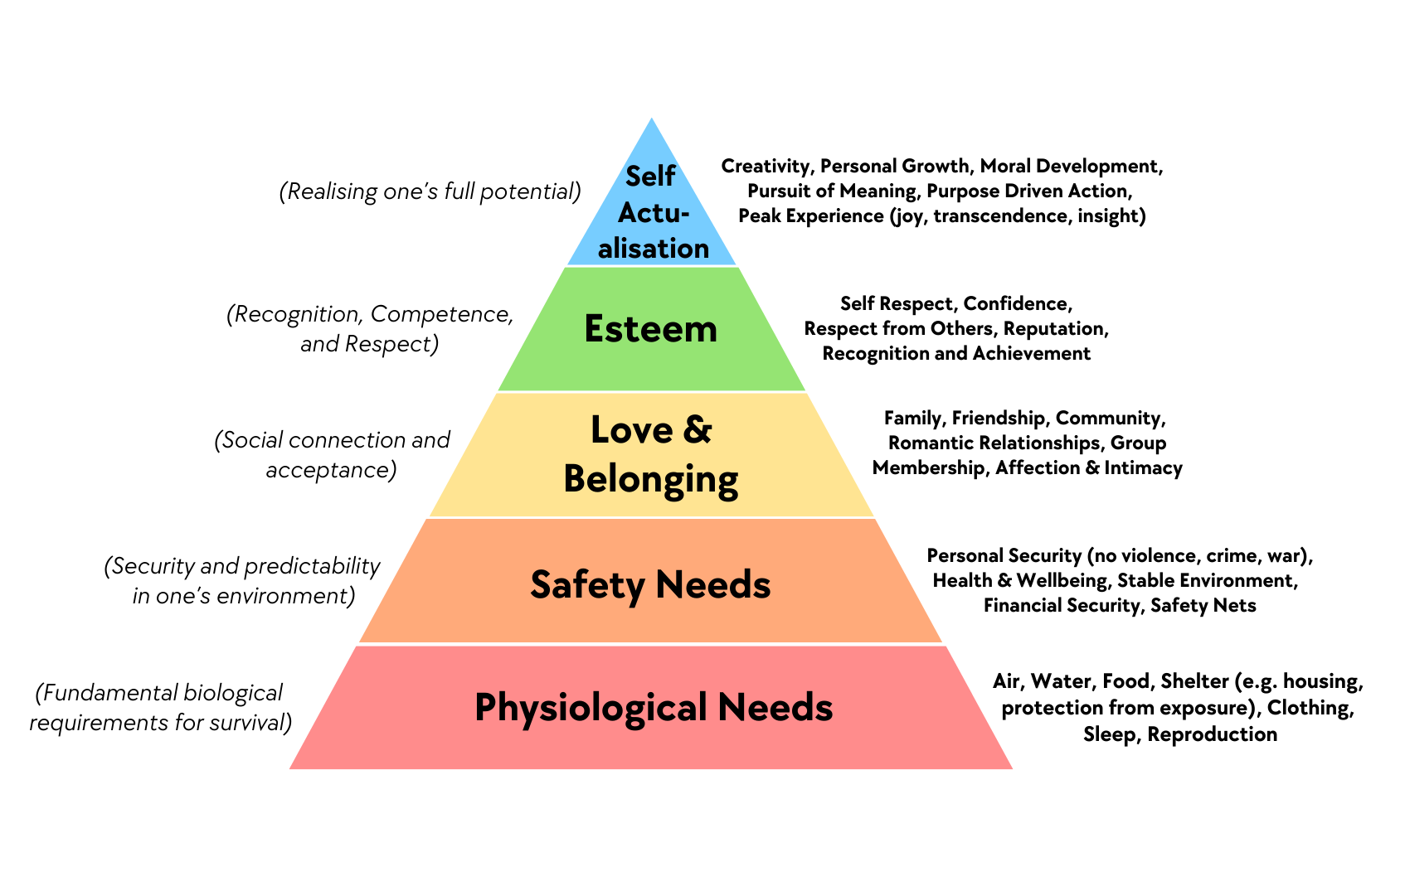
IMPORTANCE OF BELONGING
IMPORTANCE OF BELONGING
MENTAL HEALTH
PERSISTENCE
ACADEMIC PERFORMANCE
Gopalan, M., & Brady, S. T. (2020). College Students’ Sense of Belonging: A National Perspective. Educational Researcher, 49(2), 134-137. https://doi.org/10.3102/0013189X19897622

Slide 30
