Slide 1
Rage Against the Machine
Designing an Asset Protection Badge Course for Visual and Performing Artists
Katelynn Telford, MM, MLIS
Music & Arts Librarian
Daniel A. Reed Library, SUNY Fredonia

Slide 2
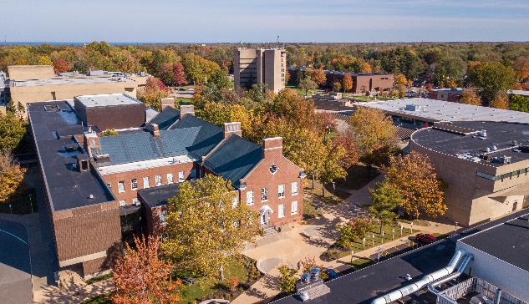
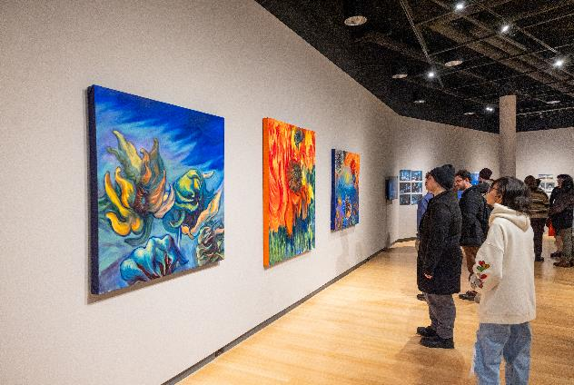
Background
Small (~3,000 students)
Liberal arts curriculum
Known for visual/performing arts programs:
  School of Music
  Theatre & Dance
  Visual Arts & New Media
Asked to incorporate AI/innovative technology into library instruction

Slide 3
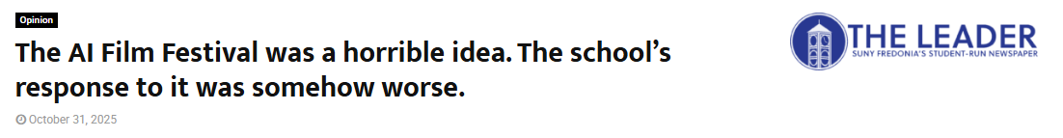
The Problem
"The same school that I have poured four years and thousands of dollars into wanted to celebrate the replacement of the very thing I’m here to study."
"If the school cared about its students, it wouldn’t be celebrating the thing that is threatening their jobs."
"...the school once again proves that it has zero regard for non-STEM students."

Slide 4


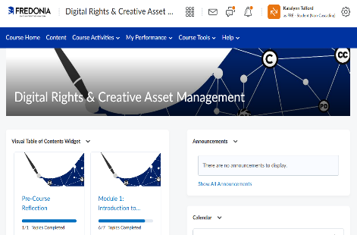
My Response

Slide 5



Course Breakdown
1
2
3
4
Introduction to Licensing
Finding & Utilizing Licenses
Protecting Work from Misuse by Humans
Protecting Work from Misuse by AI
Goal: to provide students with the skills and tools needed to advocate for their creative work

Slide 6
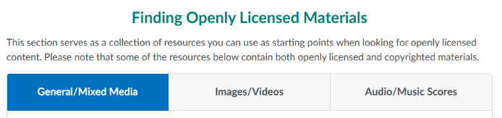
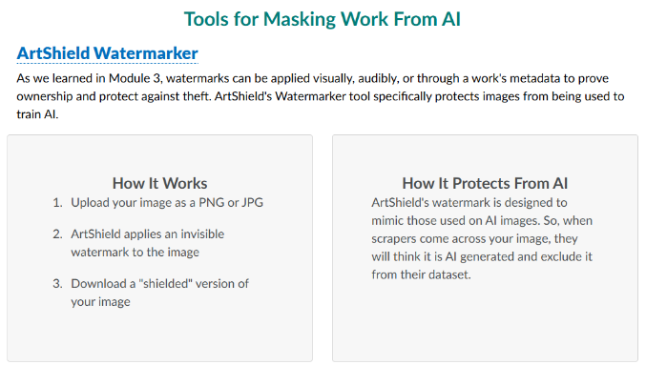
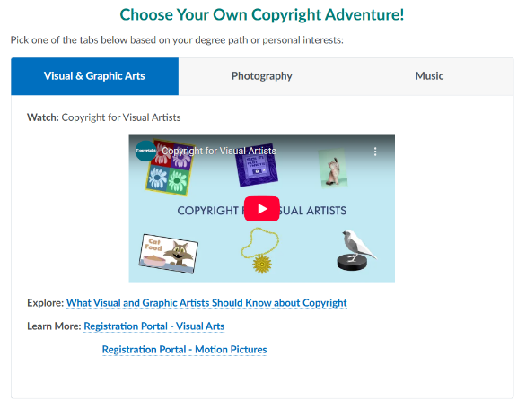

Tailoring User Experiences
Provides options for students to apply course content to their medium of choice

Slide 7
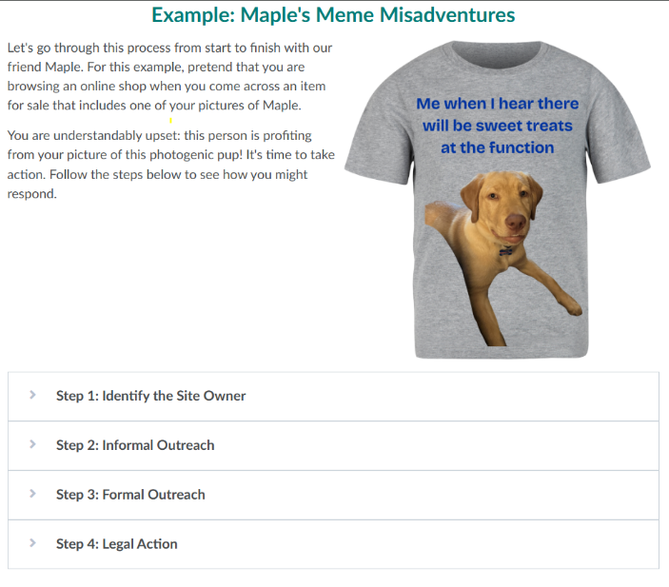
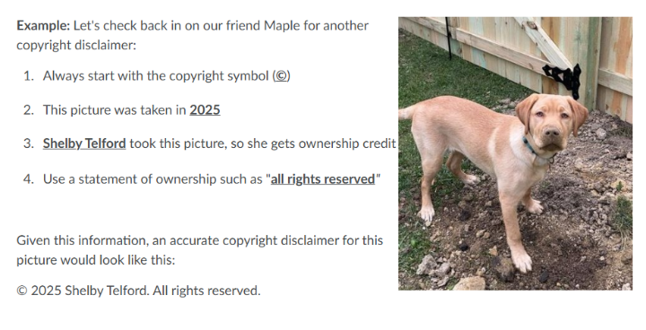
Providing Examples (& Making it Fun)
Provides tangible procedures to follow in a way that connects with participants

Slide 8
Assessments Used
Module Quizzes
Discussion Boards
Pre/Post-Course Reflections
Check for understanding
Allow students to explore/share ideas
Measure changes in understanding

Slide 9
Testing
Next Steps
Marketing
Currently working with faculty and student groups for feedback on content & design
Will share course with liaison departments: interested faculty can request that their students are added to the course

Slide 10
Thank You!
Let's Talk!
Katelynn.telford@fredonia.edu

