Slide 1

Connection and Community
Building a Student Library
Advisory Committee
Notes:
Welcome to Connection and Community: Building a Student Library Advisory Committee. We are here to talk about an initiative at Temple University’s Health Sciences Libraries that is student-focused. Our student library advisory committee structure is broad enough to be applied in any type of academic library.
A student library advisory committee is an outreach opportunity to educate students about library services and resources so they can share this knowledge with their peers. This is also a way to build community and a sense of student ownership of the library. Library staff benefit from understanding the student perspective on library services and resources.

Slide 2
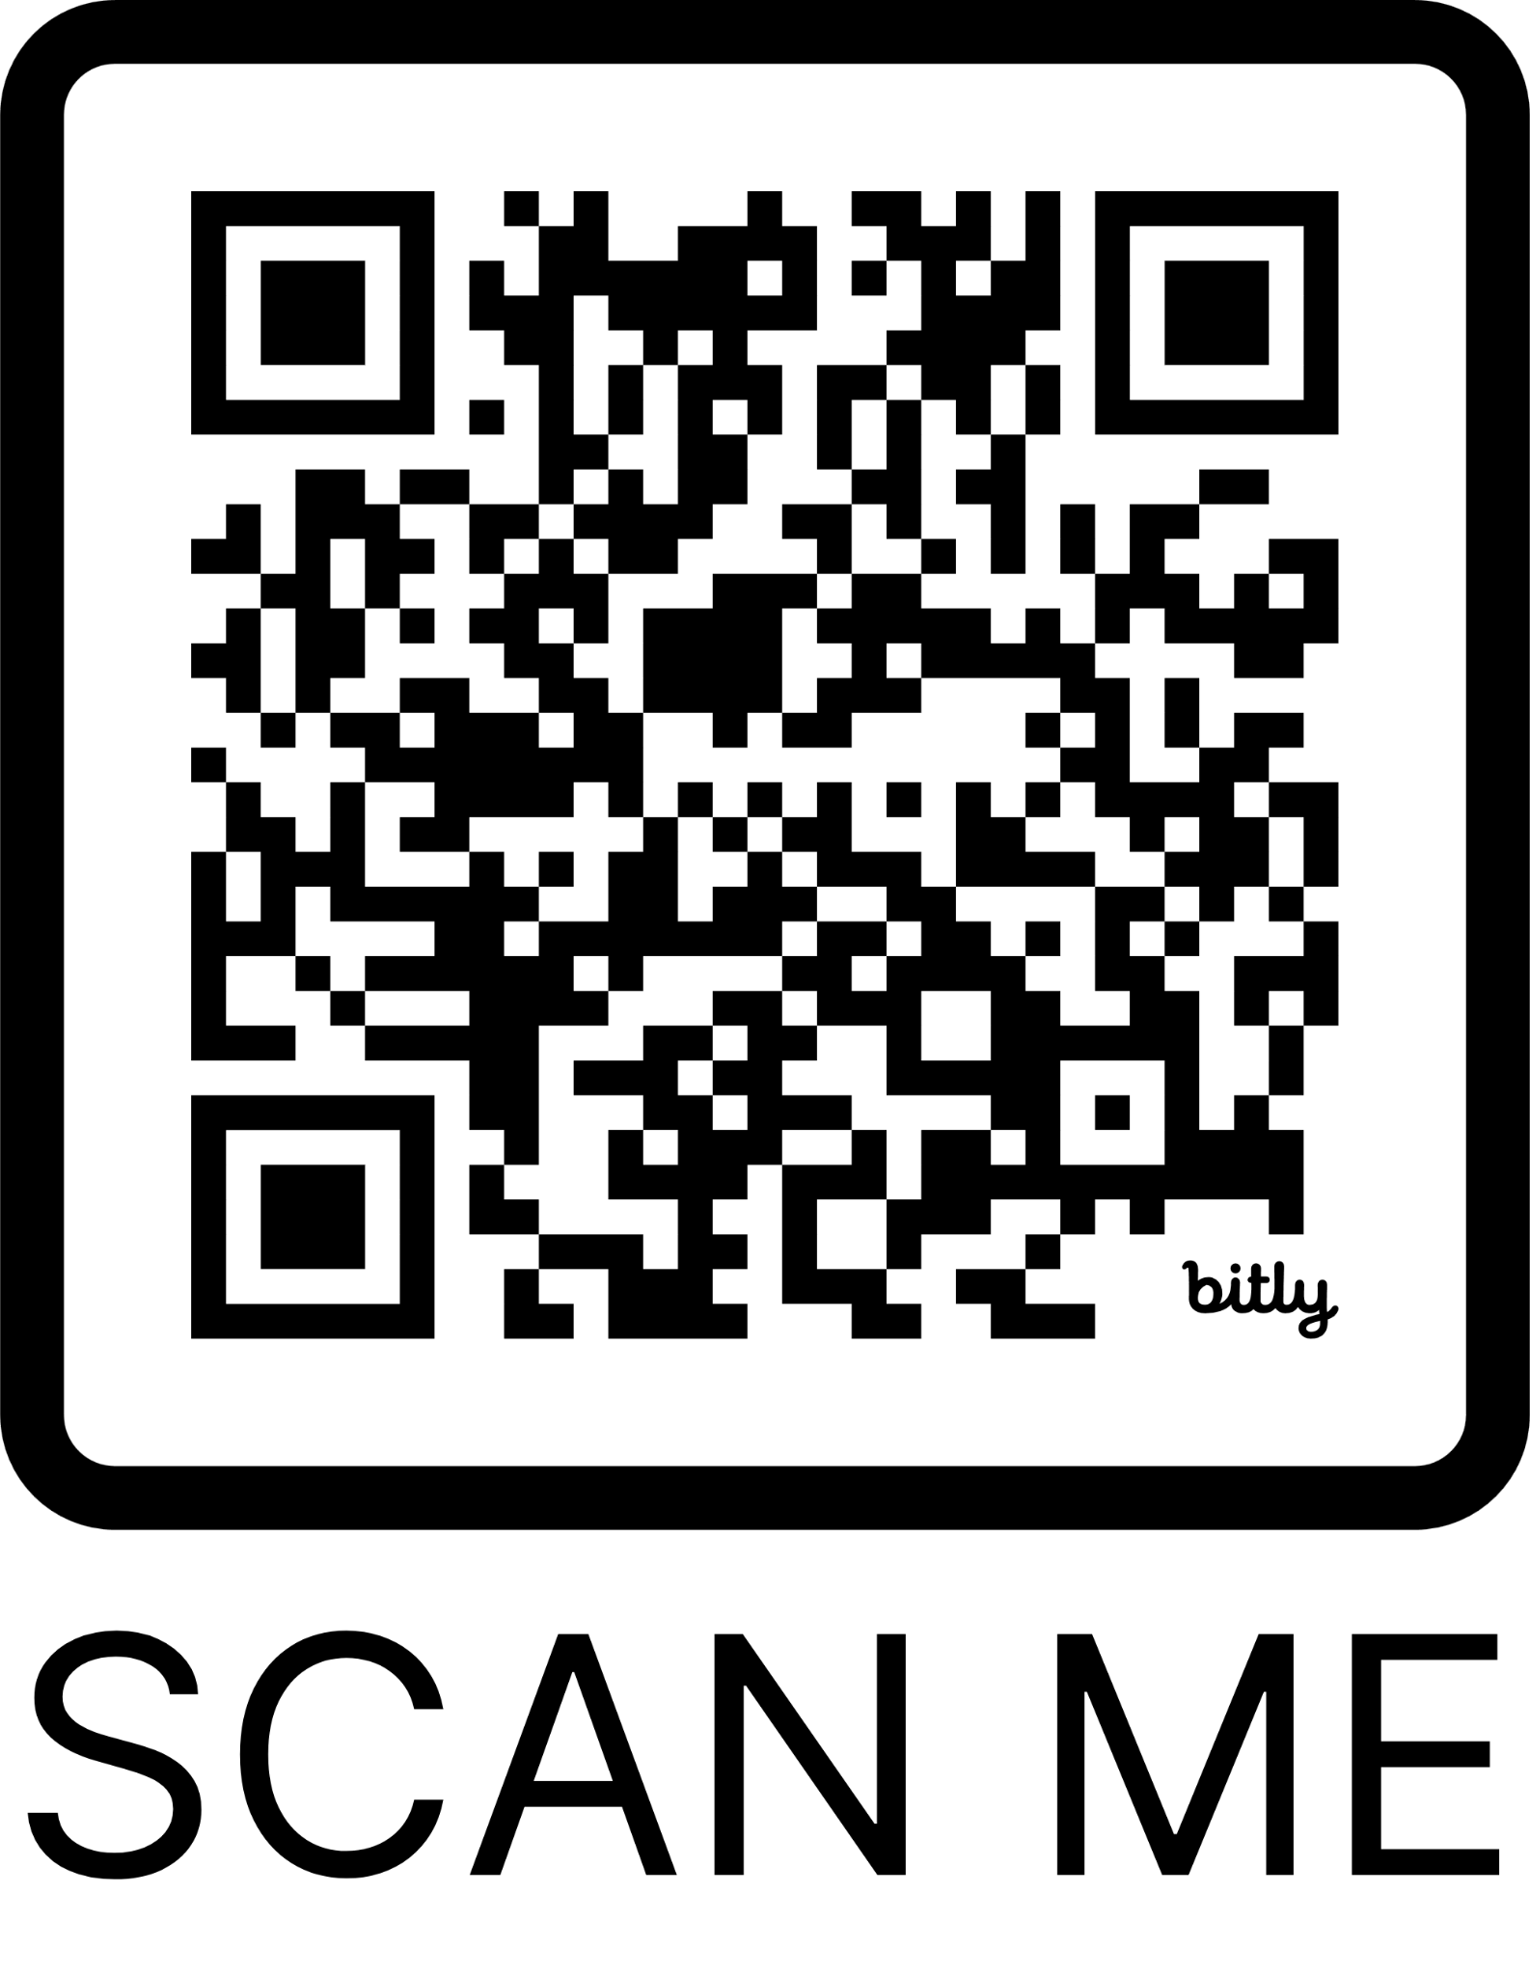


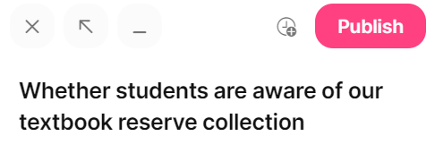
Tell us about your experience.
Answer question # 1.
To comment,
click on either Plus sign
then Publish
https://bit.ly/4oTlFIS
Notes:
Hello! As we get started here, we have some questions for you all today on a Padlet. You can pull this up now and leave it up for the duration of our presentation. We’ll paste a link to the Padlet in the chat or you can scan the QR code on the slide.
https://bit.ly/4oTlFIS
For now, we ask that you answer question #1. How do you gather student feedback on library resources and services?
To answer the question, click on either of the Plus signs that you see. There is one below each question, which is probably easiest, or you can use the one in the lower right-hand corner. Type your response, then hit Publish in order to post your answer! You can comment on others’ posts or hit a heart button to like the post.
[OPEN AND DEMONSTRATE HOW TO DO THIS]
We also want to point out that the column all the way over on the right is for questions for us.. Please ask us any questions or put ones here that you would like group input on!
----
Session abstract: A Student Library Advisory Committee (SLAC) provides an outreach and collaboration opportunity for students and library staff. Students provide input on library services, resources, and spaces, giving them a sense of belonging and ownership in the library. Staff then use that valuable input to improve the library. We’ll share the structure created for a low-stress and sustainable experience for all stakeholders and will discuss the application process, feedback questions, incentives, and assessment. Participants will hear how we used committee recommendations to improve services, resources, and marketing. We’ll also cover how students were engaged throughout their length of service.

Slide 3
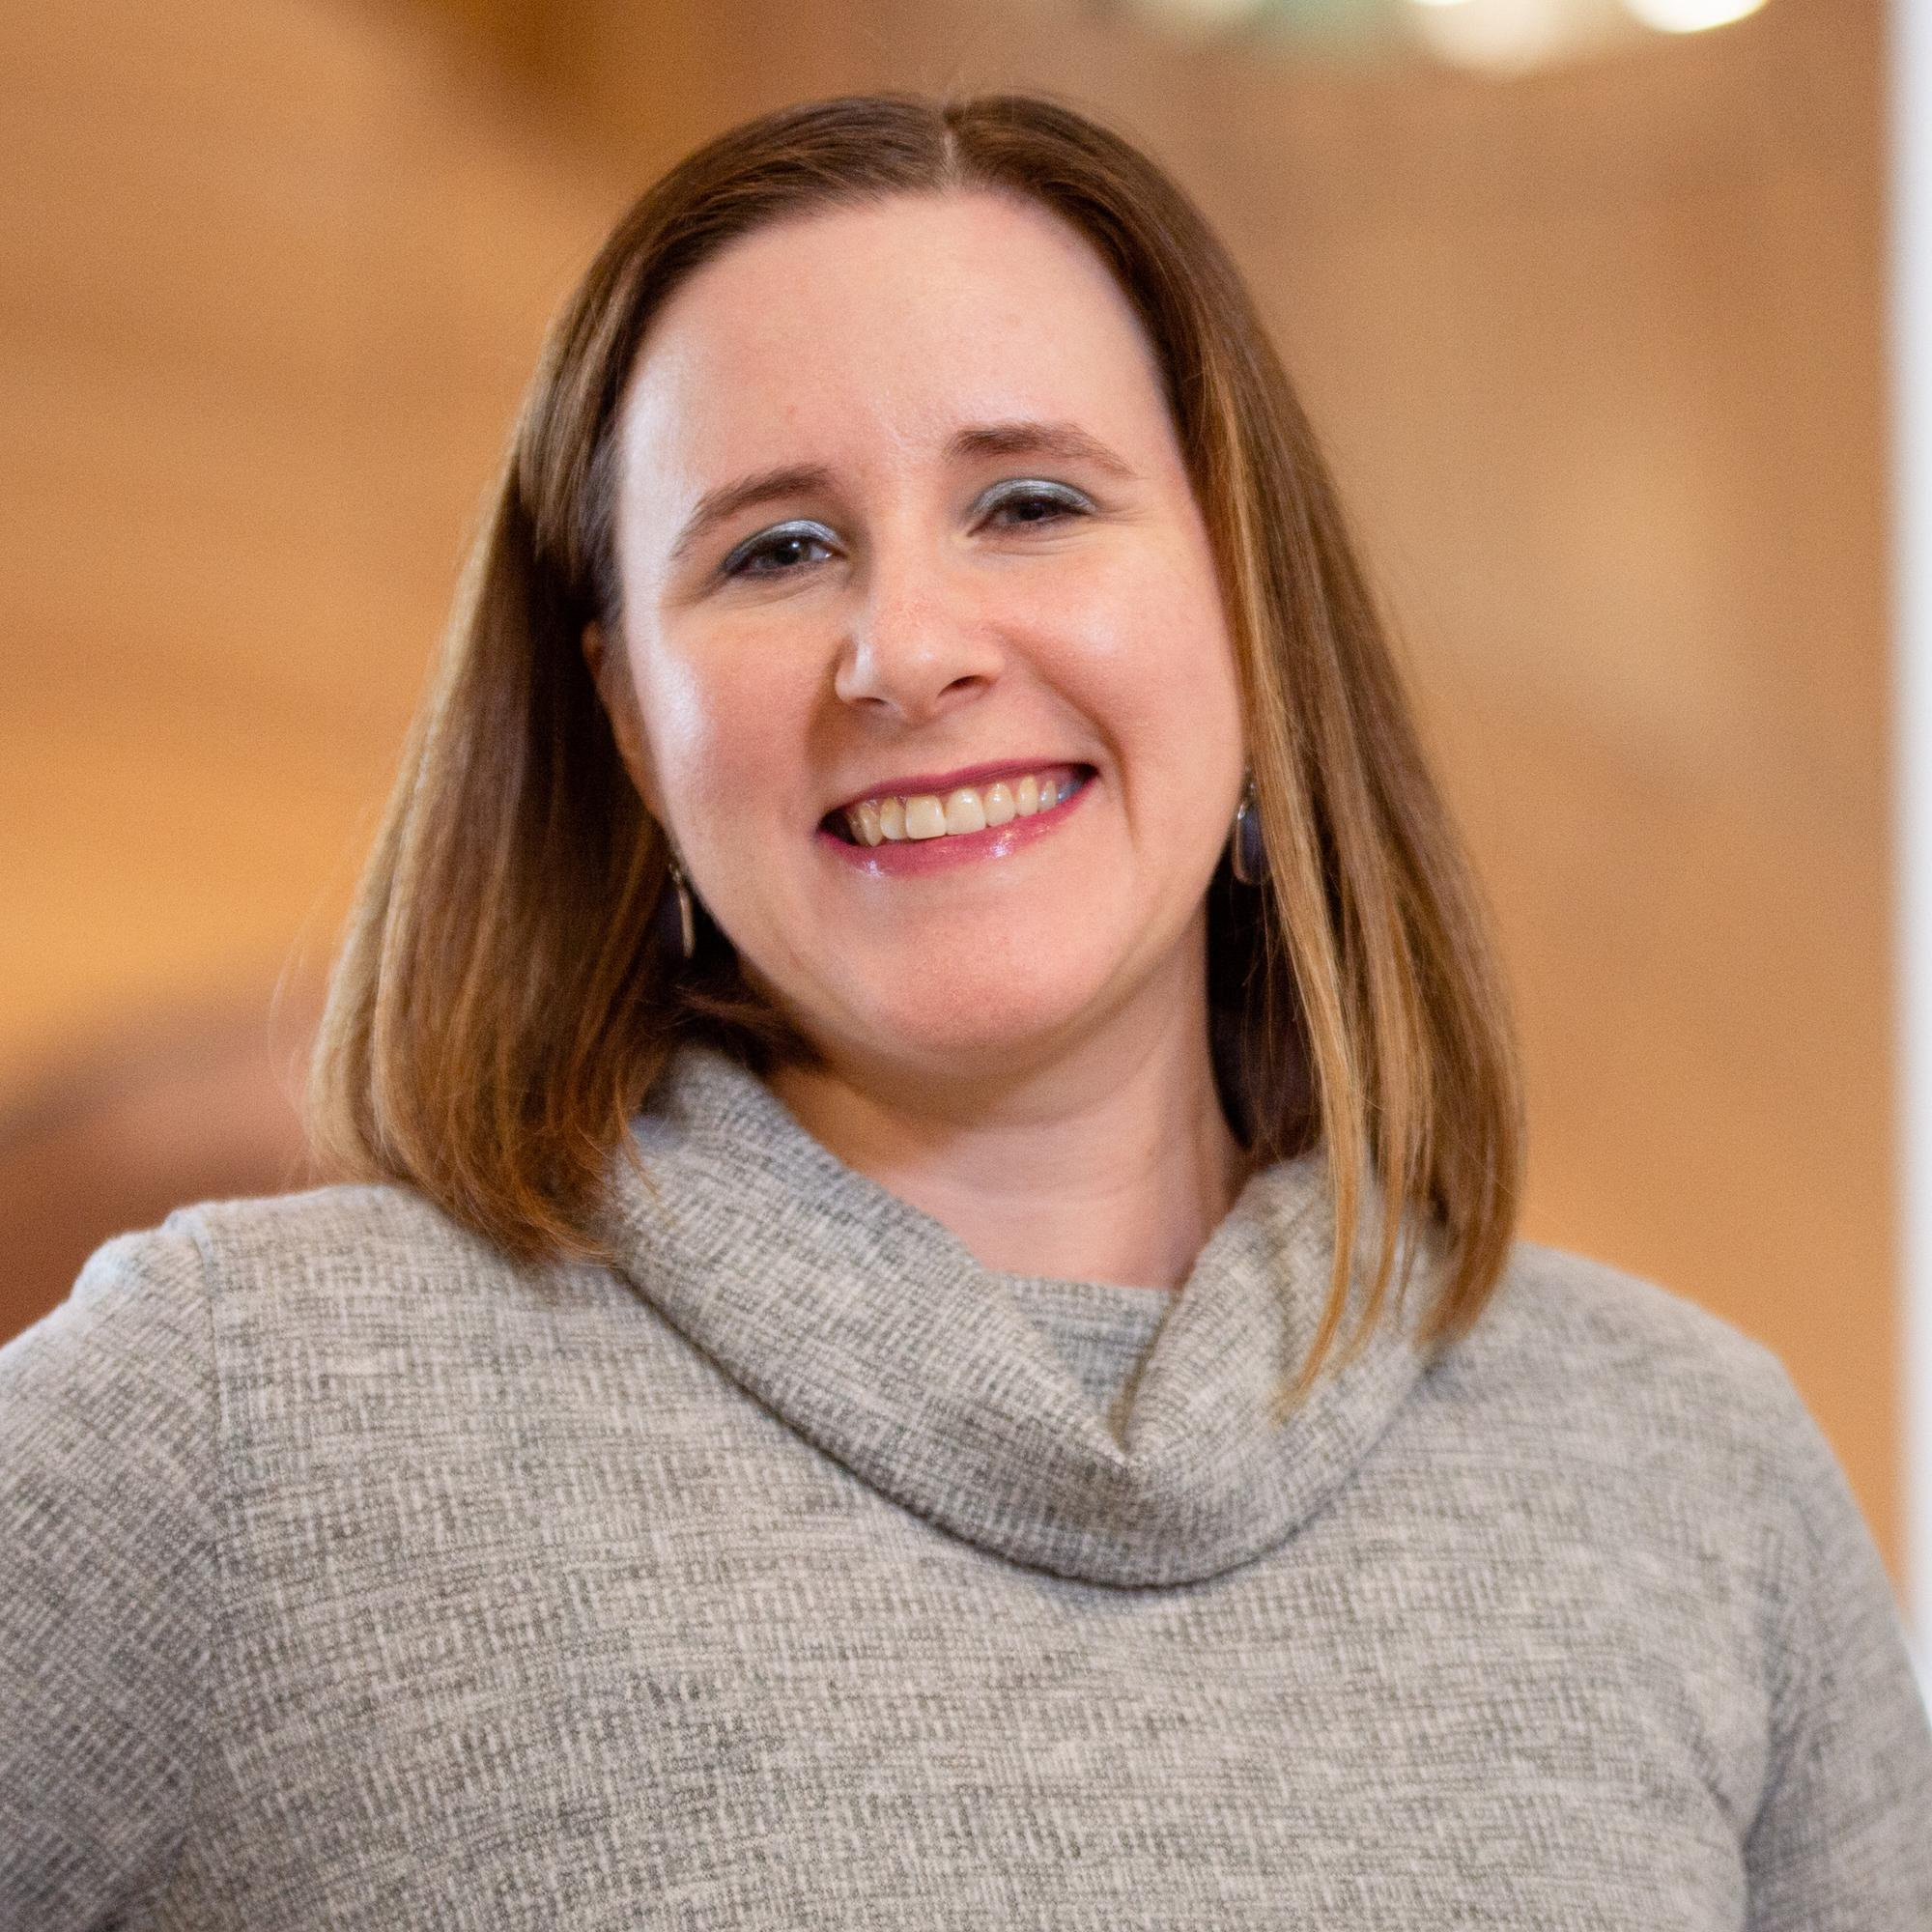
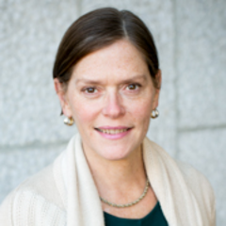
About us
Courtney Eger
Learning and Engagement Librarian
Temple University Health Sciences Libraries
Jenny Pierce
Head of Research, Education, and Outreach
Temple University Health Sciences Libraries
Notes:
Hi! I’m Courtney Eger. I’m the Learning and Engagement Librarian at Temple University’s Health Sciences Libraries in Philadelphia. Part of my job is outreach, such as special events, working on our social media, and I oversee the project that we’re presenting on today! With me today is…
Hi, I’m Jenny Pierce. I’m the head of Research, Education and Outreach at Temple. I am one of the members of the SLAC admin committee.

Slide 4
Learning outcomes
Participants will learn one model of a Student Library Advisory Committee.
Participants will understand how a Student Library Advisory Committee can engage students in library culture and give students a sense of belonging in the library community.
Participants will understand how a Student Library Advisory Committee can provide actionable feedback on library services and resources by developing their own case study questions.
Notes:
Here is what you will learn today:
Participants will learn one model of a Student Library Advisory Committee.
Participants will understand how this type of committee can engage students in library culture and give students a sense of belonging in the library community.
Participants will understand how a Student Library Advisory Committee can provide actionable feedback on library services and resources by developing their own case study questions.

Slide 5
Background
Notes:
First, a little background about Student Advisory committees and Temple University

Slide 6
Literature Review
Community-building efforts (Lindsay et al., 2016)
Strong connection to the library (Lindsay et al., 2016)
Retention and persistence rates (Thomas et al., 2021)
Graduate student participation (Couch & Hodak, 2022)
Notes:
While there is not an overabundance of literature on student library advisory committees, what we did find is that these opportunities were seen as positive experiences where students can develop a sense of belonging to the library and to the university as a whole
According to Lindsay et al., “[Student Advisory Groups] improve student and librarian experience by creating a new level of interaction and involvement for both parties. [These committees] have the potential to enrich any academic library’s community-building efforts by creating a group of library advocates and giving students a vested interest in the library.”
They also say, “At any academic library, students will appreciate the fact that the librarians care about their ideas, hopefully encouraging the students to rise to the challenge of leadership in sharing those ideas, opinions, and concerns. This, in turn, will help students feel a strong sense of connection to ‘their’ library.”
Student involvement in university organizations has been noted as a factor for retention and persistence. According to a study by Thomas et al., “Those [first semester students] who were part of a student organization were 58% less likely to leave the university compared to those not in a student organization.” Similar numbers were reported for second through fifth semester students.
In a chapter on “Engagement in Graduate Student Organizations and Programming,” authors Couch & Hodak note that graduate students are concerned about developing their potential, imposter syndrome, mattering, and marginality (p. 232) and that “Joining student organizations and participating in programs designed intentionally for graduate student audiences can help graduate students combat the loneliness and self-doubt that often leads to attrition” (p. 243).

Slide 7
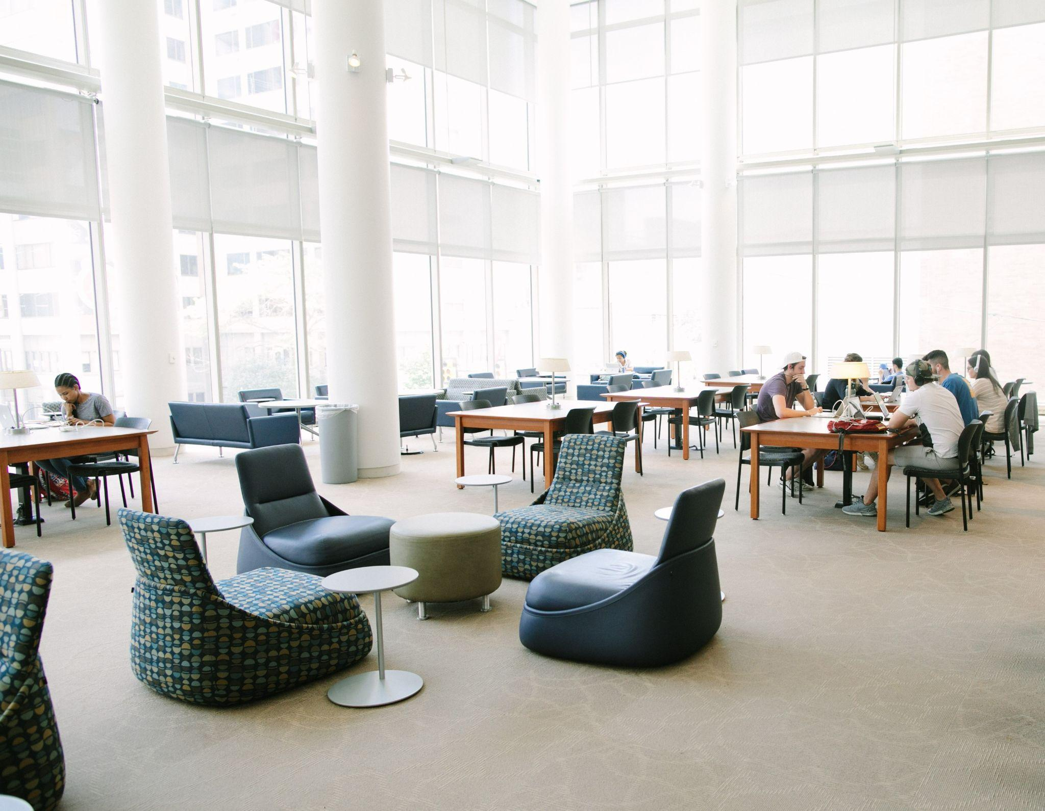
Health Sciences Libraries
School of Medicine (MDs, Physician Assistant)
School of Dentistry
School of Pharmacy
School of Podiatric Medicine
College of Public Health (nursing, rehabilitation therapies, speech language disorders, etc.)
Notes:
So we are part of Temple University which is an R1 school based in North Philadelphia, Pennsylvania, with 3 campuses in the city. Health sciences librarians are not based at the main campus library. Instead we work at the Ginsburg Health Sciences Library on the Health Sciences Center Campus and the Krausz Podiatry Library on the School of Podiatric Medicine campus. Health science librarians also support programs in the newly named Barnett College of Public Health on the main campus.
In total, we support nearly 6,000 students. Most of the students we serve are graduate students who do not live on campus. There are unique challenges for these professional students, who are juggling intensive study, high-stakes exams, and clinical opportunities.

Slide 8
History of Committee
Notes:
This was not the first time the Health Sciences Libraries had a student advisory committee.

Slide 9

Original
committee
Photo credit https://www.pexels.com
/photo/white-wooden-table-with-chairs-set-416320/
Notes:
The original Student Advisory committee grew out of a Library Advisory board made up of faculty from the schools we serve and a single student representative. The student was always from the school of medicine. The director of the libraries wanted more student involvement. She charged library staff to create a committee to represent all of the schools and programs served.
Students were nominated by the Student Affairs Offices from their respective schools and met once a semester at the Health Sciences Center (HSC) campus. Travel to the campus was always a problem for students at the podiatry campus. At the time all the others schools and programs were on the HSC campus.
Early years went well, but getting nominations became a problem. Student affairs offices were less responsive. Changes in curriculum led to differing student lunch hours which made scheduling difficult. Programs originally at the Health Science Center Campus moved to the main campus with the creation of the College of Public Health. All of this led to drop in onsite meeting attendance. As time went on there was a lack of engagement on the part of the committee members.
This previous Student Advisory Board ended in 2018 due to lack of interest on the part of the students as well as staff changes at the libraries.

Slide 10
Restarting the Committee
Notes:
The library director began discussions about restarting the committee in early 2021. Staff were tasked with creating a new student advisory group and I took on the project, along with the Head of the Podiatry Library at the time, Natalie Tagge, who has since moved on to a different institution.
One of the driving forces for restarting the committee was the impact of the pandemic on student engagement. We wanted to redesign it to be a new, more flexible, and sustainable student advisory group.

Slide 11
Student Library Advisory Committee (SLAC)
Revision goals
Increase and hold student engagement
Maximize staff efficiency
Notes:
The revision of the Student Library Advisory Committee -- or the SLAC, as we call it -- had two main goals.
First, to increase and hold student engagement. We wanted to make sure that students found the group beneficial and did not stop participating. Having students invested in contributing to the library’s improvement helps to increase their sense of belonging in our space.
Secondly, Health Sciences Libraries staff have many roles so we wanted to maximize staff efficiency.
Both of these revision goals help make SLAC sustainable and avoid student and staff burnout.

Slide 12
What We Did
Notes:
Next we’ll talk about what we did to redesign the committee to accomplish our goals.

Slide 13
Committee charge
The Temple Health Sciences Libraries Student Advisory Committee is a leadership opportunity open to Temple University health sciences professional, graduate and undergraduate students currently enrolled in the Lewis Katz School of Medicine, Maurice H. Kornberg School of Dentistry, School of Pharmacy, College of Public Health, and School of Podiatric Medicine. Student advisory committee members provide regular input and guidance on library services, policies, collections, spaces, programming, and technology. We expect that students will communicate information about Library services and resources back to their peers.
Notes:
The prior iteration of the Student Advisory Committee had no charge. We wanted to create a clear one that stated the scope of membership and explained the purpose of the committee and the responsibilities of the students taking part in this leadership opportunity. This would allow us to be transparent to students and ourselves about the committee.
We call this a student leadership opportunity and specifically name the schools that have a seat at the table. The students are expected to provide regular input and guidance on library services, policies, collections, spaces, programming and technology. We ask students to communicate information back to their peers.

Slide 14
The rules: Maximize flexibility
Length of term
Two meetings/year
Monthly asynchronous feedback
Create a safe environment
Notes:
Here’s how we set our rules in order to maximize flexibility.
Students serve a one-year term from fall to spring, and may opt to remain on the committee for the following academic year, meaning there is a 2-year limit. We recently changed this rule as some students were ready and willing to serve for a third year. Term limits keep the insights fresh, especially if we end up repeating topics or questions. We also want to give other students an opportunity to serve.
The committee meets two times per academic year, once in the fall semester and once in the spring. More on this soon.
Committee members are asked to provide monthly asynchronous feedback via Canvas. This is our big engagement in the months that we do not have a meeting. We typically meet in October and March. We ask for online feedback in November, December, January, February, and April. We end in April because some programs are finished that month.
Finally we wanted to create a safe environment. At the beginning of the year, we send students a short survey that asks what they prefer to be called, what their pronouns are, and anything else they want us to know.

Slide 15
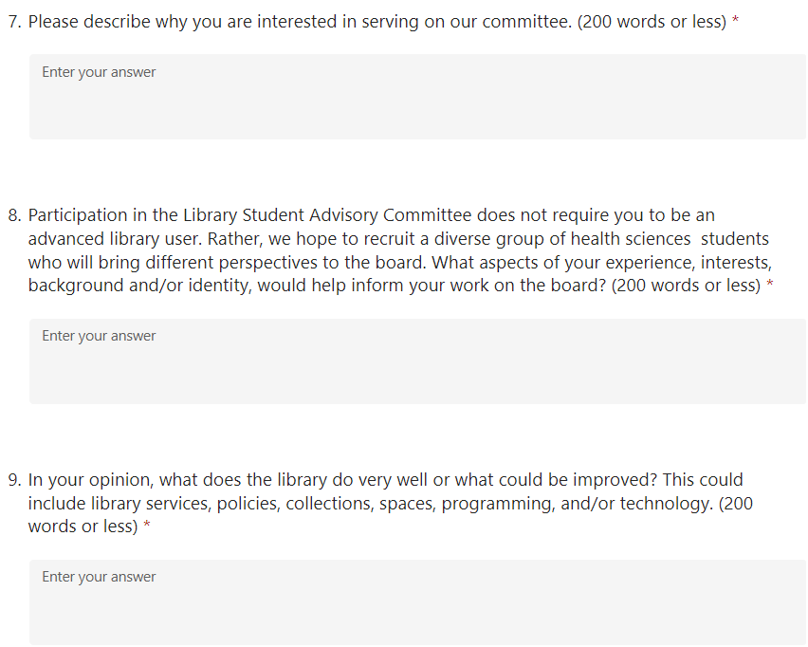
Created an application process
Notes:
Students must apply. In the past iteration of the committee students were appointed. We use a short online application that asks for standard information (contact info, the school and program the student is in, their graduation year) and 3 free response questions:
First, Please describe why you are interested in serving on our committee.
Then, Participation in the Library Student Advisory Committee does not require you to be an advanced library user. Rather, we hope to recruit a diverse group of health sciences students who will bring different perspectives to the board. What aspects of your experience, interests, background and/or identity, would help inform your work on the board?
Finally, In your opinion, what does the library do very well or what could be improved? This could include library services, policies, collections, spaces, programming, and/or technology.
As we usually receive more applications than we can accept, this question tends to give library staff a lot of feedback to reflect on.

Slide 16
Application numbers
2024-25
17 applications
2025-26
26 applications
2021-22
16 applications
2022-23
29 applications
2023-24
34 applications
Notes:
Interest in the SLAC varies every year. You can see a couple of lower interest years, at the very top. This past year, we had 26 applications, and our all-time high was 34 applications.

Slide 17
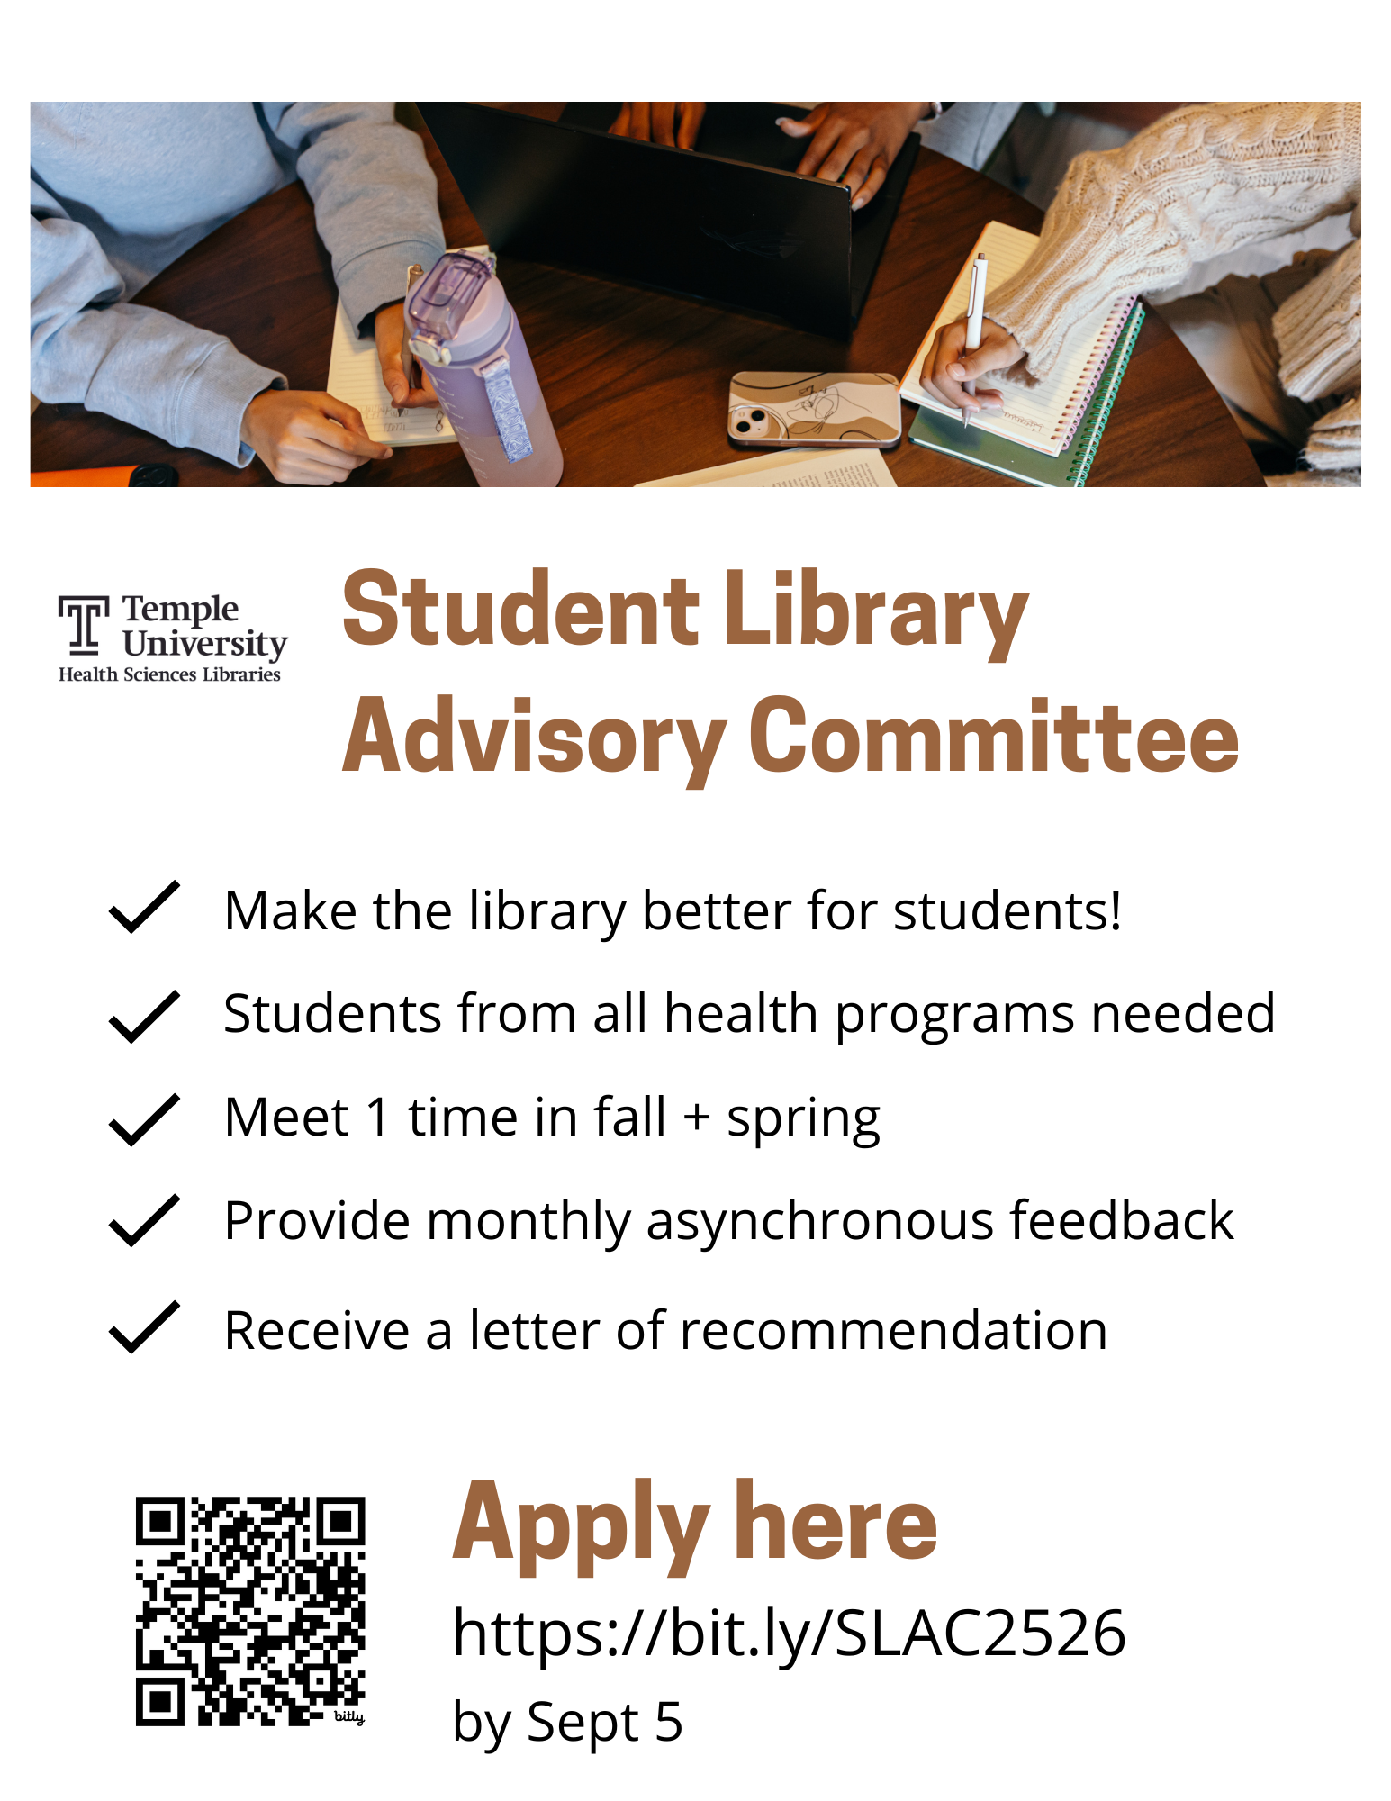
Created a marketing campaign
Notes:
I create a lot of marketing materials and we advertise broadly. This is a recent advertisement, and you can see that we explicitly say we want students to make the library better for students!
The marketing channels we advertise in include orientations, which are a great way to reach new, enthusiastic students, our monthly newsletter, social media (tagging the schools so they repost to their accounts), digital signs (including in buildings beyond the libraries), sending emails to school contacts to forward to their students, and sharing to liaison librarians so they can communicate to their faculty.

Slide 18
Student membership
2021-22
8 students
2022-23
12 students
2023-24
13 students
2024-25
12 students
2025-26
11 students
Notes:
We decided after our first year that we would allow the committee membership numbers to be fluid. We of course want to strike a balance that is manageable on our part as administrators. But we also want to be inclusive with as many students as possible.
In our first year, we did not receive any applications out of the College of Public Health, so our committee was only 8 students: two each from the dentistry, medicine, pharmacy, and podiatry programs. This is not shocking because most of the public health classes are held on the main campus near the main library.
In our second year, we were able to add 2 students from Public Health, including one who was mainly at the main campus. We gave 4 slots to the school of medicine since they are our biggest audience and there are multiple programs in the school.
I should mention that despite this new structure, the student affairs director at the Dentistry school still prefers to nominate a specific dentistry student. We ask them to complete an application, and if there are other interested dentistry students, we consider them as well.
You can see we typically hold steady around 11-13 students. One year, we had a student whom we did not accept make several pleas to join the committee. We figured that we could use their passion so we accepted them onto the committee.

Slide 19
Meetings
Twice a year
Format
Structure
Bring information to their peers
Notes:
As we said earlier, we hold meetings twice a year, once in October, which kicks off our committee work, and once in March, during the only week that none of the programs are on spring break (as this is widely spread from February to April).
We currently run these meetings online via Zoom. While we have tried, we have yet to have a successful in-person or hybrid meeting, even with the offer of a free lunch! Most folks still want to meet on Zoom which is understandable since some students are at the podiatry campus, others at main campus, and some may be away on rotations.
Surprisingly, students have said consistently in evaluations that they wish we met more often! We’re unsure how to best balance this, as we created the committee to be a low time commitment.
Our meetings are a mixture of icebreakers, library updates, and feedback questions that admins create ahead of time.
We always encourage students to bring information they hear at these meetings back to their peers - as they know the best way to reach fellow students. While we haven’t presented any formal requirements or requested that students report back to us, we do believe our members share with their peers.

Slide 20
Virtual feedback questions
For the months when we don’t hold a meeting
Posted in a Canvas discussion board
Presented as cases
Planning questions
Notes:
As mentioned earlier, the students’ main responsibility to the committee is to answer monthly feedback questions. These are asked in person and online during the months we don’t hold an in person meeting. Admins post the online questions on Canvas, our learning management system, at the beginning of the month.
The first year, admins didn’t make it a priority to respond to student answers. We just tracked their answers in a Word document. In subsequent years, we have made an effort to respond to every student answer. This helps build community and is a way that we can ask follow-up questions. Sometimes students talk to each other through Canvas, but this doesn’t happen very often. We are trying to encourage them to interact more, as this is why students are excited to join the committee -- they get to meet students from other programs.
We try to write these questions as cases to encourage students’ creative problem solving, which gives a sense of ownership and belonging.
We are very thoughtful about what questions we ask and whether the question is best for an in-person meeting or for online asynchronous feedback. The admin committee initially created a bank of questions so that we didn’t have to come up with a question at the last minute. We’ve since used up all of the questions! Now we tend to develop questions on a monthly basis. We have asked other library staff members to contribute questions or topics but that hasn’t worked out.

Slide 21
Tell us about your experience.
Answer question # 2.
To comment,
click on either Plus sign
then publish
https://bit.ly/4oTlFIS
Notes:
Going back to the Padlet, now we have a question about the kind of feedback you are seeking.
What topic would you love to hear the student perspective on? Please answer question # 2.
------
https://bit.ly/4oTlFIS
To answer the question, click on either of the Plus signs that you see. There is one below each question or you can use the one in the lower right-hand corner. Type your response, then hit Publish in order to post your answer! You can comment on others’ posts or hit a heart button to like the post.

Slide 22
Question categories
Services
Collections
Spaces
Programming / events
Technology
Notes:
Our questions tend to fall into the categories that are listed on our charge: library services, collection, spaces, programming and events, and technology.
We frame each feedback question out with context and background so what we ask can have more detail.
Let’s look at some examples.

Slide 23
Example questions - 1
Fall 2023 meeting question: Pre-COVID, we had a robust student event schedule that included events like therapy dogs, cupcakes and crafts, board game afternoons, jigsaw puzzle speed contests, and more. Post-COVID, some of these events are no longer possible. We also have to be cautious of budget and staff time.
What factors influence you in attending events?
What are the barriers to you attending events?
What is the best day and time for events?
If you attend events hosted by other organizations/groups, why? What attracted you to those events?
What kind of events would you want to see at the Health Sciences Libraries?
Notes:
In fall 2023, we presented this case during a meeting:
Pre-COVID, we had a robust student event schedule that included events like therapy dogs, cupcakes and crafts, board game afternoons, jigsaw puzzle speed contests, and more. Post-COVID, some of these events are no longer possible. We also have to be cautious of budget and staff time.
Questions we asked included: What factors influence you in attending events? What are the barriers to you attending events? What is the best day and time for events? If you attend events hosted by other organizations/groups, why? What attracted you to those events? What kind of events would you want to see at the Health Sciences Libraries?
We chose to ask questions like these in a meeting because it was interesting to have students interact around the question. We also can facilitate by asking each of the questions separately, adding follow up questions if needed and giving clarification. For example, if the students wonder why some of these events are no longer possible or want to know more about the events we used to offer.

Slide 24
Example questions – 2
January 2024 asynchronous question
When the library holds an event or participates in a school event, we occasionally hand out library "swag" (giveaways) to our students. We want this swag to be useful and to remind students about the library! Do you have ideas for swag? We have previously given out tote bags, pens, retractable ID holders, notebooks, and bottle openers.
Notes:
This is an example of a question we asked asynchronously via Canvas in January 2024:
When the library holds an event or participates in a school event, we occasionally hand out library "swag" to our students. We want this swag to be useful and to remind students about the library! Do you have ideas for swag? We have previously given out tote bags, pens, retractable ID holders, notebooks, and bottle openers.
This case doesn’t have a lot of follow up questions like the previous slide. It is straightforward and we didn’t feel that asking the question in-person was necessary for us to get good information.
Even though this case isn’t as detailed as the previous one, you’ll notice we still provide context and background information.

Slide 25
Example questions - 3
April 2023 asynchronous question
Does the page order make sense to you? If not, why?
What parts of the guide do you find most useful?
After viewing the guide, what other publishing questions do you have?
Notes:
Another asynchronous question asked students for feedback on a new publishing support guide. This was an example of a time that we asked a question because a library working group wanted student feedback to complete a project to create a new LibGuide.
We sent students a link to a research guide on scholarly publishing and asked them:
Does the page order make sense to you? If not, why?
What parts of the guide do you find most useful?
After viewing the guide, what other publishing questions do you have?
Students gave us thoughtful feedback and the working group made changes to the guide based on their input, specifically they added a flow chart of the publishing process at a SLAC members suggestion.

Slide 26
Example questions - 4
April 2025 asynchronous question
Library staff have been working to increase library material purchases by and about under-represented groups. To support this work, we formed a DEI (Diversity, Equity and Inclusion) Collections Committee. Recent projects include:
Purchasing award-winning books related to diverse identities and labeling them in our library catalog as Award Winners Honoring Diverse Experiences (view the full collection)
Supporting a local, independent, Black-owned bookstore (Uncle Bobbie's) with quarterly purchases
Assessing targeted portions of the collection to better understand how well they represent specific groups of people.
Surveying librarians about their strategies for selecting and purchasing diverse material and compiling these strategies into a guide
You can find more details on the attached slidedeck. We are looking for student input for our next steps.
Notes:
Library staff don’t always get it right. Sometimes we ask the wrong questions. The case on this screen went sideways.
Another library working group -- the DEI Collections Committee -- was seeking student feedback on library purchases for books relating to diverse identities. They gave the students some background which you can see on the screen. The students were also sent a very detailed slidedeck.
The committee asked these questions to the SLAC:
How can library collections help students feel more welcome at Temple?
Have you had any experiences with the Libraries that helped you feel welcome?
The committee was looking for project ideas. Instead the answers for the first question felt like students just rephrased the bullet points to reinforce the collection development work already being done.
The second question was too general. Students replied that they felt welcomed by staff, which isn’t a bad answer by any means! It just didn’t provide any new insights. Or the insights were off, like, “offering food, like having a plate of cookies will always bring in more students and welcome them to the library.”
It wasn’t a total bust. There was one action item that made sense, which was a suggestion to have more library displays highlighting underrepresented groups, but this example makes it clear that crafting a question to get the answer you want is complicated.

Slide 27
Tell us about your experience.
Answer question # 3.
To comment,
click on either Plus sign
then publish
https://bit.ly/4oTlFIS
Notes:
Now that you saw some examples of how we formatted questions, thinking about what you answered for question two on the Padlet, how would you structure your topic into a case and a question? Go ahead and answer question #3.
To answer the question, click on either of the Plus signs that you see. There is one below each question or you can use the one in the lower right-hand corner. Type your response, then hit Publish in order to post your answer! You can comment on others’ posts or hit a heart button to like the post.
https://bit.ly/4oTlFIS

Slide 28
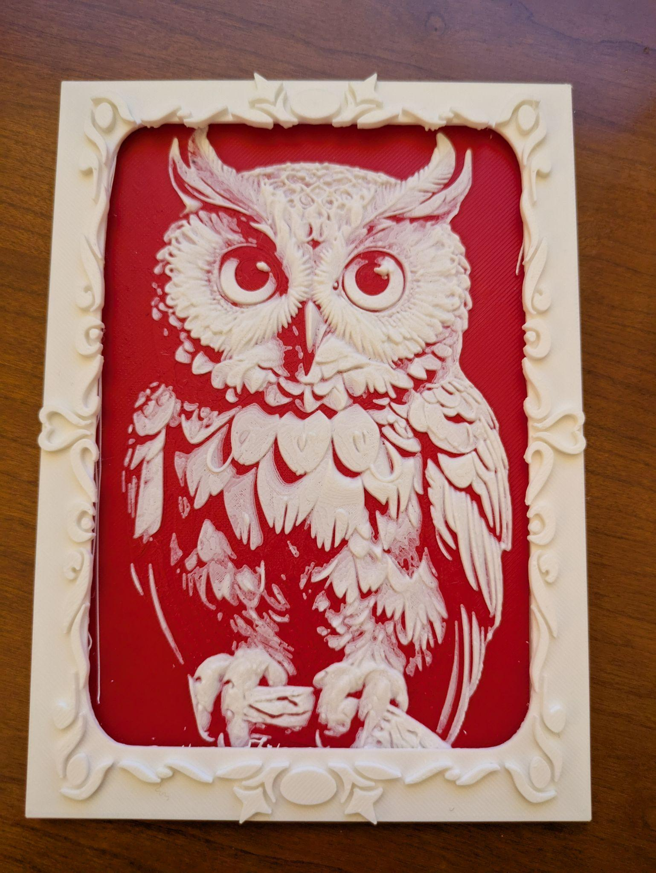
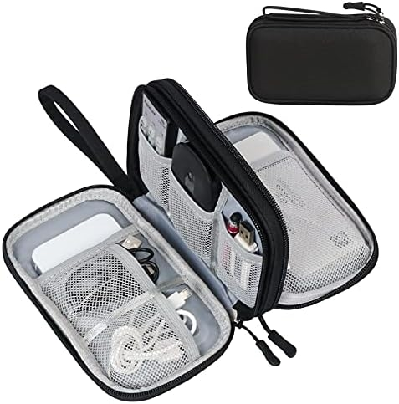
Incentives
Photo credits
Left: Amazon. Right: Nick Perilli, Innovation Librarian
Notes:
In terms of incentives for our student members, we focus on ones that are useful for students and aren’t time consuming or expensive for the library.
Initially, we gave out swag bags at the two yearly in-person meetings. These bags contained library giveaway items like pens or ID badge holders, as well as snacks, and fun items made in our Innovation Space. We discontinued this practice in fall 2023 because of the difficulty of students picking them up in a timely manner (as not everyone was present for the meeting). There were issues with mailing these items or distributing through the other campus libraries.
For a couple of years, we purchased an end of service gift, distributed at the end of the academic year. Library staff selected two possible gifts through Amazon and had the students themselves vote on which they preferred. The item with the most votes was gifted to all the students. We love that students could determine which gift was most useful. One year they selected a charging hub. Another year was a lunch bag and another was a travel cord/wire organizer, pictured on the left side of the screen.
In recent years, to save money, we have switched to gifting students an owl print - as the Temple mascot is an owl - that was 3D printed in our Innovation Space. This is pictured on the right side of the slide. We like that this is a unique gift tied to university pride.

Slide 29
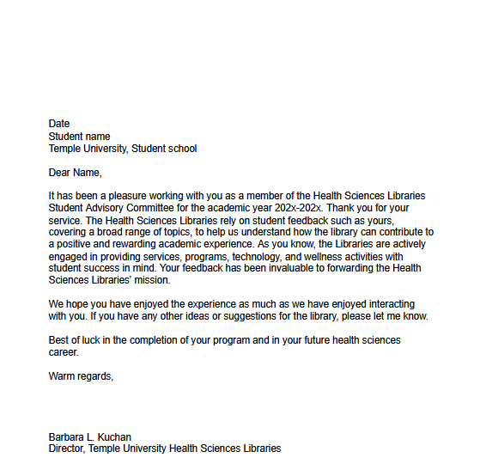
Letter of service
Notes:
Finally, the biggest incentive, which we advertise when we accept student applications, is a letter of service signed by the library director. The letter is valuable to students because they can add to their portfolio. Portfolios are particularly important to this student population. We provide a printed signed letter and an electronic PDF.
It should be noted that if students do not complete all of our work - meaning, answering all feedback questions throughout the year - they do not receive this letter. This has only happened once in the run of the SLAC. A student ghosted us about halfway through the year. She didn’t answer our repeated email inquiries, and we asked the student affairs coordinator in her school to check in with her, but still no response.

Slide 30
Tell us about your experience.
Answer question # 4.
To comment,
click on either Plus sign
then publish
https://bit.ly/4oTlFIS
Notes:
We told you about the incentives that worked -- and didn’t work -- for us. Now we ask you to answer question # 4 on the Padlet and think about what incentives you could offer. Is it money, is it credit, is it an object you buy or an object you create?
https://bit.ly/4oTlFIS

Slide 31
Evaluation and Feedback
Notes:
How do we evaluate the work that both students and library staff do for this committee?
And what kind of feedback do the students give us by answering our monthly questions?

Slide 32
Actionable items
Virtual reality for Podiatry Library
Advertise in building bathroom stalls
Meeting room redesign
Short workshops advertising resources specific to a school/discipline
Whiteboard question prompts
Self-directed (passive) programming led to Relaxation Stations
Poster art gallery contest themes
Notes:
Library staff review the students’ monthly student feedback, which we compile in one document for the year. We also have a document that lists all questions asked since the committee began as this helps us know what has been asked and what could be asked. When looking at that monthly feedback, staff identify actionable items, meaning feedback that we could realistically take action on. Some of the suggestions are easy and can be implemented immediately. Others may need more time, money, or departments to be involved so it may take us longer to act on.
Here is a sample of some student feedback that we took action on:
We purchased a VR headset for our smaller Podiatry Library
There were multiple suggestions to advertise library events in bathroom stalls -- we started doing this and continue to post Stall Talks that have proven a slight increase in workshop and event attendance
Students gave input on a meeting room redesign that was completed
A suggestion of holding workshops on discipline-specific resources led to 5 new workshops
We post monthly fun questions on a whiteboard for students to answer. We had our members generate a great list of whiteboard prompts for future boards.
Students responded to questions about self-directed (sometimes called passive) programming activities like coloring, puzzles, board games, etc. which led to simple Relaxation Stations being created in both libraries
We asked students for theme ideas for our poster art gallery contest that we hold every semester (where students can submit photos that will be displayed in the library)

Slide 33
Student feedback
April 2024 student feedback:
In the future, I would love to see we incorporate leadership and project management roles into the committee. This could also work if we have subcommittees, that focus on different aspects of library resources, such as technology, outreach. This would add-on to the committees, rather than take away, where we still have space to share our thoughts on the general feedback, while also having a dedicated project/sub-committee for the year. This could include working together as a team, led by library staff, to organizing workshops or guest lectures, or making informational flyers and engagement programs.
Notes:
Now, sometimes there is student feedback that you don’t expect. This is a response to our end-of-year question about what we could change in future iterations of this committee. The student who answered this was at the end of her service to us, and she has repeatedly expressed her desire to do more work for the library. I mean…this is great! We appreciate her enthusiasm so much!!
Realistically, our response to her was, we purposefully designed this committee so that work was low effort for the students. If we added in subcommittee work or leadership responsibilities, that would move this committee in a completely new direction.
As the staff member who bridges the space between protecting the students’ time and energy, and answering to library administration…I personally wouldn’t want students to do more work without compensation. Again, this would move things in a different direction and I don’t think we have the budget for that.
However, as we saw this feedback come through in consecutive years, we decided to offer low commitment projects this year, if students are interested. It’s not a requirement. Students expressed interest in giving suggestions for leisure reading or jigsaw puzzles that we can purchase for the library collection. We’re going to create a form where students can submit their suggestions.

Slide 34
Assessment strategies
STUDENTS
STAFF
End of year feedback question
End of year anonymous survey / evaluation form
Annual reflective meetings
Tracking actionable items
Notes:
We assess the work on this committee in different ways.
For students, We always ask this end-of-year feedback question: “Now that you have served on this committee for close to a year, how could we make this experience better for future students on the committee?”
We also send a survey that students answer anonymously about their experience on the committee. Questions we ask include, how would you rate your experience serving on this committee, what were your expectations for serving and were they met, was Canvas a useful space, how often should the group meet and in what modality, and do you have suggestions for how to improve this committee?
Library staff and the library director reflect on our experience with running the committee as well. We have annual meetings where we discuss what worked and what we want to do differently.
We mentioned identifying actionable items already. We keep notes on how we addressed these items.

Slide 35
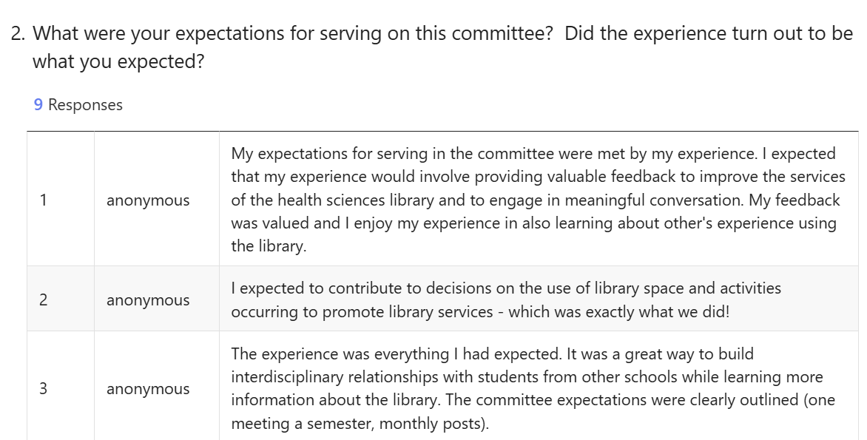
Student survey
Notes:
Student survey responses show that students find their time on the committee to be valuable. This year, there was an average satisfaction rating of 9.11 out of 10. The free response question that gets the most interaction is this one that asks what their expectations were for the committee?
Some of their responses are on the screen -- students felt their feedback was valued, it was everything they expected, and it was great to build interdisciplinary relationships.

Slide 36
Ownership of the library
“I also notice that library leadership also takes my feedback to actively implement new features to the library.”
“However the small pieces we provided actually turned into something I would find implemented in the library. I loved it!”
“Seeing the relaxation stations and various activities be made available for students and watching people explore their resources and take advantage of them has been wonderful.”
“I enjoyed serving as part of the interdisciplinary team and communicating and advocating the needs of pharmacy students at TUSP when it comes to the common setting shared by all- The Health Sciences Library.”
“It is enough of a role to feel you are making changes for future students, but it does not interfere with our studies, which are top priority for most.”
Notes:
We wanted the student advisory group to have a sense of ownership of the library, which would increase their feeling of belonging. Over the course of the years we have seen that through their discussion and comments.
Here are quotes taken from various points - some from end of year surveys and some from feedback questions that we ask at the end of the year. I’ll highlight a couple of responses:
“I also notice that library leadership also takes my feedback to actively implement new features to the library.”
“However the small pieces we provided actually turned into something I would find implemented in the library. I loved it!”
“Seeing the relaxation stations and various activities be made available for students and watching people explore their resources and take advantage of them has been wonderful.”
“I enjoyed serving as part of the interdisciplinary team and communicating and advocating the needs of pharmacy students at TUSP when it comes to the common setting shared by all- The Health Sciences Library.”
“It is enough of a role to feel you are making changes for future students, but it does not interfere with our studies, which are top priority for most.”

Slide 37
Informal assessment
Belonging mattered (student have asked to return)
Student did the work
Expanding membership
The library cares
Notes:
Some informal ways that we can say this is working:
The feeling of belonging came through the students’ work on this committee - Students have asked to return…so much so that we had to install those term limit restrictions.
Students did the work! They answered our feedback questions and they attended meetings. If they couldn’t attend, they responded via email.
We were able to expand membership into more programs. We were able to take on more students in each program, too.
By marketing this committee to all of the schools, student should feel more aware of library services and feel that the library cares about what they think.

Slide 38
Future Directions
Notes:
Let’s finish with our plans going forward. We have mentioned some of these throughout the session and wanted to highlight them here:
Students are requesting more involvement with the SLAC, which led us to offer special (optional) projects - more to come on whether the reading and puzzle suggestions are successful this year!
On this year’s application, we included a question about their free time during the week, to get a sense of availability. This helped plan our fall meeting and we will keep this on future applications.
Students have asked for more time together - we may pick a set day/time every month (or every other month) as an optional space for students to meet but this also feels tough to plan as students often say they want to meet but get too busy.
We will consider a welcome session prior to the fall meeting but again, this gets tricky to schedule.
We are trying to encourage more discussion board conversation amongst students as they answer feedback questions.
After multiple years of students suggesting a book club, we are piloting a book recommendation project where library staff will compile student suggestions into a zine. We asked this year’s team of students to contribute book suggestions for this project.

Slide 39
Thanks to our partners
Natalie Tagge
Former Head, Podiatry Library, Temple
Sarah Bauman
Current Head, Podiatry Library, Temple
Notes:
Before we finish we was to shout out both the former and current heads of Podiatry, who were/are involved as admins in this work.

Slide 40
Thank you!
Courtney Eger
courtney.eger@temple.edu
Jenny Pierce
jenny.pierce@temple.edu
Notes:
Thank you for having us here today! Are there any questions we can answer? [check that Padlet to see if there are any questions in the final column.] Our contact information is on this slide. Please feel free to contact us with any questions.

Slide 41
References
Couch, M., & Hodak, K. M. (2022). Engagement in graduate student organizations and programming. In D. J. Nguyen & C. W. Yao (Eds.), A handbook for supporting today’s graduate students (pp. 230-245). Routledge. https://doi.org/10.4324/9781003442837
Lindsay, B. D., Datig, I., Johnston, L. and Lupold, A. (2016). Optimizing library services--SAGs to the rescue: Student advisory groups in the library. Against the Grain, 28(1), 56-57. https://doi.org/10.7771/2380-176X.7287
Thomas, N. S., Barr, P. B., Hottell, D. L., Adkins, A. E., & Dick, D. M. (2021, January-February). Longitudinal influence of behavioral health, emotional health, and student involvement on college student retention. Journal of College Student Development, 62(1), p. 2-18). https://muse.jhu.edu/article/781691

