Slide 1
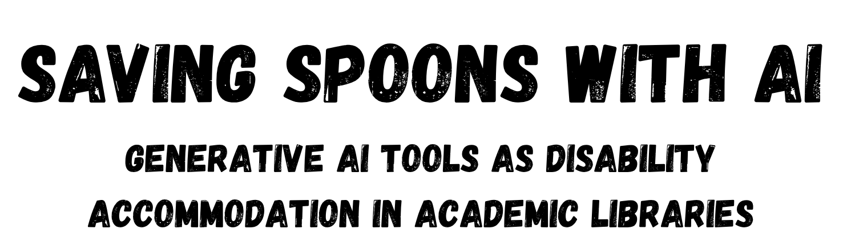
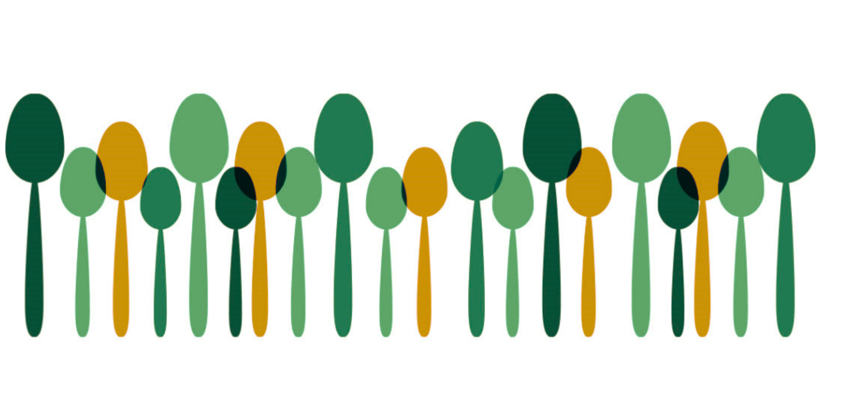
Saving Spoons with AI: Generative AI Tools as Disability Accommodation in Academic Libraries
Crystal Boyce
she/her/hers
George Mason University
Biological Sciences Librarian

Slide 2
Agenda
Welcome & Framing
Case Studies: AI as Accommodation
Reframing AI Critiques
Takeaways & Resources

Slide 3
Sins Invalid – 10 Principles of Disability Justice
Intersectionality
Leadership of the most impacted
Anti-capitalist politic
Commitment to cross-movement organizing
Recognizing wholeness
Sustainability
Commitment to cross-disability solidarity
Interdependence
Collective access
Collective liberation

Slide 4
Key Terms
Term | Short Definition
Disability | A mismatch between an individual’s body or mind and an environment not designed for them
Disability justice | A movement centering intersectionality and collective access beyond compliance
Accommodation | Any modification or adjustment to oneself, the environment, or the way things are typically done that enables an individual to have an equal or equitable opportunity to participate​
Chronic condition | A long-term physical, emotional, or mental health state that affects daily energy or function
Executive dysfunction | Difficulty initiating, planning, or organizing tasks
Brain fog | Cognitive slowness or mental fatigue that affects clarity and focus
Time blindness | Challenges in perceiving or estimating time intervals

Slide 5
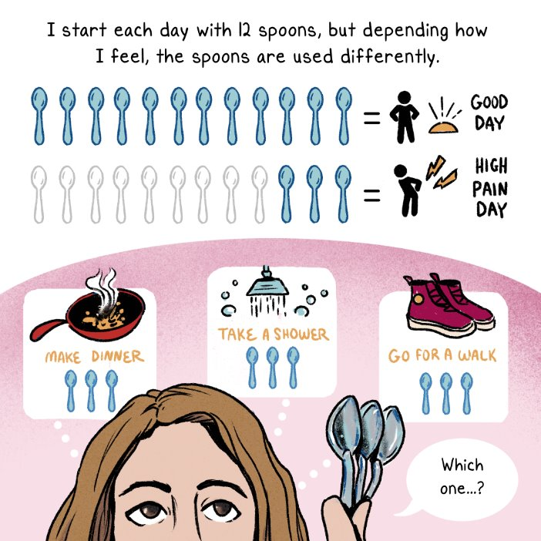
Spoon Theory
Created by Christine Miserandino
A metaphor used to explain how people with chronic illnesses, chronic pain, or disabilities have limited energy reserves and expend more energy on daily tasks compared to those without these conditions.​
​
Gaining popularity and becoming a framework for describing physiological, cognitive, emotional, and social energy availability​.

Slide 6
Flood the Chat
Activity
Write an answer to the following question in the chat box, but DON'T submit until I say so.
What is one chronic or disabling state you're managing right now?
Notes:
So we're going to do a quick "Flood the Chat."
If you're not familiar, everyone who wants to share is going to write an answer to a question in the chat, but you won't submit it until I say so.
We'll take 30 seconds to think and answer, and remember it's only if you feel comfortable sharing.
What is one chronic or disabling state you're managing right now? I have several, but the most disruptive for me is managing my kid's disabilities.
ABOUT 11:30 MINUTES

Slide 7
Questions?
What questions do you have about disability justice, spoon theory, or defining disability and accommodation broadly/inclusively?

Slide 8
Case Studies
Generative AI as Accommodation

Slide 9

Case Study 1: Emails
Writing emotionally complex messages is draining.
Tone management and self-regulation are not minor tasks.
Generative AI can serve as a copyeditor.

Slide 10
Case Study 1: Emails
write an enraged, professional tone email to […X…] for taking unilateral action to [...] , which undermines the purpose and work of committees, [...] Couch the email in the idea of [...] include that the action is incredibly disrespectful to [...] especially since […X…] has been informed of the role of […] committee several times recently. indicate that meetings and decisions were held/taken without [...committee…] involvement, which […] should have been invited into the conversation. Indicate that I understand certain actions needing to be taken in the current political landscape, but that doesn't excuse […committee…] excision from the decision making process. The following are consequences of the action: [...] Emphasize that the issue at hand is the disrespect and the failure of leadership when choosing to […]

Slide 11
Case Study 1:
Emotional Regulation & Decision Fatigue
Lesson
I don’t have to hold every emotional thread at once.
GenAI can help me disentangle emotion from intent.
Takeaway
With the right prompt, I can write with confidence
even when I’m dysregulated.

Slide 12
Case Study 2: Learning New Software
Qualtrics, Microsoft Forms
survey-design platforms
Teams, Zoom
video-conferencing tools
Excel, Google Sheets
formulas, pivot tables
Canva, PowerPoint, Google Slides
presentations, graphics editors
Interactive Polls
Poll Everywhere, Menti, Zoom Polls, Microsoft Forms
Research Databases
unique features, wildcards, complex searching
SharePoint, OneDrive, Google Workspace
file organization and collaborative workspaces
Spring Share
LibGuides, LibAnswers, LibCal

Slide 13
Case Study 2:
Executive Function & Cognitive Fatigue
Lesson
Complex software and tasks become less overwhelming
when the "where do I start?" question is answered for me.
Takeaway
I don't need to be an expert in all things.
I can use tools to scaffold the process with one-off or rarely done tasks.

Slide 14

Case Study 3: Instruction Assistant
GenAI is a judgment-free pedagogical coach
Holding space for nonlinear, curiosity-driven exploration.
Working on crip time – when spoons align.

Slide 15
Case Study 3:
Social Anxiety & Cognitive Access
Lesson
Asking questions in a psychologically safe space
can unlock deeper learning.​
Takeaway
Sometimes the hardest part of learning isn't the
materials – it's the fear of asking.

Slide 16
Questions?
What questions do you have about using generative AI to support cognitive, emotional, and psychologically demanding tasks at home or work?

Slide 17
Critiques
Generative AI is cheating, wasteful

Slide 18
AI Critiques in Higher Ed
Academic integrity
undetectable assistance; unreliable detectors; policy whiplash
Quality & accuracy
hallucinations; shallow synthesis; untraceable sources
Equity & bias
replicates data-set harms; opaque decision processes
Cognitive offloading
fear that writing or thinking muscles weaken
Privacy & IP
sensitive data in prompts; unclear ownership
Environmental costs
rising electricity and water demand of AI infrastructure

Slide 19
When AI Critiques Mirror Ableist Narratives
AI Critiques
Accommodation Critiques
It makes things too easy.
It’s cheating.
It’s bad for the planet.
Ergonomic tools are luxuries.
Captions and extra time are unfair advantages.
Ban straws, save turtles! Disability needs are wasteful.

Slide 20
Water, Social Footprints
Fast Fashion
Plastic Soda Bottles
Microchips
Textile industry
~ 215 trillion L/yr
0.5 L soda
~ 168-309 L/bottle
Average facility
~ 10 million G/day
Cement, concrete
Electronics
Data Centers
~ 5% of global CO₂
Cobalt has documented child labor and hazardous conditions
Hyperscale
~ 550,000 G/day
Smaller centers
~ 18,000 G/day

Slide 21

genAI – Critiques – Disability Justice
Which critiques of AI feel most urgent or relevant in your work?
(e.g., academic integrity, student reliance, misinformation, environmental impact, etc.)
When people argue that AI makes things “too easy” or gives and “unfair advantage,” what do you think they’re worried about?
(focus on values or fears – not technical details)

Slide 22
Reflective Application
AI is not good or bad; it is a tool. Its impact depends on how we use it.

Slide 23
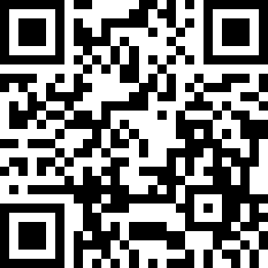
Reflective Application & Practice
Where do I spend more energy than others might see? What helps me stay present, learn, or do my best at work?
How might I offer flexibility or access without lowering expectations?
(e.g., multiple ways to participate or submit work, flexible timelines, different formats, etc.)
What questions do I still have about responsible AI use?
(e.g., disclosure, transparency, privacy, equity, environmental impact, academic integrity)
Portions of this presentation (including drafting, narrative refinement, and reflective prompts) were developed in collaboration with generative AI tools. I used AI as a thinking partner to organize complex ideas, externalize an internal dialogue, and conserve cognitive energy during the creative process. All stories, arguments, and final decisions are my own.

