Slide 1
Belonging Beyond Books:
Supporting Wellness in the Library
Monica Gingerich, Coordinator for Student Experience and Engagement
Megan Gilpin, Education Program Specialist
Penn State University Libraries
LOEX Fall Focus, November 2025
Notes:
Both- Monica can read the title and we can both introduce ourselves

Slide 2
Today's Presentation
Learning outcomes
  identify strategies libraries can implement to integrate wellness programming into existing services and spaces in order to foster student belonging.
  evaluate examples of collaborative partnerships that strengthen connections between libraries, campus partners, and college wellness initiatives.
  apply adaptable program elements—such as themed activities, inclusive spaces, or curated resources—to their own institutional contexts to support student wellbeing.
Notes:
Megan

Slide 3
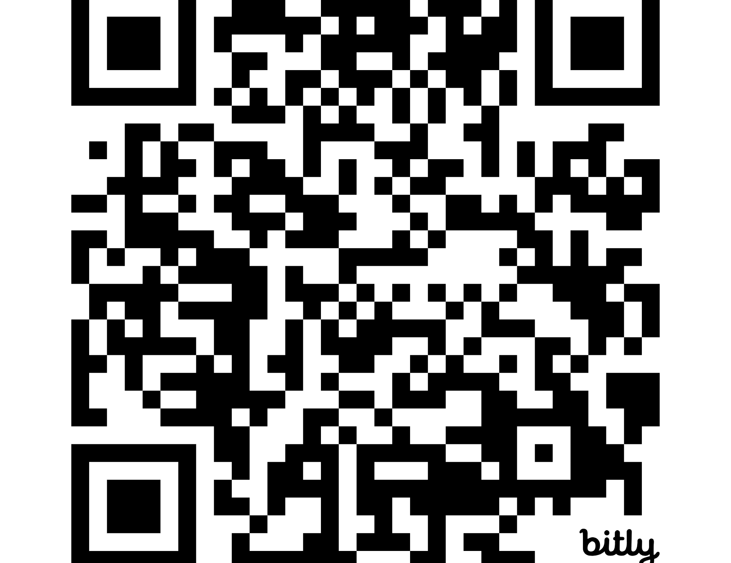
What does your library do currently to support student wellbeing?
https://bit.ly/LOEX25LibWell
Notes:
Megan

Slide 4
Why Student Wellbeing Matters
Sense of belonging
Directly impacts student success and retention
Aligns with our institutions' commitments to student success
Institution's strategic plan:
  "enhancing student success"
  "student stress and other factors affecting academic performance"
  "student, faculty, and staff health and wellness are cultivated in a caring community focused on flourishing"
Notes:
Monica

Slide 5
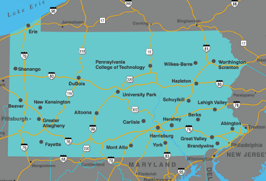
an introduction and context
Penn State Libraries landscape
Total enrollment around 90,000
19 physical campuses and World Campus (virtual)
https://datadigest.psu.edu/student-enrollment/Campus structure
Credit: Penn State. Creative Commons
Notes:
Monica

Slide 6

Beginnings
Wellness work dating back to 2014 (and probably earlier)
Formalized with establishment of the LibWell Initiative in 2023
Notes:
Megan
De-Stress Fest began before 2014
We know now that a lot of the outreach work we've been doing (Open Houses, one-off programs) contribute to that sense of belonging and well-being. We just didn't identify it as such.
Penn State formalized an actual wellness initiative in 2023 with the establishment of LibWell.

Slide 7

LibWell
Coordinate and advance student wellness efforts across the University Libraries
Plan and support activities, initiatives, and purchases directly addressing student wellbeing
Identify wellbeing resources and services related to enhancing academic success
Seek out campus partners and experts in student wellness (because we are not)
Notes:
MEGAN: We received funding that allowed us to set up our formal LibWell program. (Name of the program and the leadership group responsible for the wellness efforts at Penn State Libraries.
It took us time to get our footing. We had to figure out exactly how we were going to make it work, especially since we were supporting work spread out across the Commonwealth of Pennsylvania.
Two big sources of inspiration/help with this work:
*Student Wellness and Academic Libraries, ed. Sara Holder and Amber Lannon
*LOEX 2023 presentation on the StudyWell Initiative (we had already decided on LibWell before attending LOEX) by Laura W. Gariepy, Emily J. Hurst, Sue Robinson, Ryan Pander of Virginia Commonwealth University Libraries.

Slide 8
Mission and Objectives
Mission Statement: Enhance and support wellbeing by developing spaces and resources, connecting students with university partners, and providing wellness information and programming to uplift all students so that they can flourish.
Objectives: Student will
  see the Libraries as a place to go for wellness and wellbeing information
  use Libraries spaces and resources to enhance their wellbeing journey
  feel empowered to take control of their holistic wellbeing using provided resources and programs
Notes:
Monica- To help programming and collection development stay focused creating a mission statement for wellness work can be especially helpful. Also, having ready objectives that are broad enough in nature

Slide 9

Distinctive Branding
PR Campaign
Benefits
Easily identifiable to students
This is something that has to do with me and my wellness
Stays the same when transferring from a different campus
Students identify that the Libraries cares about their wellbeing
Notes:
Monica
Worked with our Public Relations and Marketing department to develop a campaign to support the initiative.
If you don't have a PR department, just develop marketing materials that are consistent.

Slide 10
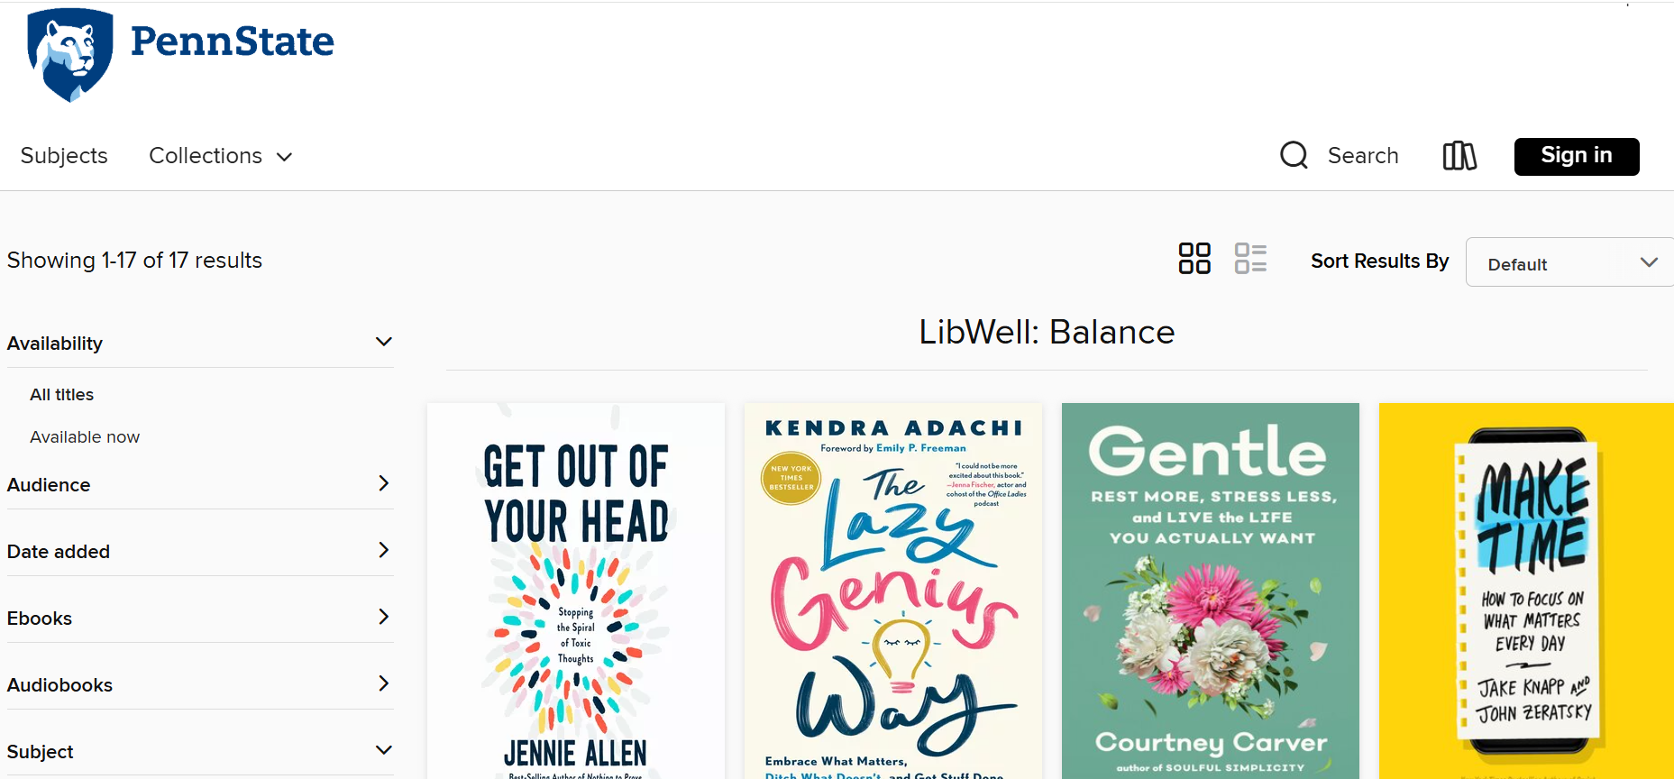
Where to start? Build on welcome events
Open House
Providing a fun and welcoming atmosphere – students meet staff
Libby stop
Reading for wellness
Notes:
Monica-Welcome events already lend themselves to

Slide 11

Next step: Semester Themes
Opt-in and tailor to the campus
Take a Break Tuesday activities and Whiteboard Wednesday prompts (thank you VCU!!!!)
Coordinated purchases to support TBT activities
Two online programs for any location (including World Campus)
Notes:
Megan
It took us some time to decide how we could be most effective. We cannot be responsible for ALL student wellness work. That is part of everyone's jobs.
Here's how we can best support all students at all locations.
Provide the tools and programs and allow those locations to decide what works best for their students.

Slide 12

Notes:
Megan

Slide 13

Notes:
Megan

Slide 14



Website
https://sites.psu.edu/libwell/
Notes:
Monica

Slide 15
Let's pause
Are there others at your institution interested in this kind of wellbeing work?
What kind of programming do students participate in at your institution?
What kind of financial support might you have to implement programming?
Talking the talk: can you connect student wellbeing to your university or library's strategic plan?
Notes:
Monica
What works best at your institution? Online? In-person? Hybrid?
What kind of financial support? Do you have a story to tell for development efforts?
Talking the talk: can you connect student wellbeing to your university or library's strategic plan? This is a way to argue for funding.
Do you have partners that come with a built-in audience? Programs are more well-attended it you have a class homework assignment or extra credit.
Lots of free resources online. Especially for Take a Break type activities.
There are programs already happening on your campus. Who can you partner up with for sponsoring?

Slide 16
What questions do you have so far?

Slide 17
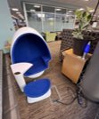
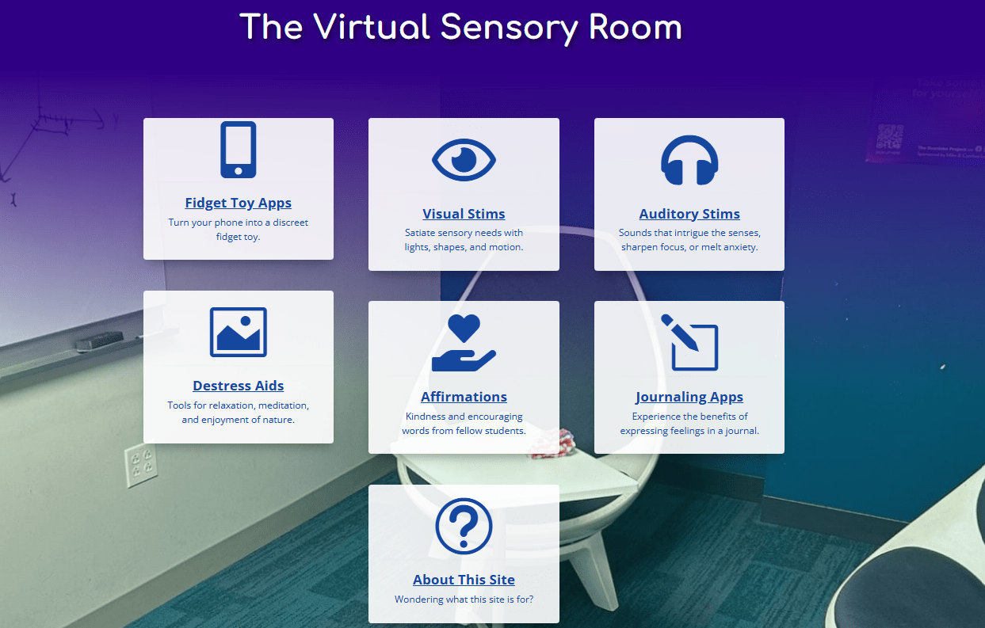
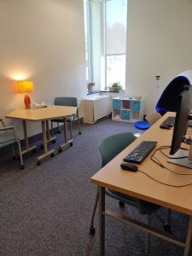
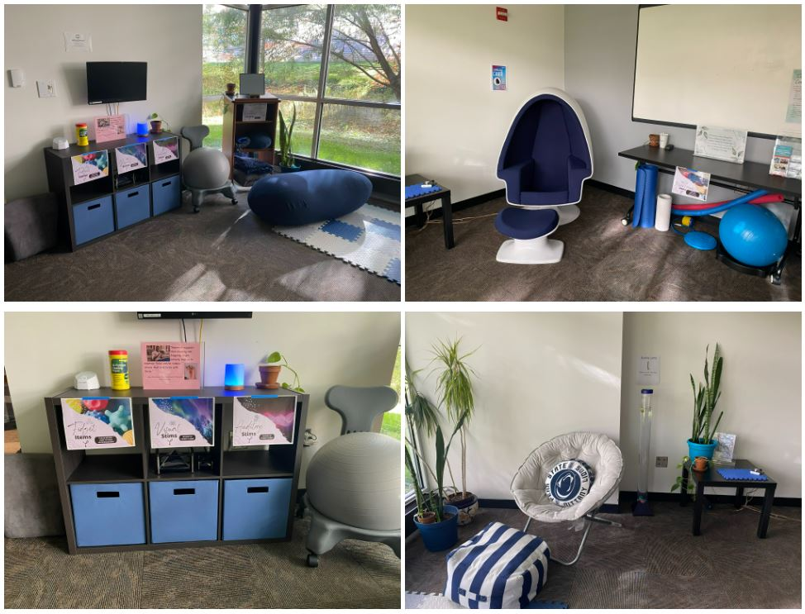



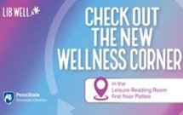
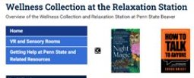
Spaces, Collections, and Other Resources
Sensory Rooms/Spaces
Wellness Corners
Meditation Station
Relaxation Station
Virtual Sensory Rooms
Curated Collections
https://sites.psu.edu/virtualsensoryroom/
https://sites.psu.edu/sensoryfriendlylibraries/
Notes:
Megan

Slide 18
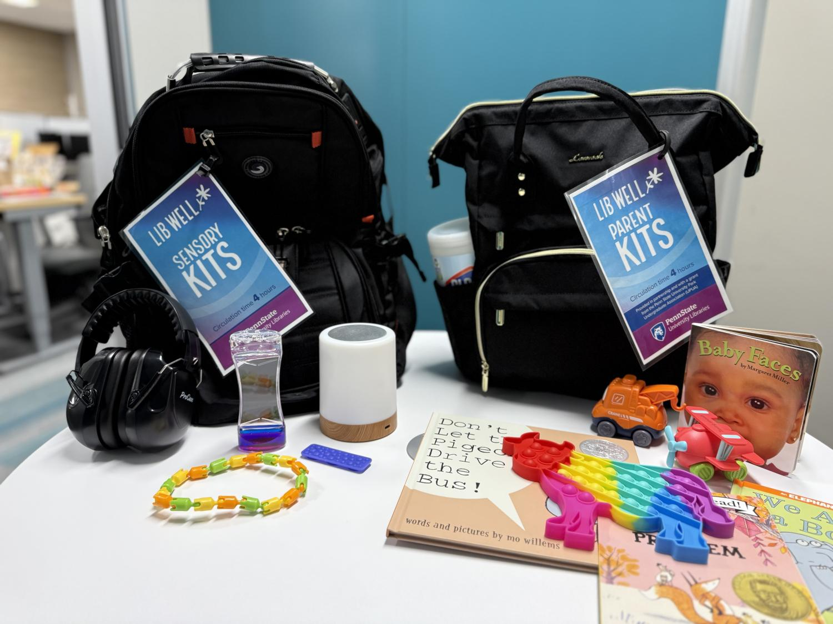
Parent and Sensory Kits
Partially in collaboration with Penn State Student Government
Provides opportunity for users to curate their own study environments to meet individual needs
Provides opportunity for students who are parents to entertain their children while using the library space.
Notes:
Monica

Slide 19
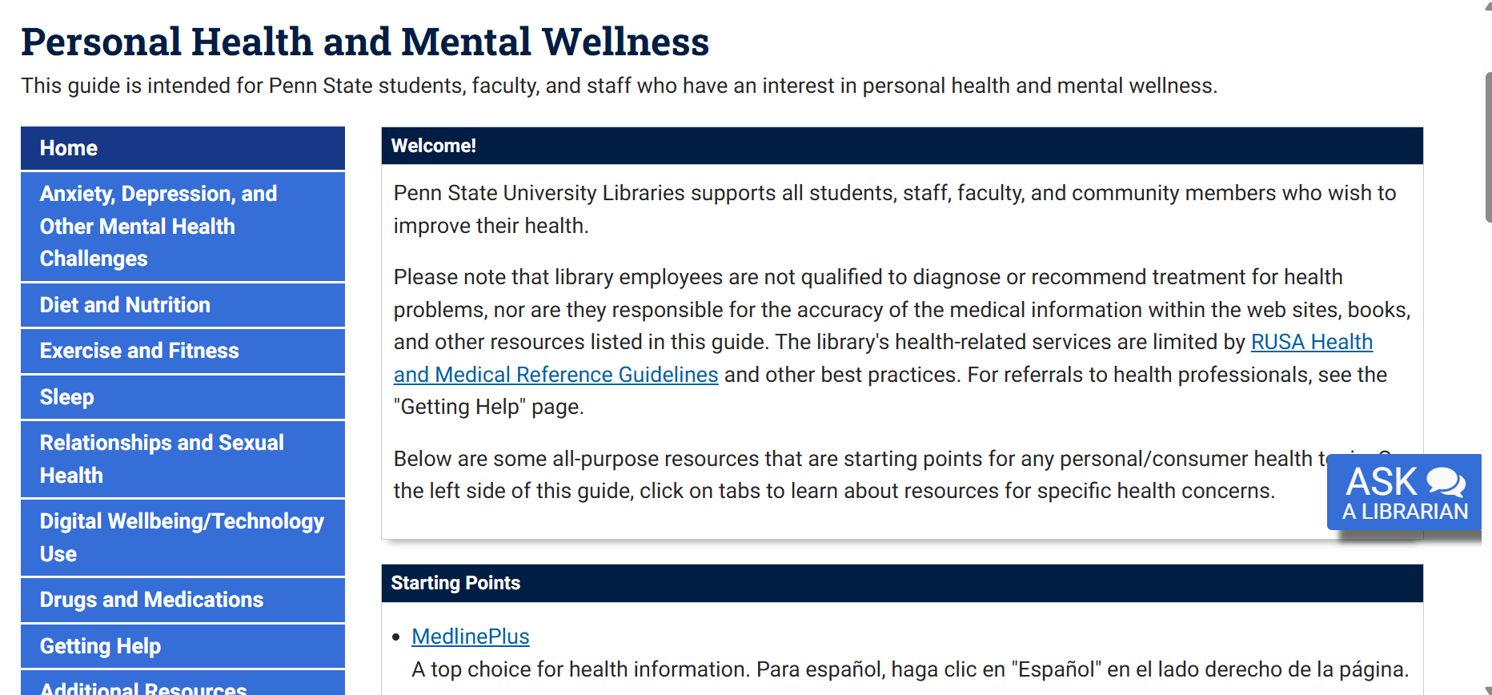
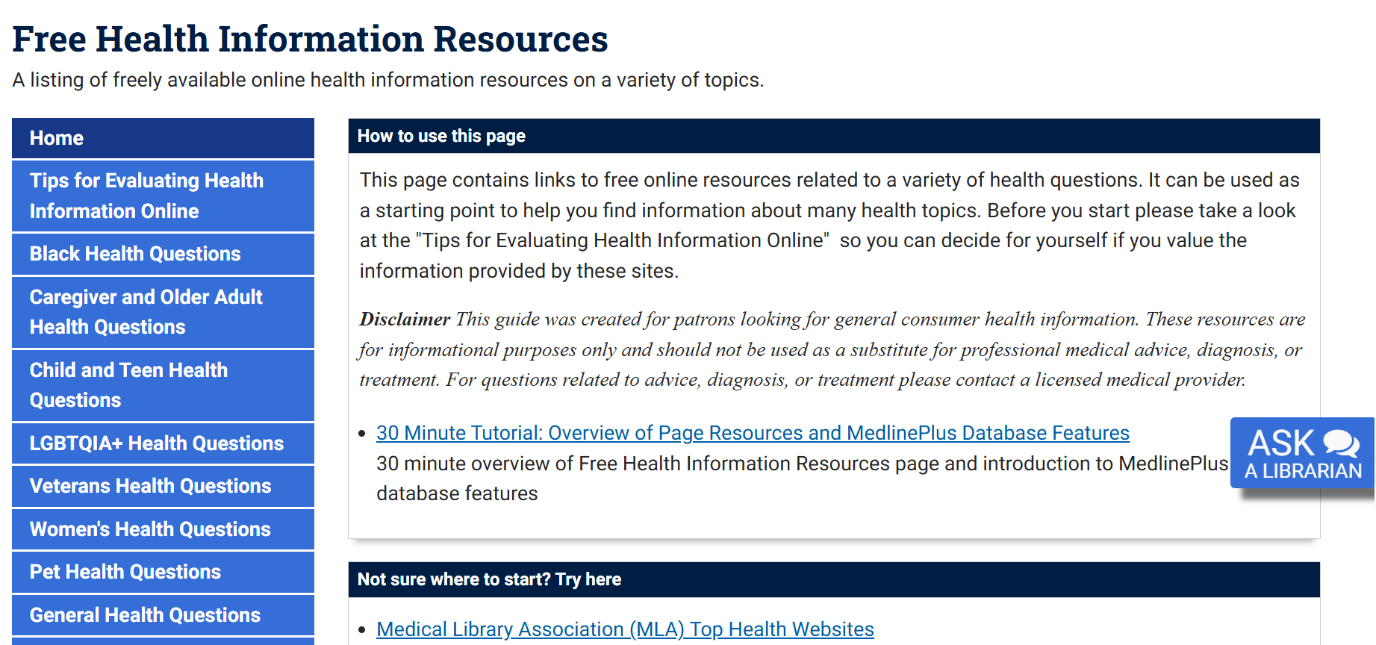
LibGuides
Notes:
Monica
Also, Libby shelves/materials and Wellness corner

Slide 20
Let's reflect again
Identify spaces within your institution where you can include a sensory room, wellness corner/collection, meditation station, etc.
What resources do you already have that you can include/relocate?
If you don't have a space where you can implement specific programming, can you create a sensory kit or parent kit?
What resources do you already have in the virtual space?
Notes:
Megan
(This should probably on the kits page – don't know why I have it here) Benefits of the kits: take little room, can spend as much or as little as you like but still have significant impact.

Slide 21
Collaborations
Strategies for developing cross-campus partnerships
  Identify departments with shared goals and complimentary strengths
  Actively seek opportunities to collaborate
  Relationship building, communication, defined roles and objectives, etc.
Our campus partners
  Health Promotion & Wellness
  Counseling & Psychological Services
  Student Success Center
Ways to support/be a good partner
  Cross promote programming (digital screens, social media, etc.)
  Pop-up libraries at events
  Book displays/virtual bookshelves
  Participation in programming sponsored by those partners
Notes:
Megan

Slide 22
Activity!
Identifying potential campus partners!
  Who conducts wellness programs?
  Are there programs that can be hosted in your space?
  Are there wellness programs on your campus where you can bring materials? Maybe a pop-up library?
https://bit.ly/LOEX25LibWell (second page)
Notes:
Monica

Slide 23

Assessment
Fall 2024
  Identifying Wellness Activities Across PSU Libraries
Spring 2025
  How does UP-Libraries support student wellness?
  Sharing Circles with Students
    A third space to study, relax, or work with friends.
    Utilizing sensory space, destress fest activities, &leisure reading collection.
    Understanding what LibWell is and how it can support them.
Notes:
Monica
Across the Commonwealth -December 2022-December 2024
Interviews with Head Librarians atCommonwealth campuses.
Leisure Reading “readingrumble”, wellness corners,sensory kits, crafts, & onlinewellness programming.

Slide 24
Future Steps
Safe Haven
Read Well
Incorporate student feedback
Notes:
Megan (Safe Haven) and
Monica (Read Well)

Slide 25
Questions?
Monica Gingerich (mcg5660@psu.edu)
Megan Gilpin (mcg13@psu.edu)

