Slide 1

Rethinking Writing-from-Sources Assignments and Academic Integrity in the Age of GenAI
Mary Broussard
Arts & Humanities Librarian, Bucknell University

Slide 2
Klaas
“If you want to know what you think about a topic, write about it. Writing has a way of ruthlessly exposing unclear thoughts and imprecision. This is part of what is lost by ChatGPT, the mistaken belief that the spat out string of words in a reasonable order is the only goal, when it’s often the cognitive act of producing the string of words that matters most.”
(Klaas 2025)

Slide 3
Today’s Agenda
Rethinking Writing-from-Sources and Academic Integrity in the Age of GenAI
Composition Studies & Information Literacy
GenAI’s Threats to Academic Integrity
Solutions?
Tools

Slide 4
Introduction to Composition Studies + Information Literacy

Slide 5
History of Composition & Rhetoric
{
Mid 20th Century
Renewed Interest in
Composition
& Rhetoric
4th Century
B.C.E.
Aristotle
2022
ChatGPT
We moved from speech-based to text-based society

Slide 6
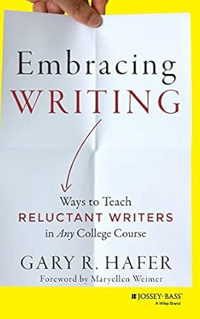
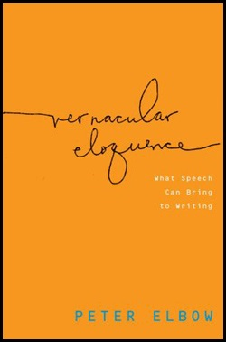
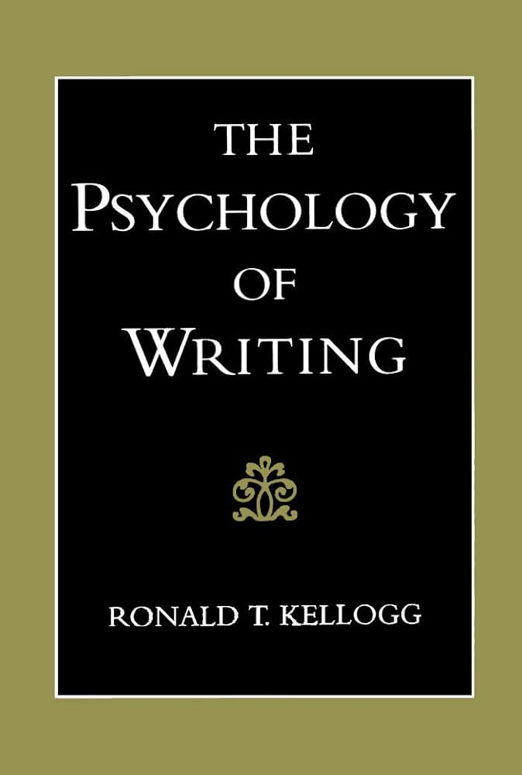

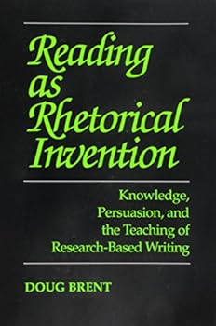
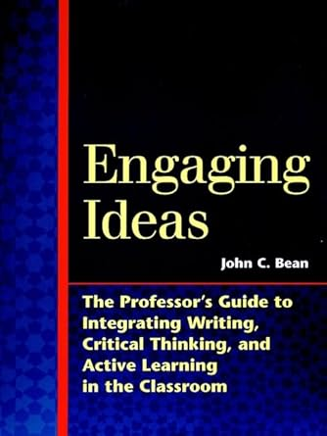
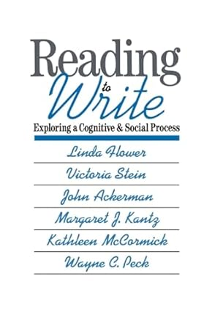
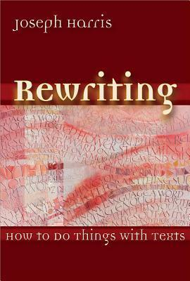
Example Titles

Slide 7
Traits of Composition & Rhetoric
WRITING… & (efferent) reading
Writing is thinking, writing is learning
Focus on the process
  Informal writing
  Revision to formal writing
  Where does the learning happen?
“Writing from Sources” (Brent)
  From product to process
  Desirable difficulty
Brent, D. (2013) The research paper and why we should still care?

Slide 8
Composition & Information Literacy
Composition
& Rhetoric
Information
Literacy

Slide 9
Definition of Information Literacy
Reading
+
Writing
+
Critical Thinking
=
Information Literacy
Cowan, S.M. (2014). Information Literacy: The Battle We Won that Lost.

Slide 10
The Framework for Information Literacy for Higher Education
Authority is Constructed and Contextual
Information Creation as a Process
Information Has Value
Research as Inquiry
Scholarship as Conversation
Searching as Strategic Exploration

Slide 11
The Framework as Composition & Rhetoric
“Imagine that you enter a parlor. You come late. When you arrive, others have long preceded you, and they are engaged in a heated discussion, a discussion too heated for them to pause and tell you exactly what it is about. In fact, the discussion had already begun long before any of them got there, so that no one present is qualified to retrace for you all the steps that had gone before. You listen for a while until you decide that you have caught the tenor of the argument; then you put in your oar. Someone answers; you answer him; another comes to your defense; another aligns himself against you, to either the embarrassment or gratification of your opponent, depending upon the quality of your ally’s assistance. However, the discussion is interminable. The hour grows late, you must depart. And you do depart, with the discussion still vigorously in progress.” (Kenneth Burke, 1941)
Scholarship as Conversation

Slide 12
GenAI’s Threats to Academic Integrity

Slide 13
Marche (1 of 2)
“The essay, in particular the undergraduate essay, has been the center of humanistic pedagogy for generations. It is the way we teach children how to research, think, and write. That entire tradition is about to be disrupted from the ground up.”
(Marche 2022 – 1 week after ChatGPT launched)

Slide 14
Marche (2 of 2)
“I figure it will take 10 years for academia to face this new reality: two years for the students to figure out the tech, three more years for the professors to recognize that students are using the tech, and then five years for university administrators to decide what, if anything, to do about it.”
(Marche 2022)

Slide 15
Scope of “Academic Integrity”
“The risk of students bypassing the learning process in favor of quick solutions undermines the fundamental goal of education, which is to foster critical thinking and problem-solving skills.” (Artyukhov et al., 2024, p. 17)
Offloading Writing-from-Sources assignments,
in part or in whole

Slide 16
Why Do Students Cheat?
Lack of Self-Efficacy
Expectations: Do they know they’re cheating?
Values: Do they think they’re doing something wrong
Moral disengagement
Messages about contract cheating services
Peer effects
Narcissism: Do the rules apply to me?
Motivation: What’s the point?
Procrastination
Instructor effects
Cost-benefit analyses
Gallant& Rettinger (2024). Opposite of Cheating: Teaching for Integrity in the Age of AI.

Slide 17
Evidence
How are students using GenAI for research?
How do faculty feel about GenAI and academic integrity?

Slide 18
Evidence,
Part 1
Student survey results
85% students surveyed have used AI for research at least once, most are repeat users.
Undergraduates using it for topic refinement and reading/summarizing articles
They report using it less for finding sources
They mostly use ChatGPT
Students confused by multiple AI policies
EBSCO. (2025). Too Good to be True: Exploring the Ways Generative AI Is (and Isn’t) Reshaping Student Research. Presentation at the 2025 EBSCO User Group.

Slide 19
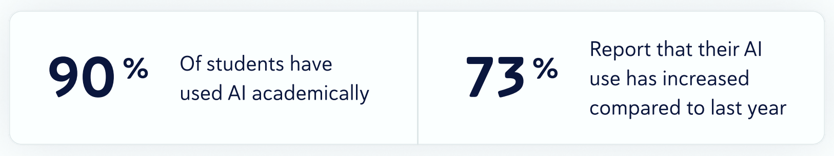
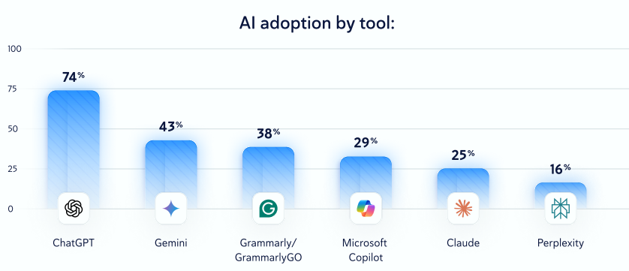
Evidence,
Part 2
Copyleaks. (2025). 2025 AI in Education Trends Report. https://copyleaks.com/wp-content/uploads/2025/09/2025-AI-in-Education-Trends-Report_1.pdf

Slide 20
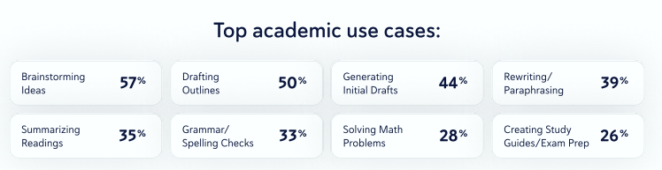
Evidence,
Part 3
Copyleaks. (2025). 2025 AI in Education Trends Report. https://copyleaks.com/wp-content/uploads/2025/09/2025-AI-in-Education-Trends-Report_1.pdf

Slide 21
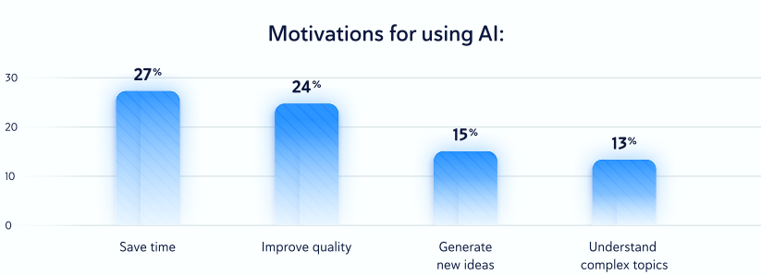
Evidence,
Part 4
Copyleaks. (2025). 2025 AI in Education Trends Report. https://copyleaks.com/wp-content/uploads/2025/09/2025-AI-in-Education-Trends-Report_1.pdf

Slide 22
Evidence,
Part 5
Local informal faculty survey (no IRB)
Most faculty have changed writing assignments to reduce cheating due to AI
Most think reductions in writing assignments have negative effects on student learning

Slide 23
Evidence,
Part 6
“The rapidly improving ability to impressively mimic human language poses an existential threat to traditional methods of crafting smarter minds—which thereby challenges the future of human cognition.”
(Klaas 2025)

Slide 24
Evidence,
Part 7
Articles about overuse of GenAI’s effects on critical thinking skills
Gerlich, M. (2025). AI Tools in Society: Impacts on Cognitive Offloading and the Future of Critical Thinking. Societies, 15(1), 6. Lee, H.P. et al. (2025). The Impact of Generative AI on Critical Thinking: Self-Reported Reductions in Cognitive Effort and Confidence Effects From a Survey of Knowledge Workers. Proceedings of the 2025 CHI Conference on Human Factors in Computing Systems, 1–22.
Kosmyna, N. et al. (2025). Your Brain on ChatGPT: Accumulation of Cognitive Debt when Using an AI Assistant for Essay Writing Task arXiv.

Slide 25
Warner
“If we aren’t careful, we will lose things that it turns out we need but might have a hard time getting back once they are lost.”
(Warner 2025, p. 129)

Slide 26
GenAI’s Threats to Academic Integrity - List
Cheating is easier & cheaper than ever before
Gap between GenAI use & policies
GenAI companies’ marketing
  Higher education – key market
  “Inevitable”
  Necessary for future employment
  Plagiarism tools
Proliferation of AI slop & deepfakes
Loss of plagiarism detection
AI can fake the process

Slide 27
GenAI’s Threats to Composition
+ IL
What is authorship and authority in GenAI-produced texts? How can we know what’s real anymore?
Authority is Constructed and Contextual
Information Creation as a Process
Research as Inquiry
Searching as Strategic Exploration
Information Has Value
Scholarship as Conversation
{
Is there a process anymore?
Undermining of authors’ intellectual property rights?
Conversation between algorithms?

Slide 28
Rhetorical Triangle
Logos
(logic)
Blair. (2025). How an AI-Generated Summer Reading List got Published in Major Newspapers. NPR.
Chandler. (2025). Judge Considers Sanctions Against Attorneys in Prison Case for Using AI in Court Filings. Associated Press.
Ethos
(ethics & credibility)
Pathos
(emotion)

Slide 29
Solutions

Slide 30
Unplugging?
Move away from written papers to:
  Blue books
  Presentations
  Conferences
  Internet-free zones?
Issues:
Accessibility
Informal vs formal writing
Depth of thinking
Impracticality

Slide 31
Technical Solutions?
Technochauvanist Solutions
AI text detection
Browser lockdowns
Online proctoring
Broussard (2019). Artificial Unintelligence

Slide 32
What does Gemini say…
(manually shortened)
Redesign Assignments to Center Learning and Critical Thinking
  Design assignments that generative AI tools struggle to complete effectively
  Focus on the Process, Not Just the Product
  Emphasize Authentic and Personalized Assessments
  Integrate Oral and In-Class Assessments
Establish Clear and Collaborative AI Policies
  Define AI Use in the Syllabus and Assignments
  Teach AI Literacy and Responsible Use
  Discuss Academic Integrity Values
Foster Intrinsic Motivation and Reduce Anxiety
  Use Low-Stakes Assessments
  Build Trust

Slide 33
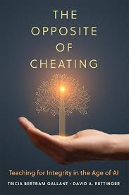
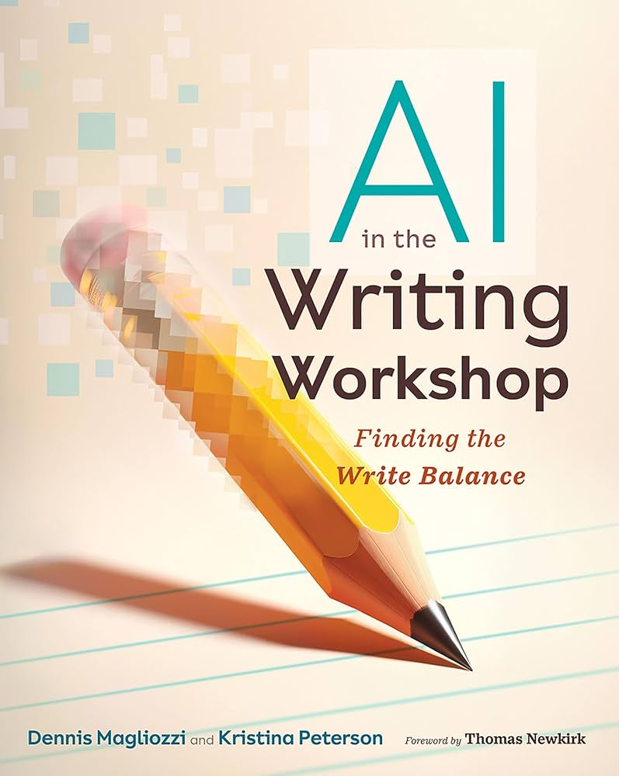
Protecting Student Learning in the Age of GenAI
Literature Is…
Gallant, T. B., Rettinger, D. A. (2024). Opposite of Cheating: Teaching for Integrity in the Age of AI. University of Oklahoma Press.
Magliozzi, D. & Peterson, K. (2024). AI in the Writing Workshop: Finding the Write Balance. Heinemann.

Slide 34
The Opposite of Cheating: Summary
Dig into good pedagogy & beg students not to cheat

Slide 35
The Opposite of Cheating
Analyze why students cheat
Communicate integrity
  Define academic integrity/dishonesty
  Why integrity matters
  Co-create ethical standards
Design courses and assessments for integrity
  Articulate learning objectives
  Consider flexible deadlines
  Draw focus away from grades
  Infuse integrity
  Authentic assessments
Strategies that promote success with integrity
  Model desired behaviors
  Be engaging & intentional
  Create a sense of belonging
Teach ethics

Slide 36
Klaas Again
“Convincing students that intelligence is a skill they must cultivate through hard work—no shortcuts—has become one of the core functions of education.”
(Klaas 2025)

Slide 37
AI in the Writing Workshop
Central Rules for Writing with AI
  Write First
  Struggle
  Prompt
  Question
  Reflect and Be Transparent

Slide 38
Additional Potential Solutions – Without AI
Focus on process for affective reasons (motivation & confidence) rather than plagiarism-proofing assignments
Assessments of the process of creating (Gribble)
Revisit arguments against policing plagiarism (Bruton)
Post-process theory? (Smith)
AI refusal is legitimate (San-Franchini)
Reuniting of humanities and tech (Marche)
Gribble & Wardrop. (2024). Exploring the Challenges Posed to Academic Integrity
Bruton & Childers (2016). The ethics and politics of policing plagiarism.
Smith. (2024). The Unbearable Lightness of Inventing.
Sano-Franchini et al. (2025). Refusing GenAI in Writing Studies
Marche. (2022). The College Essay is Dead.

Slide 39
Additional Potential Solutions – Teaching AI
Teach Students to Use AI “Ethically”
Teach students how to use GenAI without offloading critical thinking and learning
Sample Concrete AI Policies:
  Can’t have AI open at same time as assignment
  No copy & paste
Revising AI-generated essays to students’ own voice (Krueger)
Consider teaching structured prompting (Gerlich)
Don’t forget about reading (Watkins)
Promote AI literacy about cognitive offloading (my video on cognitive offloading)
Krueger. (2025). Rhetorical Choices & Voice
Gerlich (2025). From Offloading to Engagement.
Watkins. (2024). Automated Aid or Offloading Close Reading?

Slide 40
Closing Thoughts
“We need to recognize that learning always involves overcoming obstacles. If there is no resistance, no real learning is taking place. The problem is that the human mind is programmed for taking shortcuts, to look for what is most efficient. It’s evolutionary. We want to conserve energy. The problem is that if we always take the shortcut, we risk losing valuable learnings that will benefit us in the long term.”
(Winero 2023, 13:21)

Slide 41
Citations (1 of 2)
Artyukhov, A., Wołowiec, T., Artyukhova, N., Bogacki, S., & Vasylieva, T. (2024). SDG 4, Academic Integrity and Artificial Intelligence: Clash or Win-Win Cooperation? Sustainability, 16(19), 8483. https://doi.org/10.3390/su16198483
Brent, D. (2013). The research paper and why we should still care. Writing Program Administration 37(1):34-53.
Broussard, M. (2019). Artificial unintelligence: How computers misunderstand the world (First MIT Press paperback edition). The MIT Press.
Broussard, M.S. (2017). Reading, research, and writing: Teaching information literacy with process-based research assignments, ACRL.
Bruton, S., & Childers, D. (2016). The ethics and politics of policing plagiarism: A qualitative study of faculty views on student plagiarism and Turnitin®. Assessment & Evaluation in Higher Education, 41(2), 316–330. https://doi.org/10.1080/02602938.2015.1008981
Copyleaks. (2025). 2025 AI in Education Trends Report. https://copyleaks.com/wp-content/uploads/2025/09/2025-AI-in-Education-Trends-Report_1.pdf
Cowan, S.M. (2014). Information literacy: The battle we won that we lost? Portal: Libraries and the Academy 14(1), 23-32.
Gerlich, M. (2025). AI Tools in Society: Impacts on Cognitive Offloading and the Future of Critical Thinking. Societies, 15(1), 6. https://doi.org/10.3390/soc15010006
Gerlich, M. (2025). From Offloading to Engagement: An Experimental Study on Structured Prompting and Critical Reasoning with Generative AI. Data, 10(11), 172. https://doi.org/10.3390/data10110172
Gribble, L., & Wardrop, J. (2024). Exploring the Challenges Posed to Academic Integrity and Credentialing by Generative AI. In H. Crompton & D. Burke, Artificial Intelligence Applications in Higher Education: Artificial intelligence applications in higher education: Theories, ethics, and case studies for universities (1st ed., pp. 143–162). Routledge. https://doi.org/10.4324/9781003440178-9

Slide 42
Citations (2 of 2)
Klaas, B. (2025, June 19). The Death of the Student Essay—And the Future of Cognition. https://www.forkingpaths.co/p/the-death-of-the-student-essayand
Kosmyna, N. et al. (2025). Your Brain on ChatGPT: Accumulation of Cognitive Debt when Using an AI Assistant for Essay Writing Task (No. arXiv:2506.08872). arXiv. https://doi.org/10.48550/arXiv.2506.08872
Krueger, G. J. (n.d.). Rhetorical Choices & Voice: Generative AI in the First-Year Composition Classroom. Thresholds, 48(1), 99-110.
Lee, H.P. et al. (2025). The Impact of Generative AI on Critical Thinking: Self-Reported Reductions in Cognitive Effort and Confidence Effects From a Survey of Knowledge Workers. Proceedings of the 2025 CHI Conference on Human Factors in Computing Systems, 1–22. https://doi.org/10.1145/3706598.3713778
Marche, S. (2022, December 6). The College Essay Is Dead. Atlantic Online.
Sano-Franchini, J., McIntyre, M., & Fernandes, M. (n.d.). Refusing Generative AI in Writing Studies. Refusing Generative AI in Writing Studies. Retrieved October 8, 2025, from https://refusinggenai.wordpress.com/
Smith, D. (n.d.). The Unbearable Lightness of Inventing: Postprocess in the Age of Generative AI. https://papers.ssrn.com/sol3/papers.cfm?abstract_id=4848720
Warner, J. (2025). More than words: How to think about writing in the age of AI (First edition). Basic Books.
Watkins, M. (2024). Automated Aid or Offloading Close Reading? Student Perspectives on AI Reading Assistants. https://uen.pressbooks.pub/teachingandgenerativeai/chapter/automated-aid-or-offloading-close-reading-student-perspectives-on-ai-reading-assistants/

