Slide 1


Critically evaluating Artificial Intelligence output: adapting source evaluation for AI
Allison Faix and Samantha Duncan

Slide 2
Introduction
Who are Allison and Sam?
Why this topic?
  AI became widely available in 2022
  We started looking at academic alternatives to ChatGPT to help faculty redirect student AI enthusiasm to scholarly sources
  Even with academic AIs, students still need help evaluating output
  Students are still using less-academic AIs and also would benefit from how to evaluate the output there
  We are presenting the preliminary findings of a small study and article we are currently working on

Slide 3
Disclaimer: we aren't experts yet
We started reading the literature and looking at what other libraries are doing so we could learn.
While we have found some consensus, there doesn't seem to be a clear path that everyone is taking yet.
We're here to share what we have learned, but we also are excited to learn from all of you.

Slide 4
Traditional Source Evaluation Methods
Many traditional heuristics librarians have used are checklist formats that focus on authority, currency, credentials, and relevancy:
CRAAP (Currency, Relevance, Authority, Accuracy, Purpose)
CARS (Credibility, Accuracy, Reasonableness, Support)
RADAR (Rationale, Authority, Date, Accuracy, Relevance)
PROVEN (Purpose, Relevance, Objectivity, Verifiability, Expertise, Newness)

Slide 5
Newer Source Evaluation Methods
SIFT (Stop, Investigate the Source, Find better coverage, Trace claims to the original)
Lateral Reading
Less checklist style, non-linear, less rigid
However, it has already been questioned whether any of these methods (new or old) are going to work when it comes to evaluating AI output.

Slide 6
Challenges of Evaluating AI Output
Doesn't always disclose or cite sources.
Sometimes cites sources that aren't real.
Doesn't always interpret sources correctly or use them in the right context.
Sounds authoritative and confident even when wrong.

Slide 7
Challenges of Evaluating AI Output
There is no actual author, and the information can't be replicated. If you do the same exact search again, you won't get the same answer again.
Plays into the bias of the person asking the question. You are more likely to get answers that you will like.
Provides only one answer rather than providing links to multiple sources for the user to examine and choose from (removes search autonomy from the user).

Slide 8
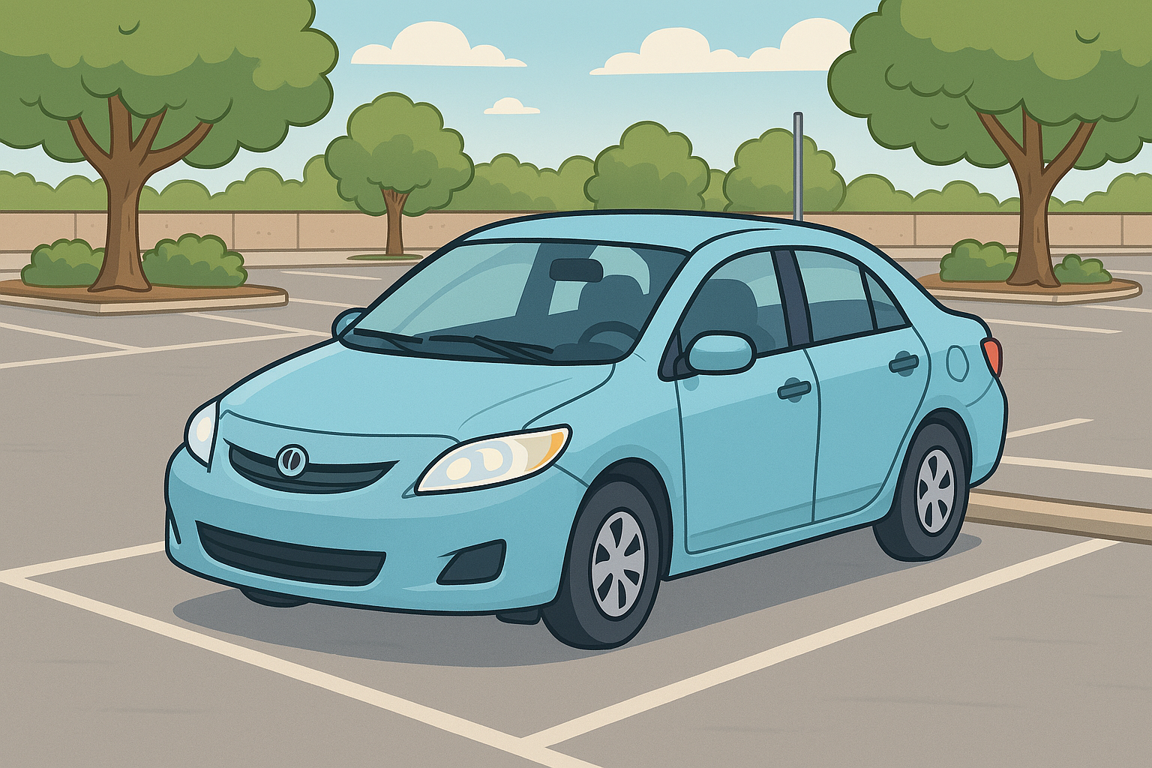
Parking Lot
Questions from chat
Image generated using Microsoft CoPilot from the prompt animated car in a parking lot

Slide 9
Our study (Dec 2024-present)
Randomly selected 40 of the 125 ARL libraries in Feb 2025
Visited their websites and looked for LibGuides that talked about artificial intelligence, LLMs or GenAI
We noted if they gave any advice for evaluating the output of artificial intelligence tools

Slide 10
Initial findings (April 2025)
16 out of the 40 libraries had ANY LibGuides that discussed AI (40%)
8 of the 16 libraries discussed evaluating AI output (50%)
We looked at those 8 in detail to see what was recommended
Another disclaimer: We don’t have a LibGuide with recommendations for evaluating AI output yet, either

Slide 11
Current methods to evaluate
Can traditional source evaluation heuristics and methods be adapted for critically evaluating the output of generative artificial intelligence
Review the recommendations for evaluating AI output that could potentially be used in your own classroom/teaching

Slide 12
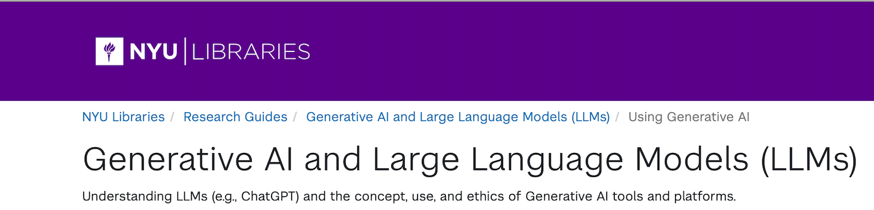
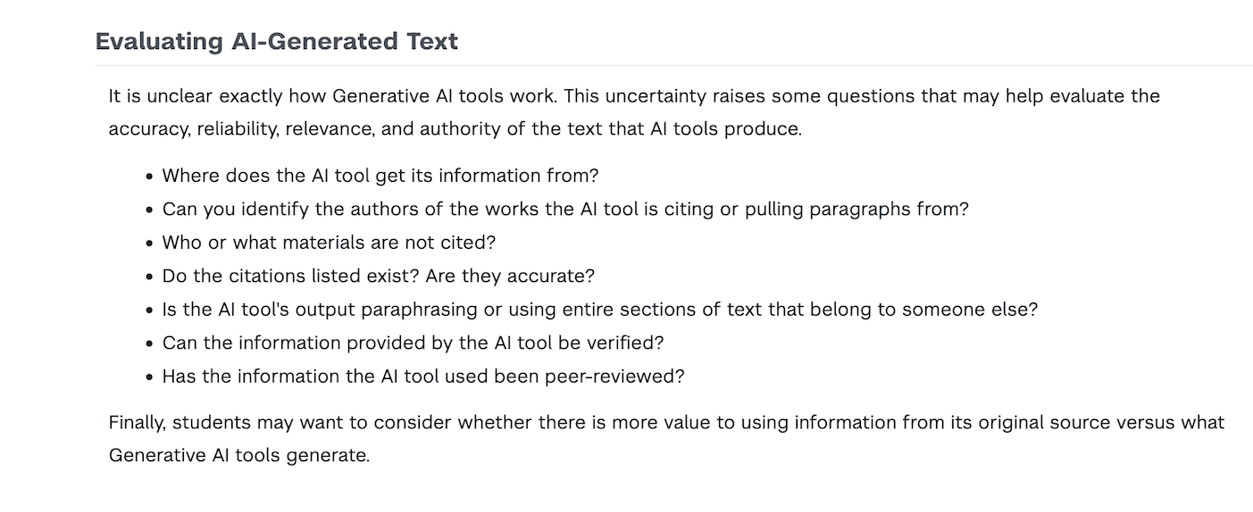
New York University
https://guides.nyu.edu/c.php?g=1307730&p=9624166

Slide 13

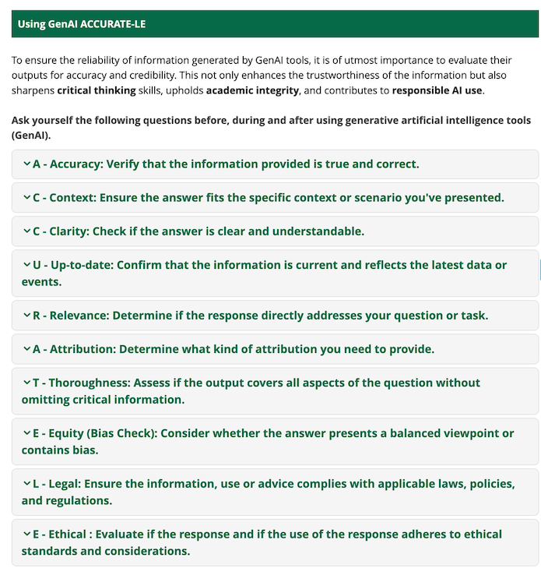
University of Saskatchewan
https://libguides.usask.ca/gen_ai/evaluating

Slide 14
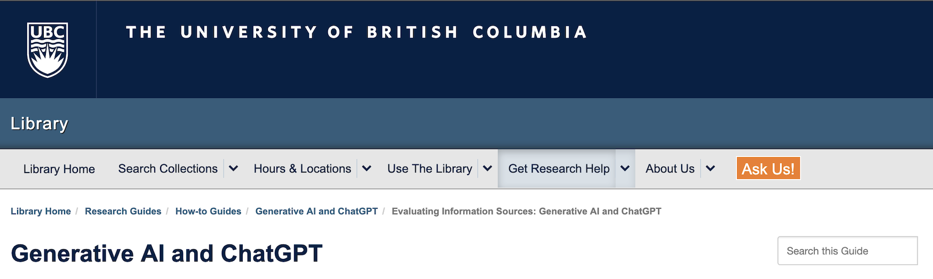
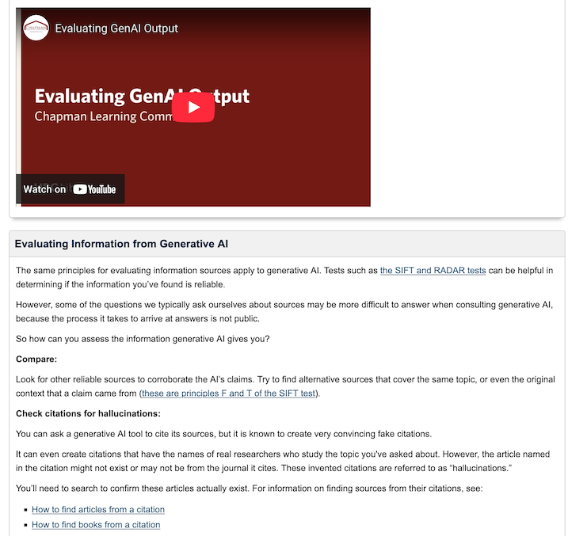
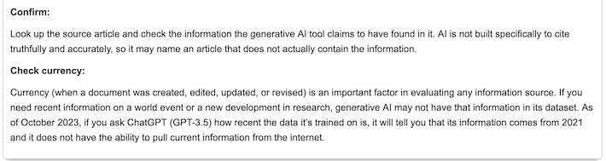
University of British Columbia
https://guides.library.ubc.ca/GenAI/Evaluating

Slide 15
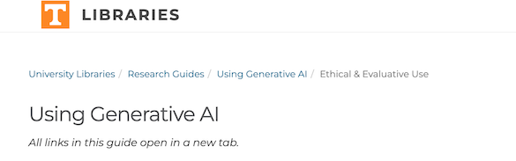
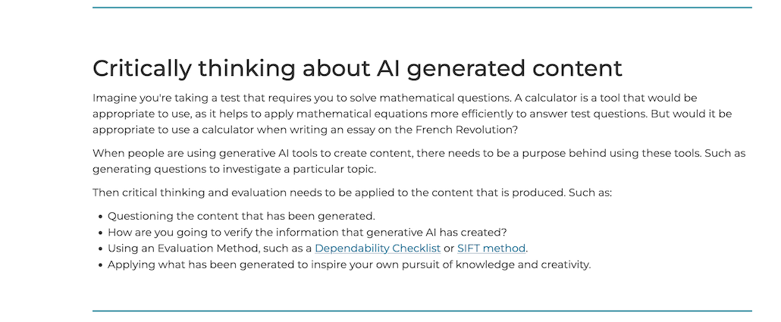
University of Tennessee Knoxville
https://libguides.utk.edu/Generative-AI/ethical-evaluative

Slide 16
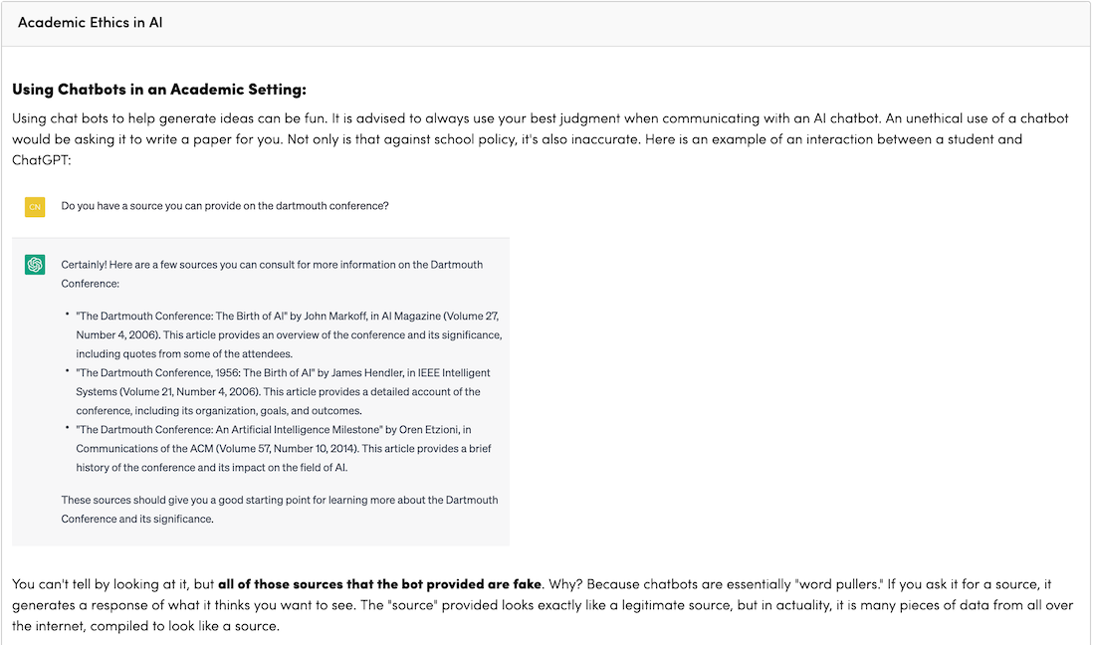
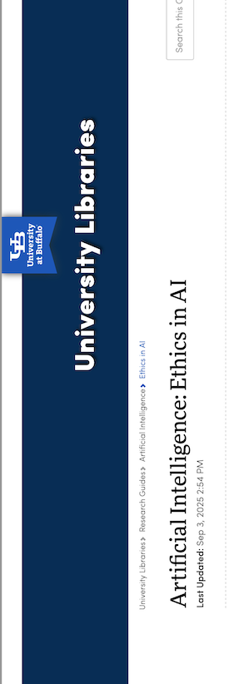
University of Buffalo
https://research.lib.buffalo.edu/artificial-intelligence/ethics

Slide 17

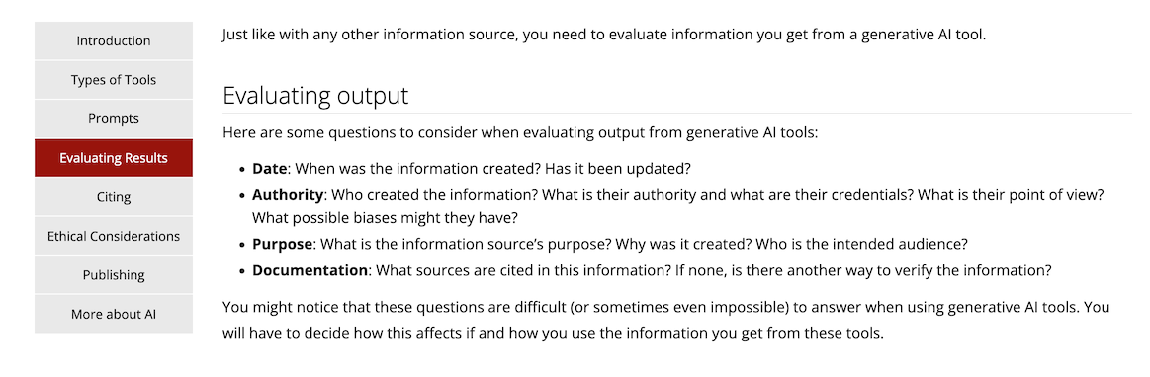
Boston College
https://libguides.bc.edu/generative-AI/evaluation

Slide 18
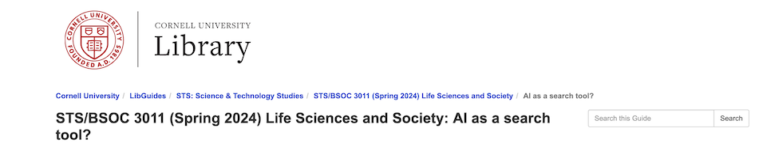
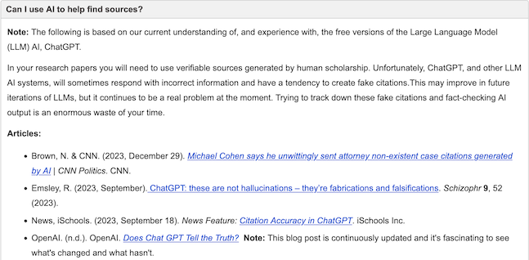
Cornell University
https://guides.library.cornell.edu/sts4041/AI

Slide 19

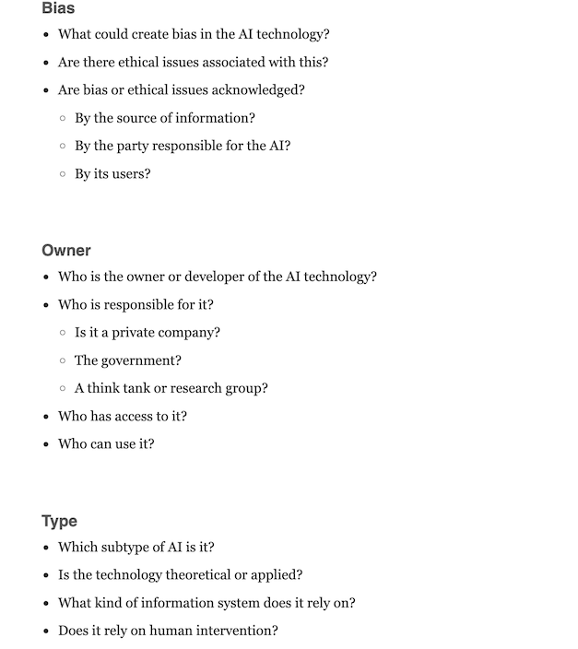
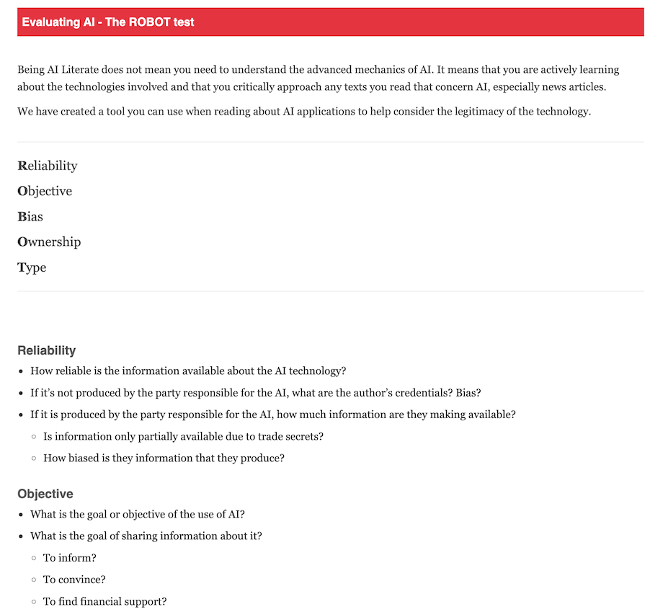
McGill University
https://libraryguides.mcgill.ca/ai/literacy

Slide 20
Summary of Findings and Meaning
Some libraries gave warnings (demonstration of problems)
Some provided general advice (guiding questions, etc.)
Some libraries recommended specific, acronym-based evaluation systems to use (ROBOT, ACCURATE-LE)
Several libraries also suggested that if it takes you too long to verify AI generated sources, you may want to use other types of sources that are easier to verify instead
Libraries that recommended specific heuristics did not always demonstrate how to apply them to AI output

Slide 21
Additional, recent recommendations from the literature:
CAT (check, ask, think, proposed by Tomaszewski)
TIMED framework for AI Evaluation (proposed by Yi et al)
  https://pressbooks.library.virginia.edu/ai-literacy/chapter/critical-evaluation-of-ai-outputs/
Notes:
This article proposes the CAT test for evaluating ChatGPT and other AI-mediated content:
Tomaszewski, R. (2025). Mnemonic evaluative frameworks in scholarly publications: A cited reference analysis across disciplines and AI-mediated contexts. The Journal of Academic Librarianship, 51(5), 103113. https://scholarworks.calstate.edu/concern/publications/jq085v781
This open access book for educators proposes the TIMED framework for evaluating AI content in its evaluation chapter:
Yi, F., Taggart, J., & Mickel, B. (2025). Fostering AI Literacy: A Guide for Educators in Higher Education. University of Virginia. https://pressbooks.library.virginia.edu/ai-literacy/
Direct link to evaluation chapter: https://pressbooks.library.virginia.edu/ai-literacy/chapter/critical-evaluation-of-ai-outputs/

Slide 22
Additional, recent recommendations from the literature, continued:
RABAC (Relevance, Accuracy, Coverage, Bias, Authority, Currency, proposed by Zang et al)
SIFT for AI, proposed by Mike Caulfield
  Get in the habit of checking things with AI, follow citations to original sources, use suggested follow up prompts to get more accurate responses from AI
Notes:
This article proposes that librarians should first instruct students in basic AI literacy and then teach them to evaluate AI output through their new suggested evaluation framework:
Zhang, C., Wang, B., Ye, S., & Khamo. (2025). Proposing a critical AI literacy framework for academic librarians: A case study of a database-anchored genAI tool for Chinese Studies. International Journal of Librarianship, 10(2), 34–47. https://doi.org/10.23974/ijol.2025.vol10.2.431
Mike Caulfield has started proposing methods of adapting SIFT to AI evaluation. Here’s one example:
Caulfield, Mike (2025, Oct 12). “Get it in, track it down, follow up: three essential moves to using AI for verification and contextualization, with a bit of LLM-specific guidance.” The End(s) of Arguement. https://mikecaulfield.substack.com/p/get-it-in-track-it-down-follow-up

Slide 23
Suggestions for teaching
Begin testing these methods
Consider AI Literacy skills or knowledge needed to evaluate output
Collaborate and share ideas
Design assignments for students to help them to start thinking and brainstorming how to fact check the output

Slide 24
Debate: When is it worth using AI?

Slide 25
Questions and Answers

