Slide 1
LOEX Fall Focus 2023 “Thinking Through” a Model for Library Support of a New General Education Course
Teresa S. Edge : Head of User & Access Services
Jill M. Borin : Interim Head of Research & Instructional Services;
Head of Archives & Distinctive Collections
Wolfgram Memorial Library

Slide 2
Outcomes & Outline
Learning outcomes:
Participants will:
Identify the variety of information literacy options offered in support of a new first-year course.
Evaluate this multi-level approach for the benefit of your library stakeholders.
Outline
Background: Who we are
New General Education Curriculum & First Year Course
Information Literacy Support
Assessment

Slide 3
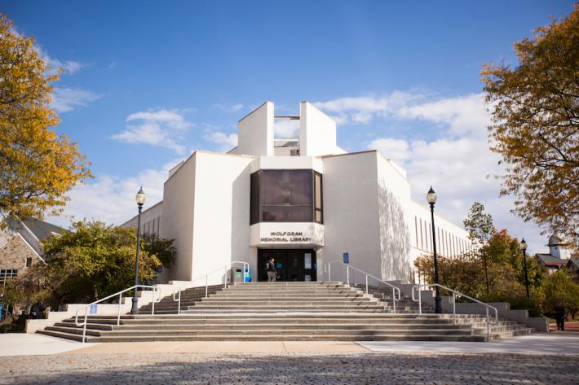
Who are we?
Widener University – Main Campus
Chester, PA; about 20 minutes south of Philadelphia
Private, Co-ed, Doctoral/Research—Intensive
4500 undergraduate and graduate students on main campus
Six Schools/Colleges: Arts & Sciences, Health & Human Services, Business, Engineering, Nursing and the Center for Graduate and Continuing Studies
Wolfgram Memorial Library
7 Librarian Faculty, including the Executive Director
Offer research support and virtual assistance 7 days/week
Liaison services to all subject areas, including outreach, collection management and information literacy

Slide 4
Foundations and Transformations – New General Education Curriculum
The program is designed to transform students, to develop ways of being, knowing, and doing that foster the habits of:
curiosity and creativity,
the ability to grapple with complexity and ambiguity,
the commitment to responsible citizenship and social justice,
and the flourishing of lifelong learning for personal and professional growth.

Slide 5
ASC 101 – Thinking Through
All students take ASC 101: Thinking Through during their first year.
Each ASC 101 class explores a pressing question - a question of great significance that asks us to engage with the big issues that shape our world, our ways of relating to each other, or our ways of producing and sharing knowledge.
ASC 101 is a chance to explore new ways of thinking, outside of a student's major.
2023-2024 Undergraduate Course Catalog

Slide 6
Learning Objectives
Students will be able to:
analyze and evaluate a pressing question with attention to students’ own worldviews.
engage with multiple perspectives related to a pressing question.
differentiate opinions and beliefs from evidence-based claims and recognize that kinds of evidence will vary from subject to subject.
2023-2024 Undergraduate Course Catalog

Slide 7
ASC 101 Courses
Know no Limits: Borders -- Anthropology Professor
What would a world without borders look like?
Our Monsters, Our Selves – Creative Writing/Theater Professor
Why are we compelled to create monsters? What do they tell us about our past, ourselves, and our world?
Conspiracy Theories – Psychology Professor
How do we evaluate alternative explanations of commonly accepted beliefs?
Pirates: Heroes or Villains?– History Professor
What is it about pirates that has caused many to see a group of seemingly unsavory figures as heroes?
Life in the Universe – Physics Professor
Is there alien life out there?

Slide 8
Multifaceted Library Support Program
Embedded Librarian - enables the librarian to view all course assignments and contact the students through timely announcements.
Class Specific Research Guide –provides access to digital resources and research tools related to class topics, all in one place.
In Person Scavenger Hunt - highlights important tasks and includes puzzles, riddles, and clues designed to create memorable connections for future research.
Library Instruction Classes - customized instruction sessions for the class. Can Include: keyword searching, resource searching and assessing results, evaluating resources and citing sources.

Slide 9
Scavenger Hunt Handout

Slide 10
Sample Clues

Slide 11
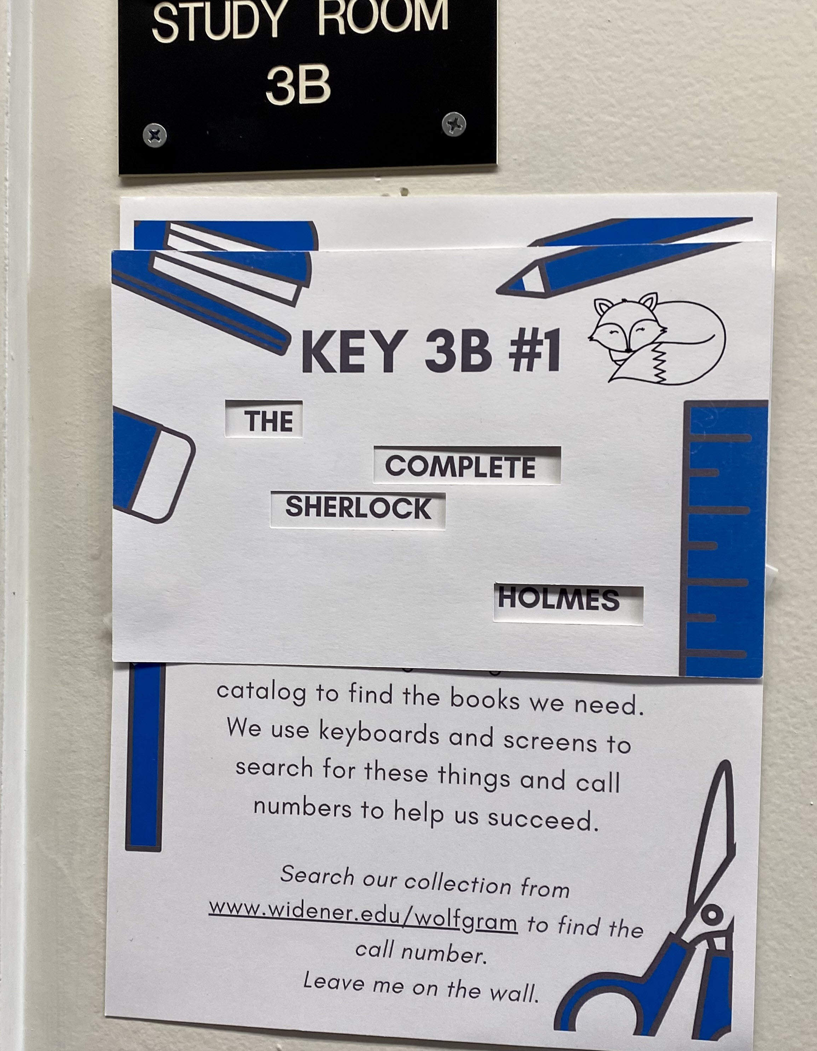
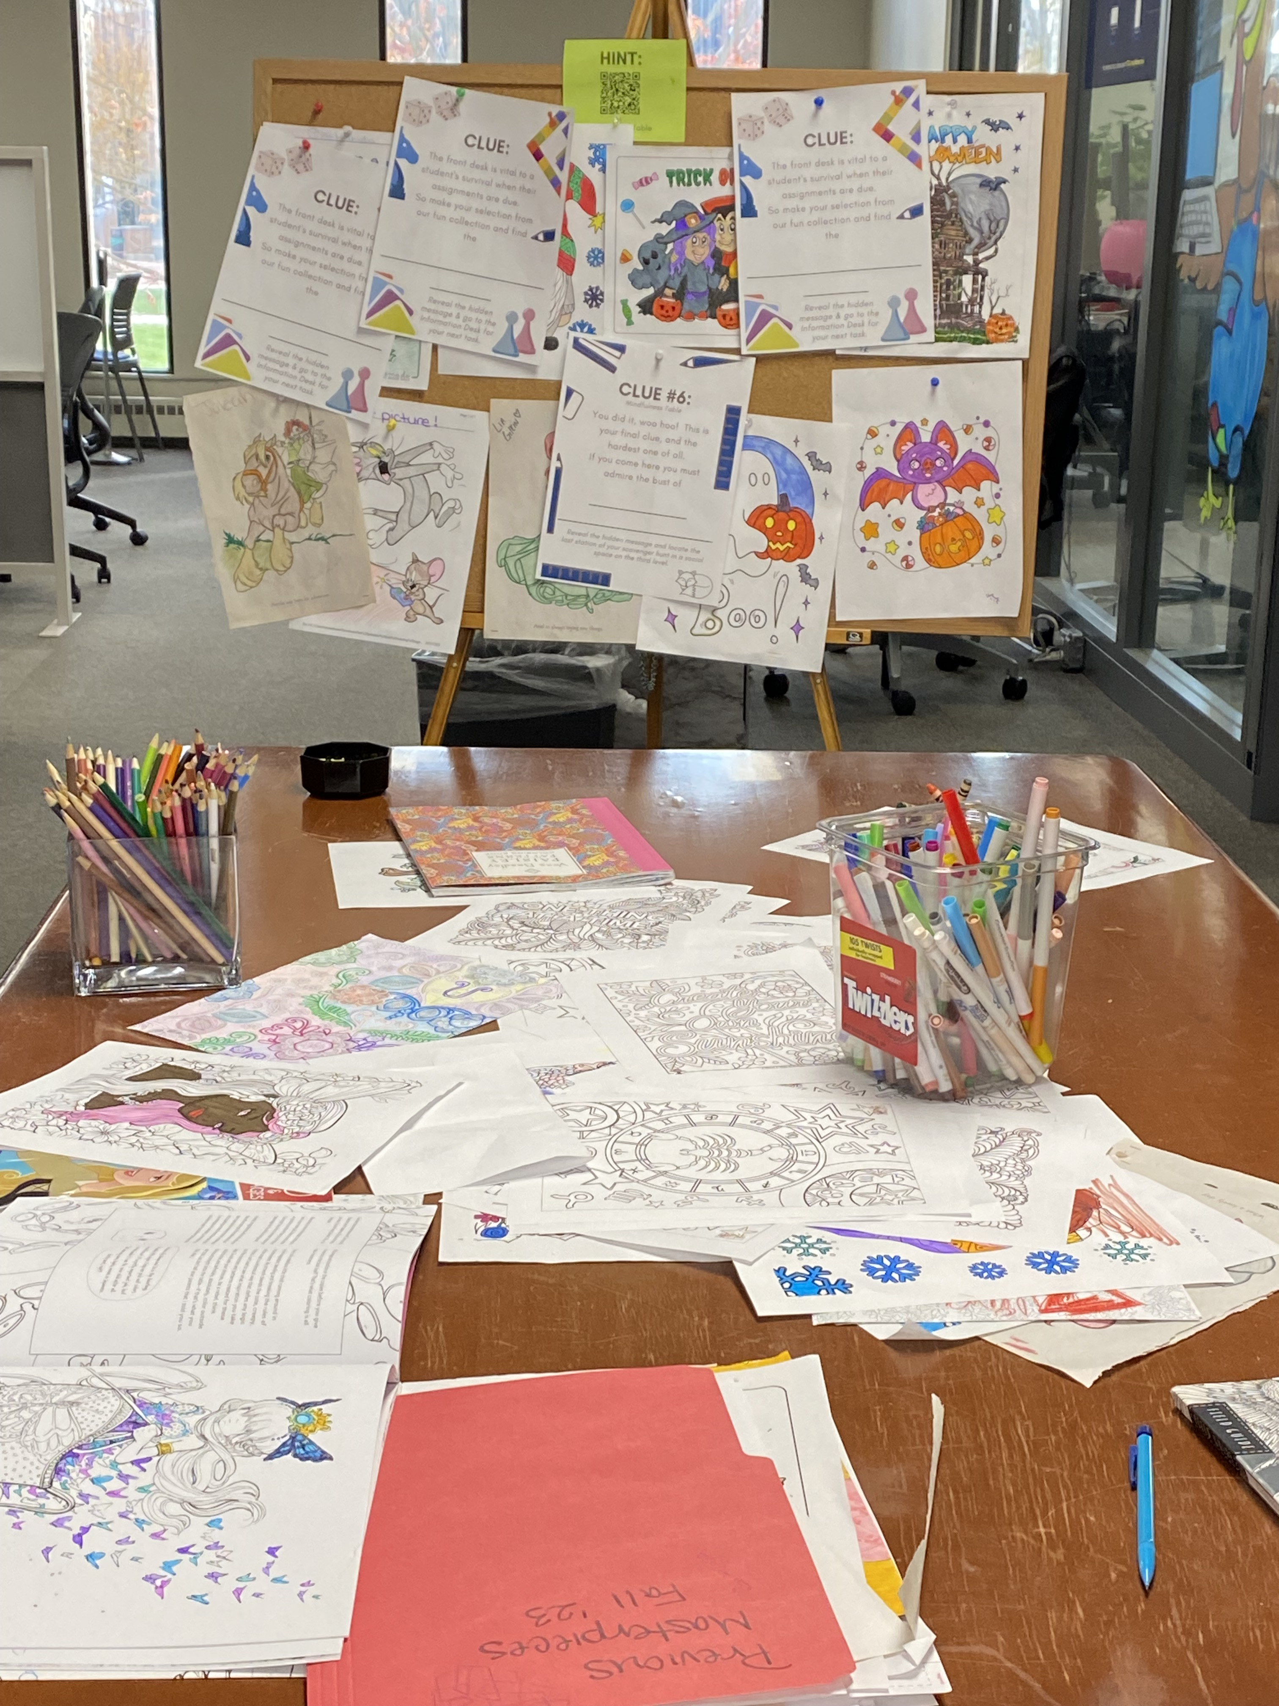
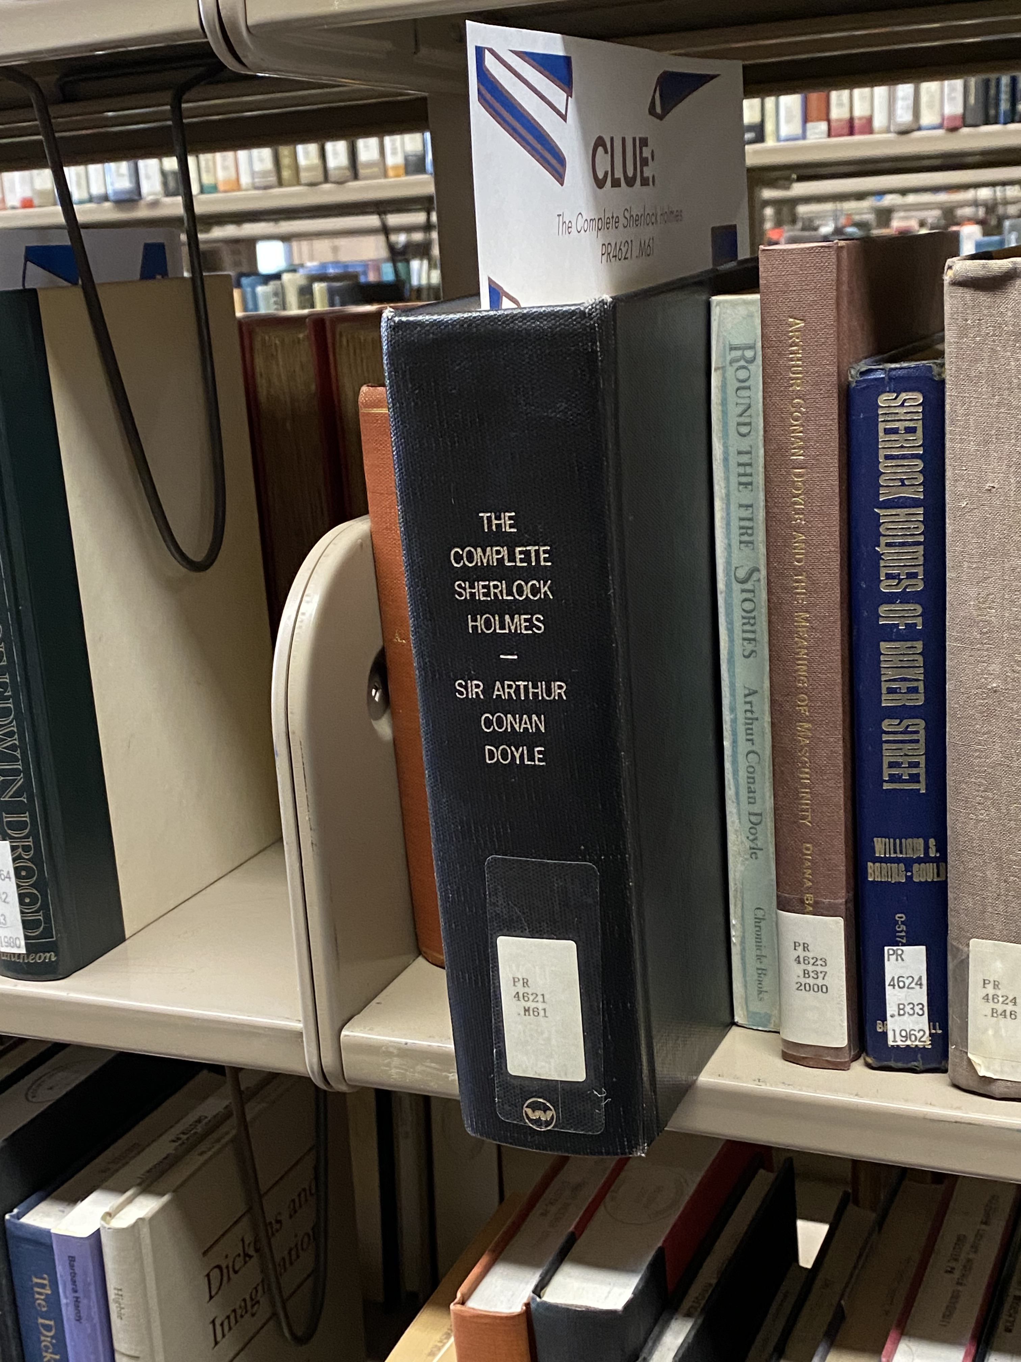
Clues Around the Library
Study Rooms ➟ Circulating Books
Mindfulness Table

Slide 12
Distribution of Classes
52 ASC 101 Classes for 892 First Year Students.
Distributed to 7 librarians roughly by subject specialty.
Many Social Science and Humanities classes, yet several classes taught by professors in the sciences.
Health Sciences, Humanities, History/Social Work and Engineering Librarians taught Social Science and Humanities ASC 101 classes.
Librarians were assigned 8-11 classes.

Slide 13
Outreach
Attended Spring 2023 ASC Workshop
Asked Director of the General Education Foundations and Transformations Program to send flyer in mid-July and late August to ASC 101 Faculty
Librarians sent flyer to assigned ASC 101 faculty in late August and late September.
Flyer provided a link to Qualtrics Survey for registration and faculty encouraged to register with librarian directly

Slide 14
What questions do you have at this point?

Slide 15
Levels of Participation
Total sections = 52
Sections with library intervention = 37 (70%)

Slide 16
Assessment: Embedded Librarian
9 courses embedded a librarian within their Canvas section
Primarily used to post announcements regarding library resources and services
Valuable to have access to assignments and calendar for timely announcements

Slide 17
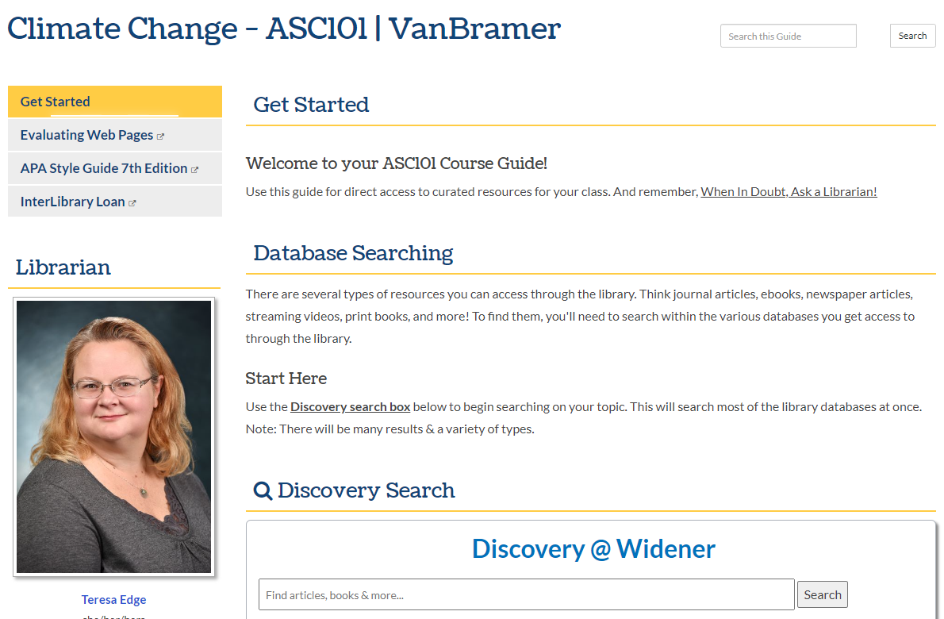
Assessment: Course Guides
Only 3 professors requested a course guide
Each guide was viewed 20-60 times so far
A valuable resource with minimal investment

Slide 18
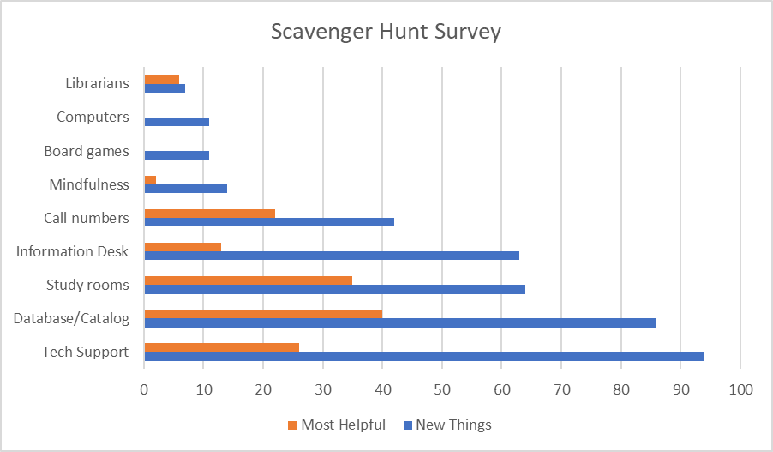
Assessment: Scavenger Hunt
The library has lots of cool spaces!
Last stop on the hunt included a QR code to a feedback survey
150 total responses
List three things you learned. What was most helpful? What remaining questions do you have?
What are the library hours?
How can I check out a book?
How do I print?
How do I book a study room?

Slide 19
Assessment: Instruction
Librarians are here to help!
Librarians were able to share a feedback survey with students in some sections.
Sessions were tailored to each specific course, so content varied
51 total responses
Interlibrary loan
Lateral Reading
Library hours
Finding Credible Sources
APA/MLA format

Slide 20
Take-aways
What went well?
Early communication with ASC101 faculty and high interest
Connected students with library early in the semester
Able to reach the majority of class sections, some with multiple interventions
All feedback was overwhelmingly positive
How can we do better?
Immediately realized we needed to simplify the scavenger hunt
Students who had only library instruction missed “tour” type information
Consider streamlining and clarifying options. Heavy work load for all librarians and overlap with FYS and ENG101
Scheduling of instruction sessions closer to student time of need

Slide 21
Thank you!
Questions?

