Slide 1
FIRST-YEAR STUDENTS AT A PRIVATE, JESUIT INSTITUTION: ENGAGING FIRST-GEN STUDENTS AND EMPHASIZING THE LIBRARY AS A SPACE FOR EVERYONE
Rose Melonis
Creighton University
Rosemelonis@creighton.edu

Slide 2
Jesuit understanding of "cura personalis"
Latin meaning, “care for the person” or “personal care,” Cura Personalis is having concern and care for the personal development of the “whole person” and dedication to promoting human dignity.

Slide 3
Definitions
TRiO:
The Federal TRIO Programs (TRIO) are Federal outreach and student services programs designed to identify and provide services for individuals from disadvantaged backgrounds. TRIO includes eight programs targeted to serve and assist low-income individuals, first-generation college students, and individuals with disabilities to progress through the academic pipeline from middle school to postbaccalaureate programs.
SSS:
The purpose of Student Support Services Program (SSS) is to increase the number of low-income college students, first generation students, and college students with disabilities who successfully complete a program of study at the postsecondary level.

Slide 4
Starting out
In 2020, the SSS director requested a library class session for her lab students that went beyond our basic library scavenger hunt
This led to further conversations and our partnership began

Slide 5
Library Services for SSS Lab
Wanted them to come with an assignment from one of their classes
Created a short "intro to the library website video" to reference again
Live demo with student questions; see me struggle! Research as a process.
How you can meet 1:1 with a librarian

Slide 6
Strategic Plan: Actions items
Update information literacy sessions for first-year students to include background on what academic libraries provide for those who have not had prior access to one.
Host annual open house event for first generation and international students.

Slide 7
Library Encounter Online (LEO)
LEO public link
Created in Canvas
Required course for all freshmen

Slide 8
Revised LEO
Included:
Introduction to Academic Libraries
Library-related terminology defined
Changed quizzes from "2 chances and you are done" to unlimited chances to keep trying

Slide 9
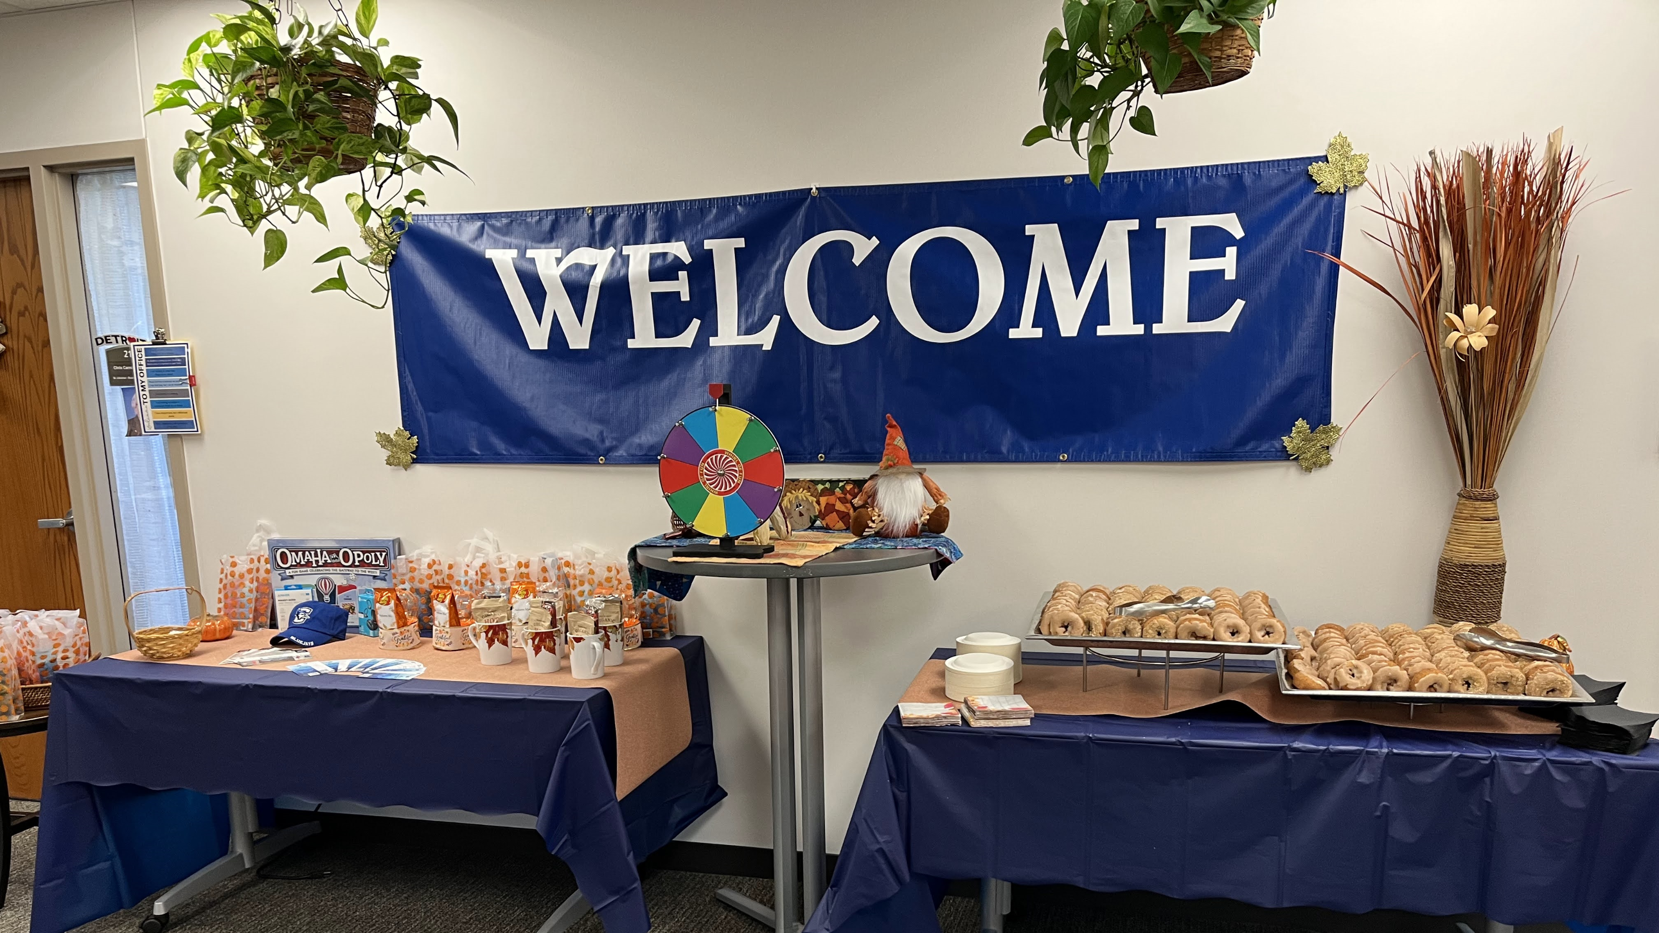
Fall Open House

Slide 10
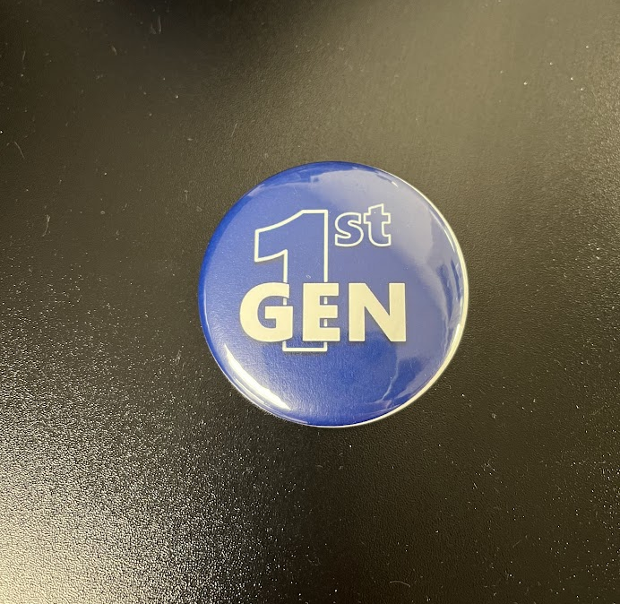
Fall Open House
Any 1st Gen staff wore 1st Gen buttons
Coincided with Family Weekend, so parents and siblings could attend

Slide 11
Passport

Slide 12
Thank you!

Slide 13
Bibliography materials
-Conversations with former director of SSS lab
-Vanderbilt Center for Teaching: Teaching First-Generation College Students
https://cft.vanderbilt.edu/guides-sub-pages/teaching-first-generation-college-students/
-Creighton Library's strategic plan
-Cura Personalis: Some Ignatian Inspirations: https://epublications.regis.edu/jhe/vol3/iss2/2/
-TRiO and SSS: https://www2.ed.gov/programs/triostudsupp/index.html
https://www2.ed.gov/about/offices/list/ope/trio/index.html

