Slide 1
How-To Tuesday: A dynamic approach to library workshop programming in the First Year Experience to promote persistence and student success
LOEX Fall Focus 2023 // November 12, 2023

Slide 2
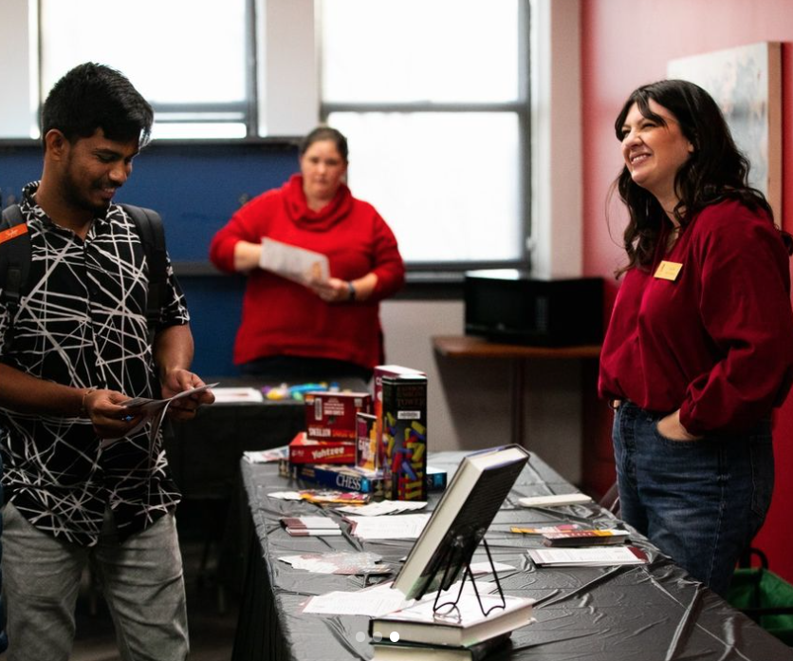
Camille Abdeljawad (she/her)
Assistant Professor, Instruction & Outreach Librarian
Park University in Parkville, MO
camille.abdeljawad@park.edu
816-584-6282

Slide 3
Park University
Mid-size, private, Liberal Arts University outside of Kansas City, in Parkville, MO
58.7% of student body is military-affiliated
Average age of undergraduates is 30 y/o
8,000 students
4,969 FTE in Fall of 2022
Predominantly (about 80%) take classes online or at Campus Centers)
800 located on Parkville campus
Most are contemporary and part-time students

Slide 4
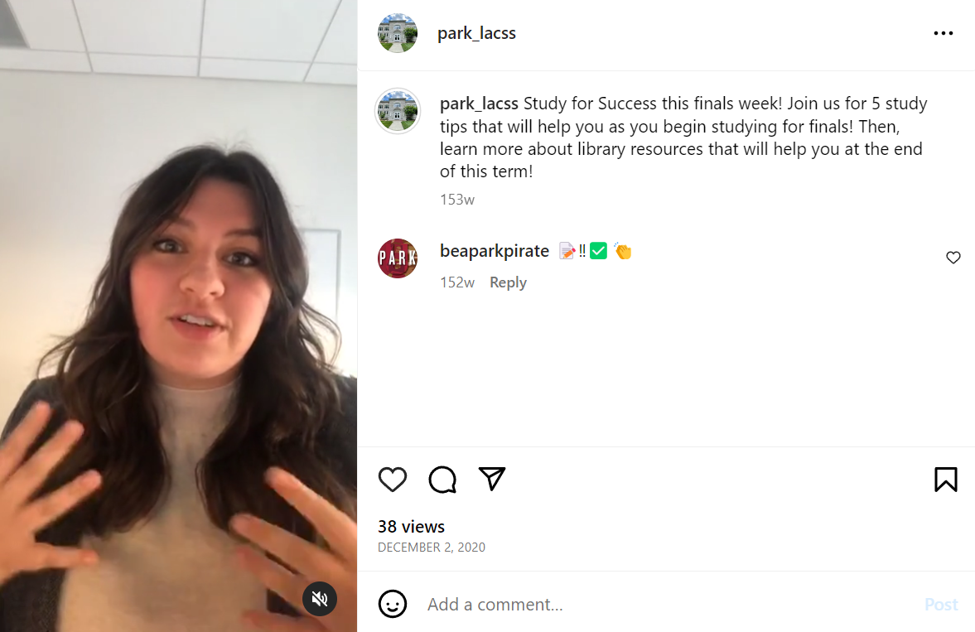
The graveyard of How-To Tuesdays past…
Notes:
A sad history of how How-To Tuesday came to be… I came to be a librarian in a really strange time. I graduated with my MLS in May of 2020 and

Slide 5
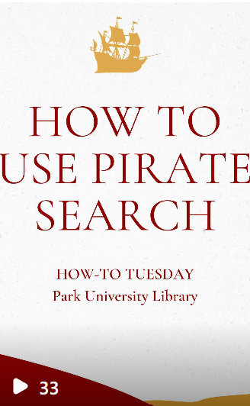
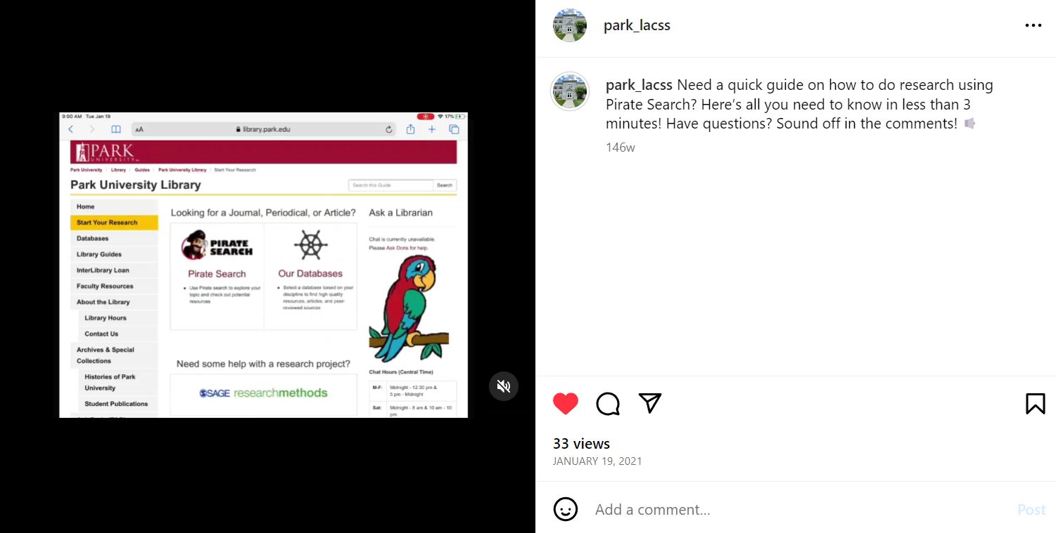

Slide 6
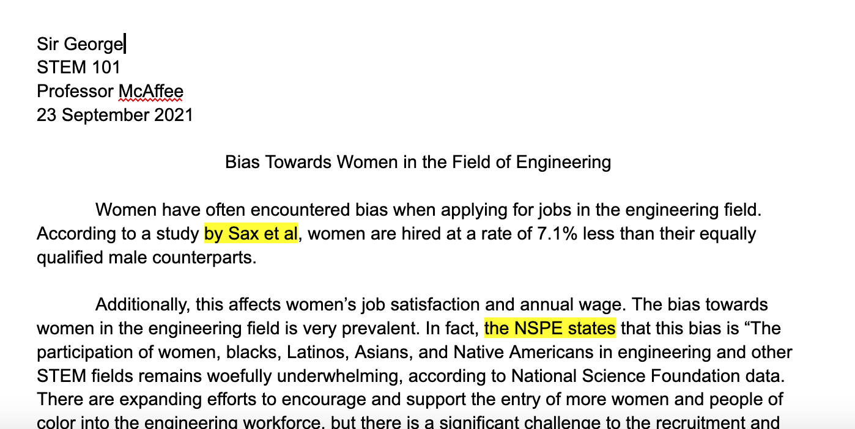
Notes:
Monthly over the lunch hour
all students (both graduate and undergraduate), faculty, and staff. What I found? Even though I was casting a wide net, I still wasn’t getting any fish – literally! I had many workshops with zero attendees!

Slide 7
Why isn’t this working?
I wasn’t meeting students at their direct point of need
I wasn’t reaching students where they natively are
Notes:
I was out of touch with the academic cycle. What were students doing and when.
I was missing a key demographic – our online students who make up 90% of our student population.

Slide 8
Enter First Year Experience…
First Year Experience 100
8-Week Blended Modality
3 hours in class / 3 hours of asynchronous coursework
Required for all new-to-college students, highly recommended for transfer
Brand new curriculum
First Year Experience
New home & leadership in the library
Provided a built-in audience for workshops
Scaffolding to curriculum
Notes:
Right around this time, another on-campus department was failing and looking to … First Year Experience. Originally part of our Liberal Education program, our 3 credit hour First Year Experience class – LE100 – actually had one of the worst successful course completion rates across the entire institution, at about a 75% pass rate. It was clear that students were less college ready than before AND that this class was not serving it’s intended purpose to prepare them for the rigor of college life.

Slide 9
How-To Tuesday 2.0
Completely Virtual via Zoom
10-15 min of direct instruction, 5 min of Q&A
Register now, watch on demand model
Direct response to knowing our unique student population
Weekly Format
Campus Partnerships
Aligned topics to FYE100 curriculum
More intentional marketing
Advertised within FYE100 as a step to complete the “Campus Challenge”

Slide 10
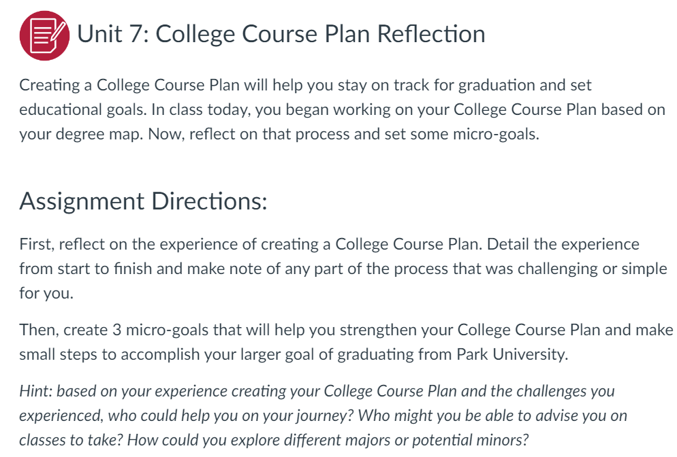
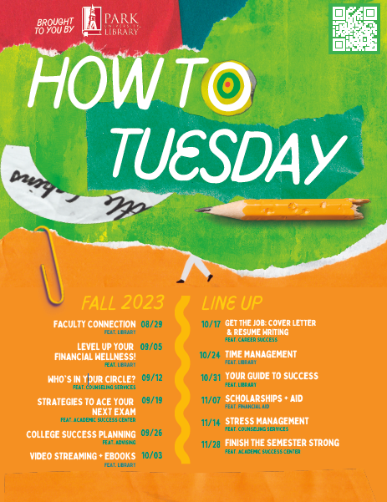
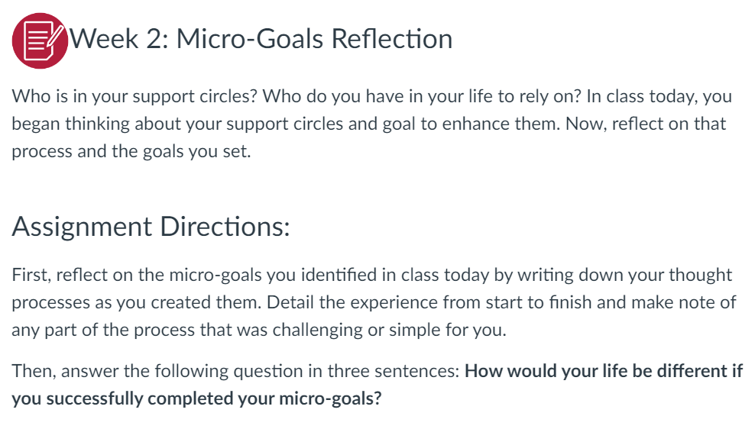

Slide 11
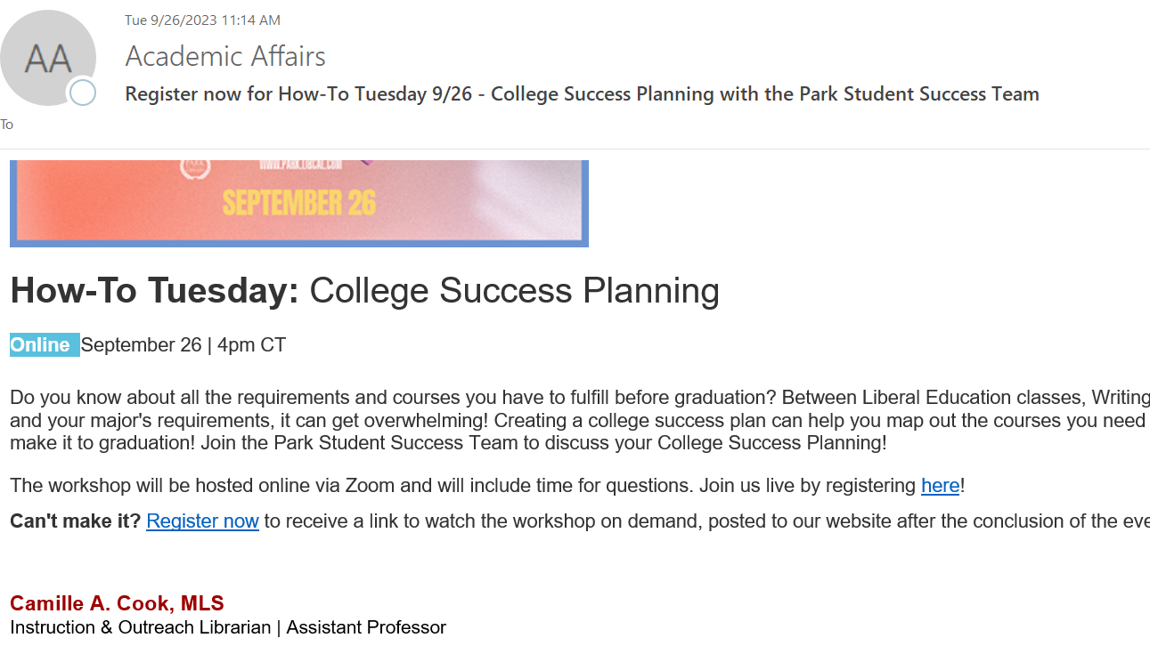

Slide 12
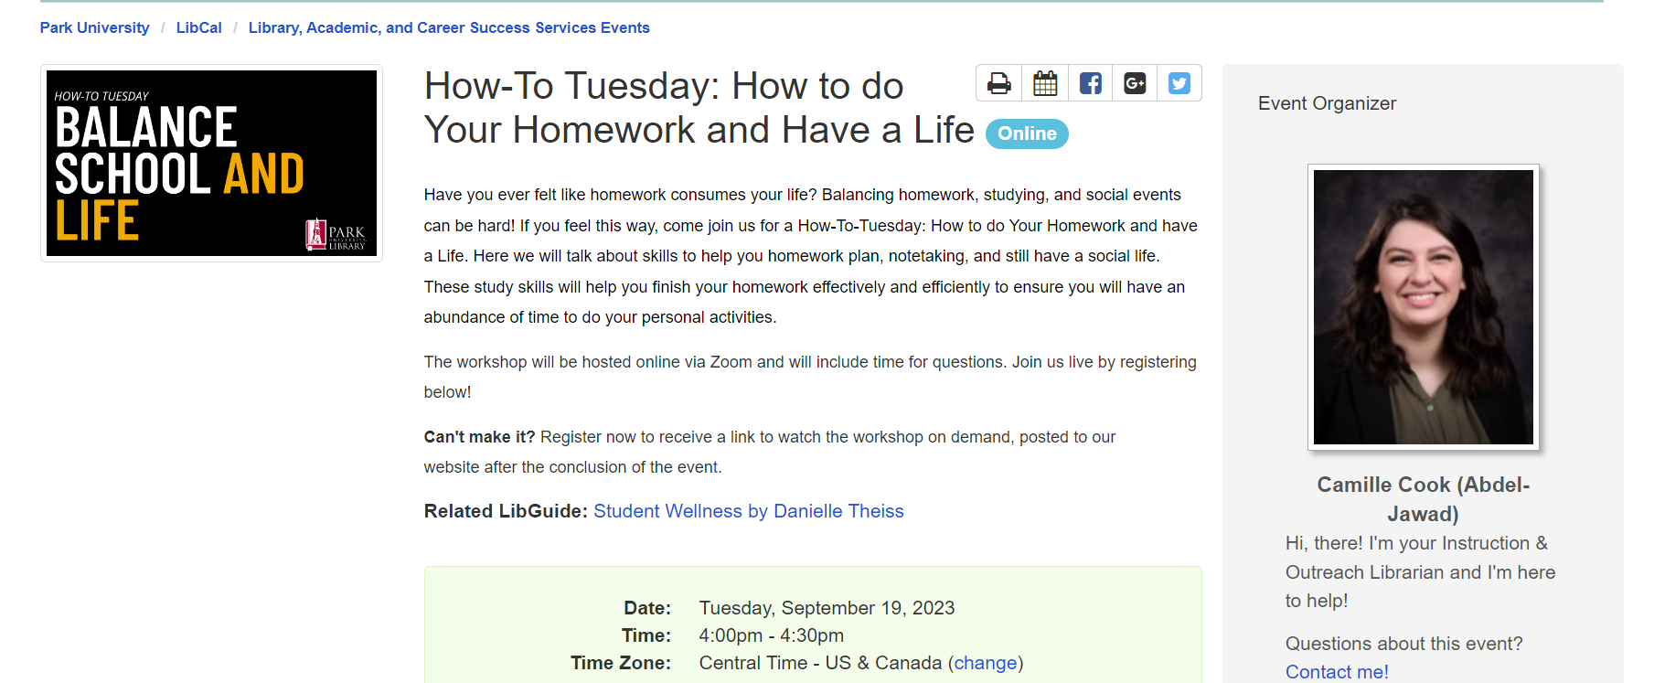
50-75 registrations per session on average!

Slide 13
Why is this working?
Smaller pool, more fish
Meeting students at their point of need, where they are (ONLINE!)
Register now, recording on-demand on their own schedule
Campus Challenge to attend 3 on-campus events built into curriculum
Programming designed with their curriculum in mind

Slide 14
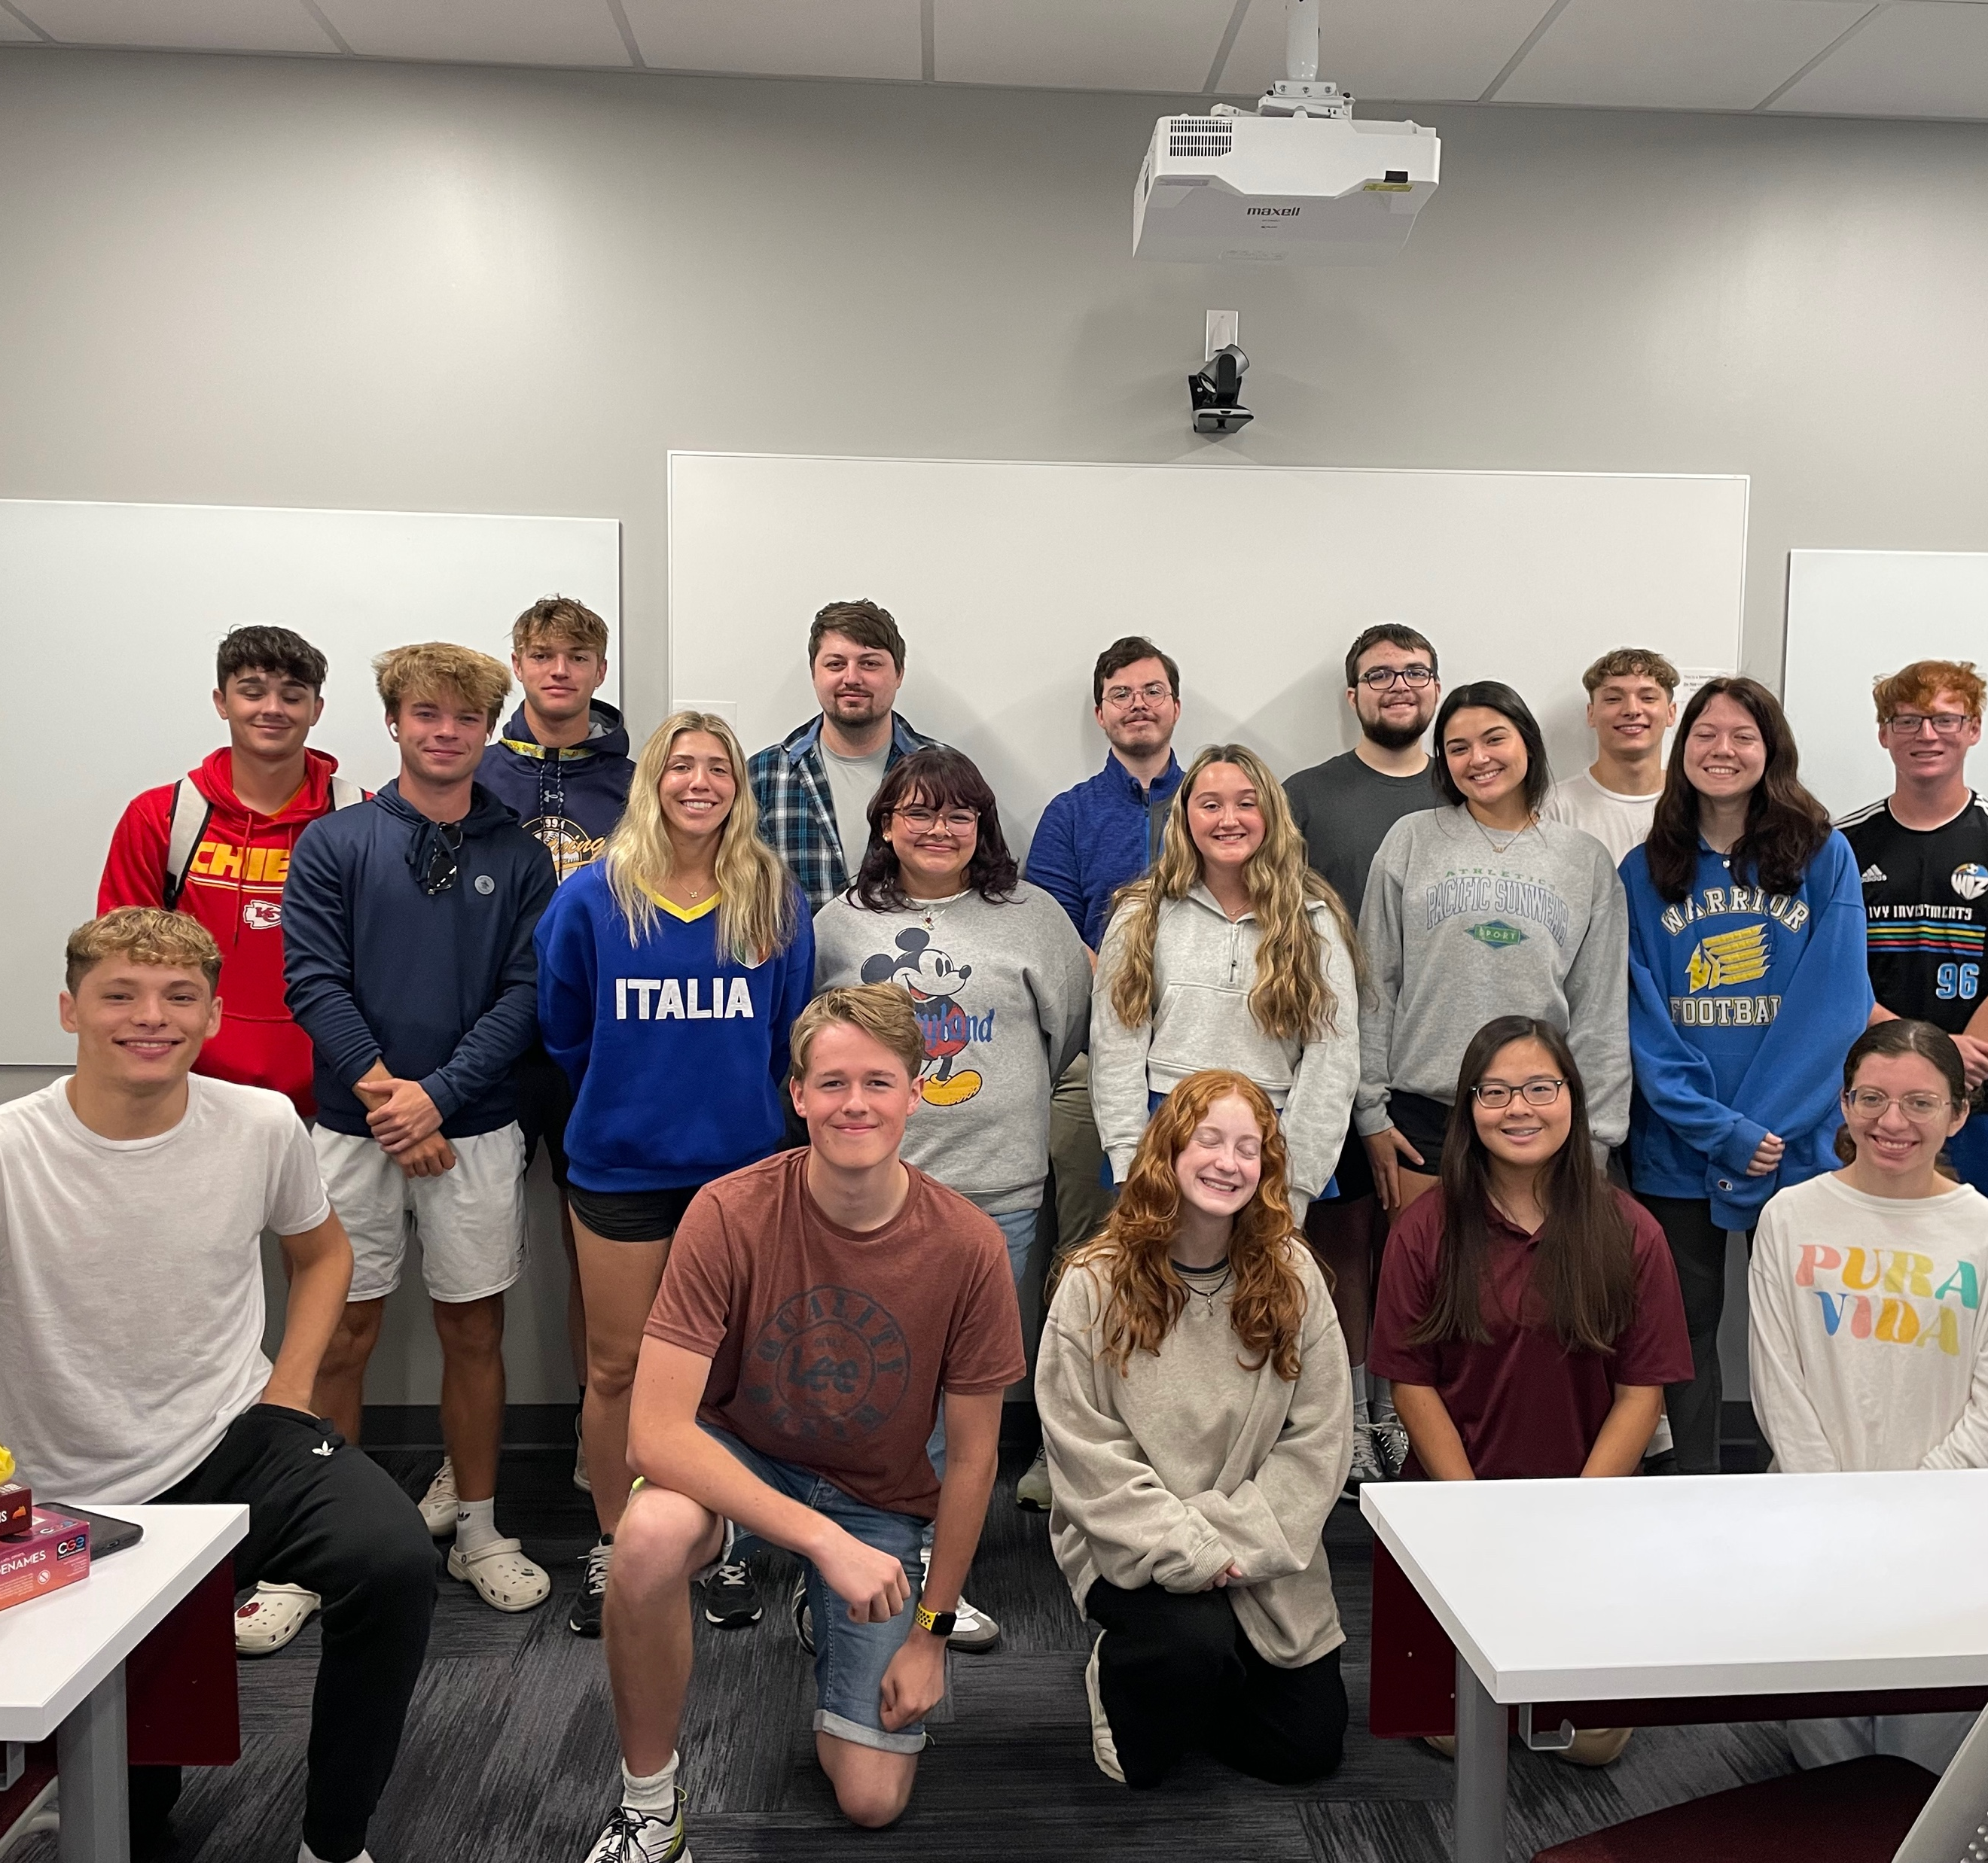
Our results
This was our BEST year of First Year Experience at Park with our HIGHEST co-curricular involvement and BEST successful course-completion rate.

Slide 15
Reviving YOUR Library Workshops
Assessing your student body
01
Who are your students? What do they need?
Where can you reach them? Where do they organically access information at your institution? (In-Person? Online? Both?)
Who is your target audience for these workshops?
Intentional marketing can be okay!
Target audience is critical for success
Partnering for Success
02
How can you supplement a pre-existing curriculum?
What areas can provide support for a pre-existing need?
EX: Students need additional exposure to on-campus services in the first year
What can you do today to start building partnerships with key stakeholders?

Slide 16
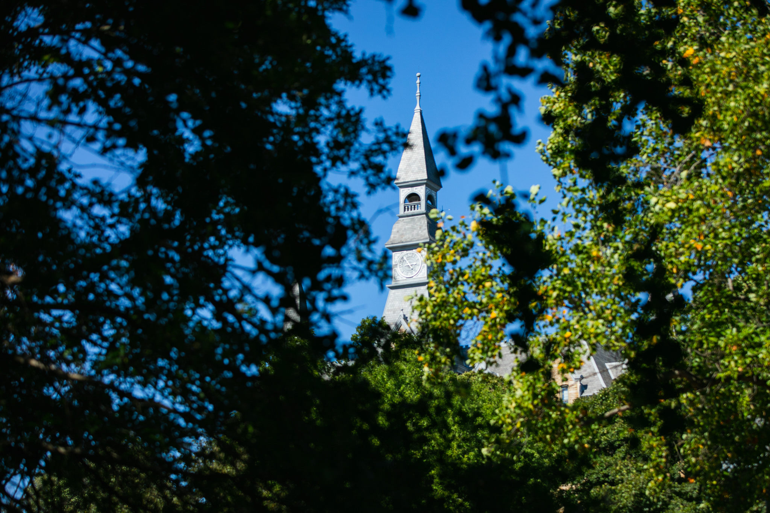
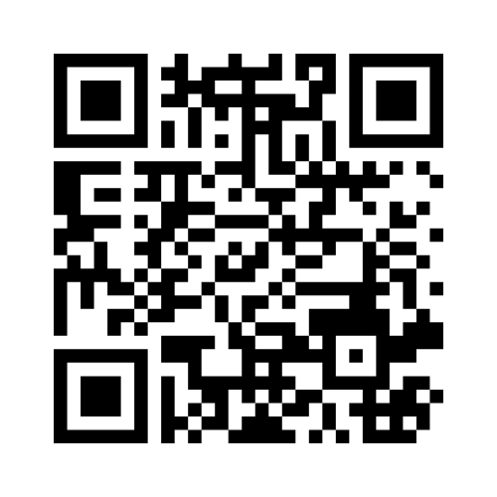
What’s your next step?
https://www.menti.com/alcicy2kwt1x

Slide 17
Questions?
Camille Abdeljawad
Assistant Professor, Instruction & Outreach Librarian
Park University
camille.abdeljawad@park.edu
816-584-6282

