Slide 1
More Than One Shot: Collectively Scaffolding Information Literacy in the First-Year Seminar
Brittany O’Neill
University of North Carolina Wilmington

Slide 2
About
Me
Information Literacy Librarian since 2022
Liaison to University College, English Composition & Honors College
Coordinator of Information Literacy Faculty Fellows program
University of North Carolina Wilmington
State System’s coastal university in Wilmington, NC
Predominately White Institution
~18,000 students (~5,000 new students this Fall)
Information Literacy at UNCW
IL is a common SLO for University Studies
UNI 101
Required First-Year Seminar
IL-designated, 3-credit course
100+ sections, ~2500 students
Instructors: combination of disciplinary faculty, advisors, and adjuncts
Randall Library – Academic & Research Engagement
14 librarians (liaisons, teaching & learning team & scholarly research services team)

Slide 3
Information Literacy is a Shared Responsibility
IL as a University Studies SLO
3 IL SLOs tied to ACRL Framework
6-credits required (1 class must be in major)
Randall Library Information Literacy Faculty Fellows program
A semester-long intensive for faculty to build IL skills and apply to a course-related project
In UNI, shift to shared responsibility over time:
Pre-COVID: face-to-face one-shots with librarians
Early COVID: Canvas modules
2022-2023: train-the-trainer lesson plan (more on this later!)
2023-2024: IL embedded in curriculum (also more on this later!)

Slide 4
Sustainability Challenges
UNI desired a return to F2F
Recent R2 status, growing enrollment, new programs
Unsustainable demand for one-shots: liaisons shift from shared responsibility for UNI to focus on subject areas
100+ one-shots is too much for one person!

Slide 5
Curricular Challenges
IL out of context within course
Deficit narratives in curriculum
“The deficit model of education focuses on learners’ weaknesses, including the knowledge, motivation, or cultural values that they presumably lack. First widely theorized and applied in the 1960s and 1970s, the deficit model provided an easy explanation for why some students could not achieve as much as others: these learners simply were not applying themselves. Deficit models have seen a resurgence in the last decade under different names, most notably grit and growth mind-set” (Tewell, 2020).
Library desired emphasis for asset-based pedagogy to counteract existing deficit approaches
Asset-based pedagogies: a collection of approaches that focus on the strengths of students’ diverse backgrounds, in direct response to deficit models; an umbrella under which more inclusive approaches (e.g. culturally relevant pedagogy) fall (California Department of Education, 2022)
E.g. connecting learning to lived experience, providing choice/student agency, addressing systemic issues in LIS, student-led learning, discussing social constructions of knowledge

Slide 6
A Brief Introduction to the Fall 2022 Pilot
“Train-the-trainer” lesson plan
A librarian-created lesson plan focused on evaluating information for academic research using everyday research scenarios (and cats!) – but to be delivered by the UNI instructors
This proposed activity and background behind it was shared by Zelick & Webster @ LOEX 2022!
Presented at UNCW First-Year Studies Conference – embraced by UNI admin
Train-the-trainer session at Fall instructor kickoff

Slide 7
Feedback: End-of-Semester Assessment
Faculty: mostly positive, but some found the lesson hard to connect to completing research papers and wanted more IL SLOs covered
Some faculty suggested more than one lesson would be helpful
Students: predominantly choosing appropriate sources, but some struggle to identify source types
Anecdotally, some also shared that this didn’t help them with a paper

Slide 8
Cornerstones of Research
Spring 2023 Cornerstones of Research Workshop Series
Aimed at first-year students, but open to all – promoted through liaisons and library outreach & engagement
5 1-hour, virtual workshops with a focus on active learning
Attendance poor, but not a failure!

Slide 9
Planning for Fall 2023
Service on University Studies Advisory Committee
Conversations about IL being central, but feeling disjointed, and the focus on a paper not making a sense as a non-writing-intensive course
Desires to make changes now given potential textbook changes, growing enrollment
UNI proposed:
Eliminating the research paper; shift to research portfolio
More IL lessons, inspired by Cornerstones of Research Workshop series topics
As a committee, discussed desired SLOs and ideal number of class sessions
Discussion about workload and shared responsibilities
Combine efforts and work on 4 lesson plans, together, that capture all 3 IL SLOs
Team composition:
2 librarians (me, and Zelick, who contributed to the original lesson plan and Cornerstones)
1 instructional designer (also a librarian and UNI instructor)
2 UNI instructors (who were inspired by Cornerstones)
2 UNI admins (who had supported the 2022 pilot)

Slide 10
Creating the Lesson Plans
“Imagine you are writing a paper…”
Each lesson plan addresses a step in the research process
Pre-class flipped work
In-class mini-lecture
In-class group activity & discussion
Post-class homework
Each lesson plan builds on the last (e.g. first assignment builds a search strategy, second assignment applies that search strategy to finding popular sources) and incorporates reflection
Uses instructional scaffolding
Scaffolding: providing supports to students, building on existing knowledge as they master new skills and build knowledge (Chittooran, 2018)
Final project: research portfolio combining all previous assignments with a reflection
Created in pairs and as a group over summer of 2023 with asynchronous options

Slide 11
The New Modules
#1
Inquire & Explore
#2
Evaluate
Research questions/search strategies/intro to library
Evaluating info/fact-checking/popular sources
#3
Identify & Analyze
#4
Citations & Plagiarism
Understanding scholarly articles/peer review/info synthesis
Why/how we cite (style-agnostic, trauma-informed)
Notes:
Asset-based approaches include: highlighting prior experiences and pitfalls with research, sharing personal values for evaluating information, “everyday research” experience, acknowledging past negative experiences with citation instruction, transparent and reflective for both student and instructor, flexibility in assignment topics and some products

Slide 12
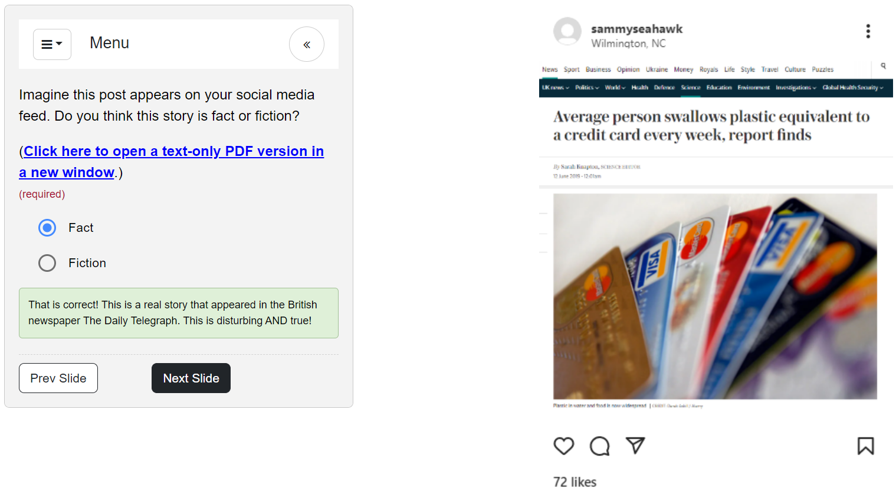
Example – Module #2 (Evaluate)
Before class:
SIFTing through the Trash tutorial + reflection (completion grade)
During class:
Mini-lecture on what makes a source “good”
Everyday research Cats group activity + class discussion
Think-pair-share on differences in what we value most as we evaluate
After class:
Using search strategy from module 1, find two popular sources
Explain what makes them good for their need
SIFT those sources

Slide 13
Instructors Receive:
Canvas shell with all content ready-built
Lesson plan with timings + flexible modality options
Discussion facilitator guide
Slide deck
Worksheets
Canvas assignments
Ample opportunities for feedback, training, and support
First-Year Studies Conference
Fall UNI instructor Kickoff
UNI Lunch & Learn Panel
IL instructional design consultations

Slide 14
Outcomes (so far) & Next Steps
Fully course integrated + 20% of total grade
Required for all UNI courses, with opportunity to better align curriculum of Honors and Transfer versions of FYS
Opportunity for students to “double-dip” with research in other courses and receive support for it
New OER textbook
Cost-savings of more than $225,000
IL component built into textbook
What’s next?
End-of-semester survey
Collaborating with assessment coordinator & new research analyst on student outcomes
Tweaks for Fall 2024
More intentional with asset-based pedagogy
Reflect faculty feedback
Student-led learning
Notes:
Course integration: pre-class homework and post-class assignments = 20% of total grade
Required for all UNI courses (HON 110 may choose one or more or use Canvas modules) – opportunity to better align those programs
Should better prep students for other courses (and for UNI 201’s paper)
New OER textbook
Cost-savings of more than $225,000
IL component built into textbook
What’s next?
Gathering feedback – Lunch & Learn, end-of semester survey
Collaborating with assessment coordinator on student outcomes
Tweaks for Fall 2024 – but nothing major

Slide 15
Tips
Foster a culture of shared responsibility for IL through faculty development
Faculty development programs (like ILFF) – but smart small!
Be confident in positioning yourself as a collaborator and consultant

Slide 16
Tips
Identify partnerships & IL champions
This could look like…
That faculty member who always wants to collaborate with you
The administrator who always goes to bat for the library
Program coordinators/department chairs
Online learning/instructional designers
Your center for teaching/faculty
Students

Slide 17
Tips
Reduce (burnout), reuse, recycle
Create workshops/lesson plans that can be reused and adapted (by you or other faculty)
Make use of scaffolding, active learning & asset-based pedagogies
Make them open!

Slide 18
Tips
Get seats at the right tables
Advocate for IL in your curriculum
Get on relevant faculty/staff committees & be where the faculty are

Slide 19
Tips
Accept baby steps & release control

Slide 20
View the lesson plans:
lib.uncw.edu/il-uni101

Slide 21
References
California Department of Education. (2022, September 30). Asset-Based Pedagogies. Retrieved from https://www.cde.ca.gov/pd/ee/assetbasedpedagogies.asp
Caufield, M. (2021). The SIFT Method. In W. Butler, A. Sargent & K. Smith (Eds.), Introduction to College Research. https://oer.pressbooks.pub/collegeresearch/chapter/the-sift-method/
Chittooran, M. M. (2018). Scaffolding. In B. Frey (Ed.), The SAGE Encyclopedia of Educational Research, Measurement, and Evaluation. Sage Publications. Retrieved from https://search.credoreference.com/articles/Qm9va0FydGljbGU6NDY3MDkwMg==.
Tewell, E. (2020). The problem with grit: Dismantling deficit thinking in library instruction. Portal: Libraries and the Academy, 20(1). https://doi.org/10.1353/pla.2020.0007
Zelick, S. & Webster, K. (2022). The doctor will see you meow: Contextual authority via problem based learning (and cat memes). LOEX 2022, Ypsilanti, MI. https://loexconference.org/2022/breakout-session-materials/
Notes:
Course integration: pre-class homework and post-class assignments = 20% of total grade
Required for all UNI courses (HON 110 may choose one or more or use Canvas modules) – opportunity to better align those programs
Should better prep students for other courses (and for UNI 201’s paper)
New OER textbook
Cost-savings of more than $225,000
IL component built into textbook
What’s next?
Gathering feedback – Lunch & Learn, end-of semester survey
Collaborating with assessment coordinator on student outcomes
Tweaks for Fall 2024 – but nothing major

Slide 22
Thanks!
Do you have any questions?
Brittany O’Neill
Information Literacy Librarian
University of North Carolina Wilmington
oneillb@uncw.edu

