Slide 1
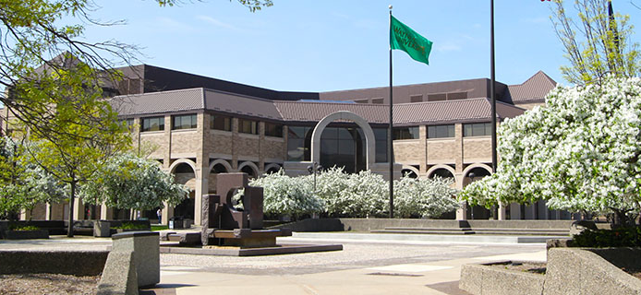
Empowering New Students in their Exploration of Physical and Virtual Library Spaces
Daniel Cichowlas MLIS,Graduate Student Assistant, Wayne State University

Slide 2
Introduction
Two-part tour
Self-guided QR Code
Question based virtual
Strategic changes made
Where can we simplify ‘information dumps’?
Can this be changed in a way to make it available outside orientation?

Slide 3
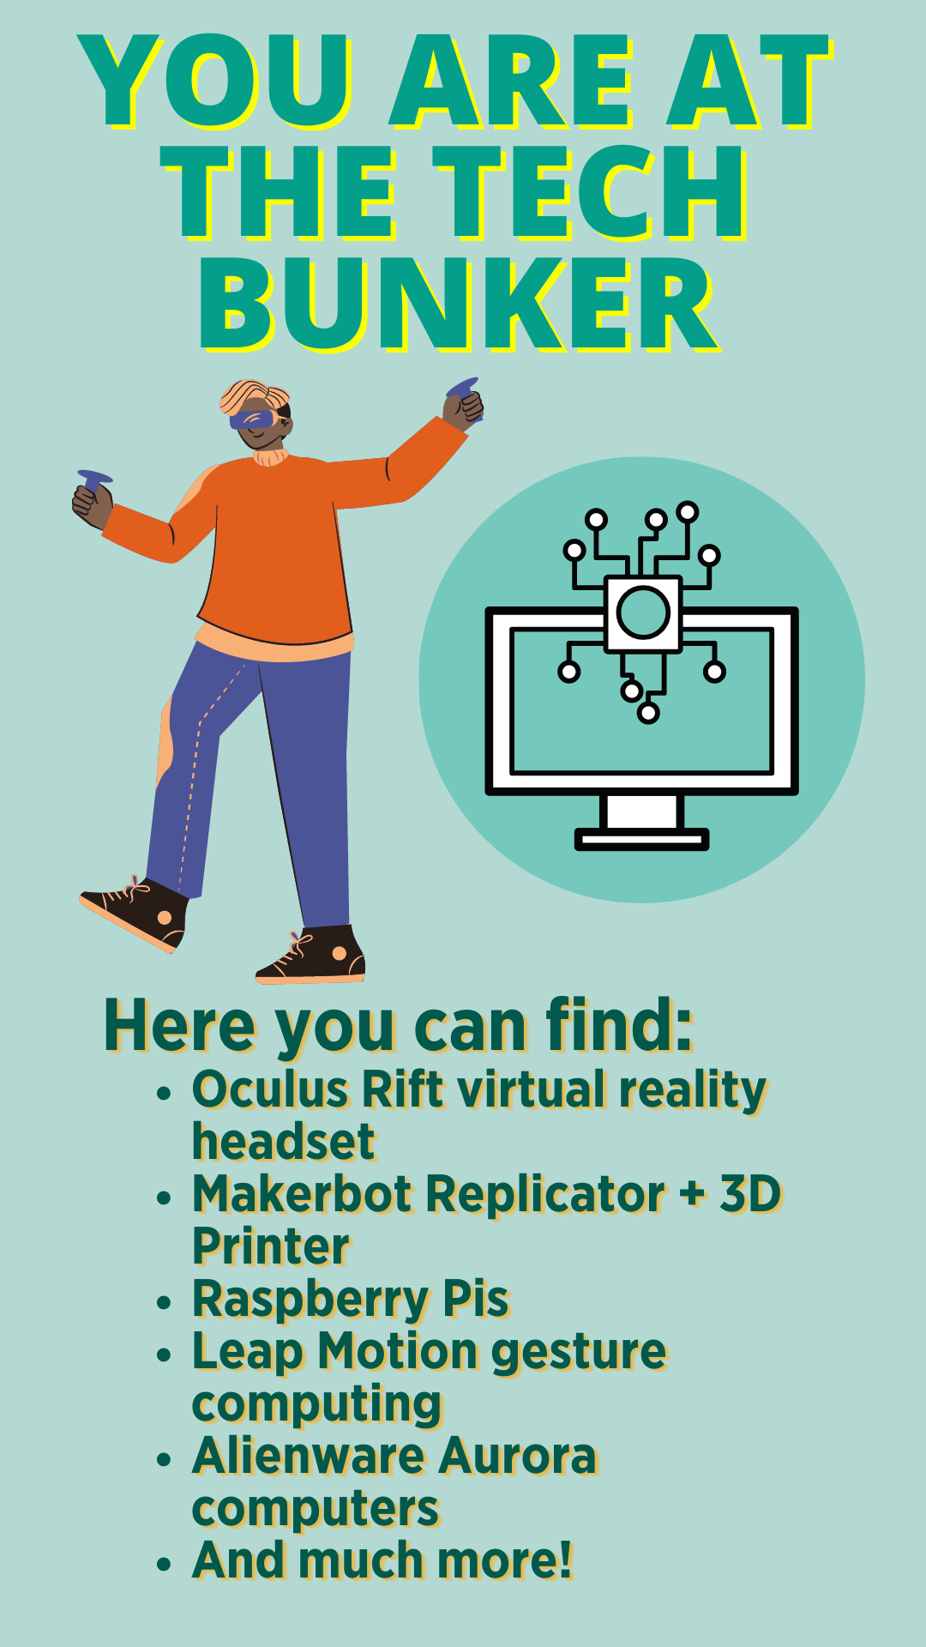
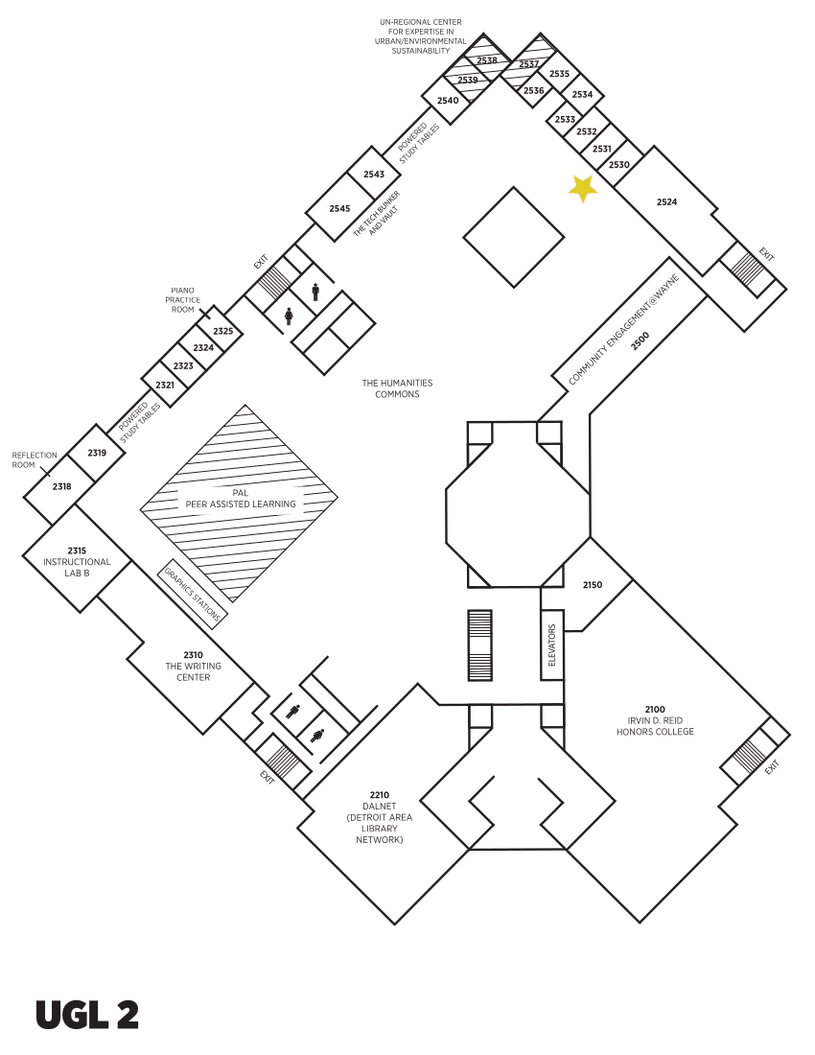
QR Code Tour

Slide 4
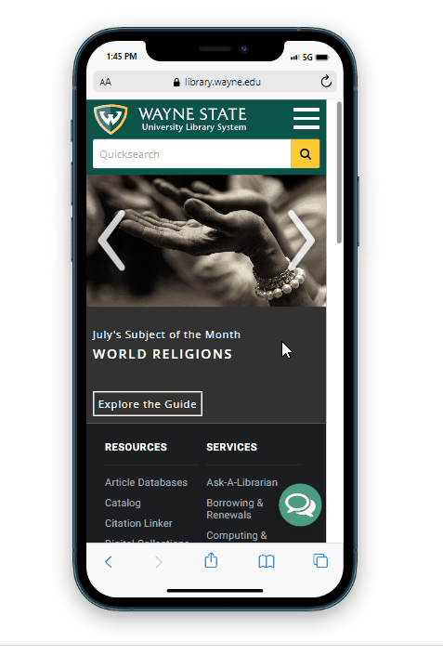
Library Homepage Tour
Find and select the Interlibrary Services link at library.wayne.edu
The two Interlibrary Services that deliver books and other materials to campus for you, free of charge, are called MeLCat and Interlibrary Loan. True or False?

Slide 5
Survey Questions
I am confident in knowing how to navigate the physical library space in the upcoming semester
I am confident in knowing how to navigate the library homepage in the upcoming semester
This was a fun way to learn about locations, services, and resources of WSU Libraries

Slide 6
Thank you
Daniel Cichowlas
cichowld@wayne.edu

